Slide 1
Board of Specialty Societies (BOS)
Update
<Insert BOS Representative Name>
<Insert Date>

Slide 2
Purpose of the Board of Specialty Societies (BOS)
Provide a mechanism to increase opportunities for involvement and participation in AAOS affairs by Fellows.
Facilitate communications and the dissemination of AAOS policy within the individual specialty societies.
Consider and make recommendations regarding the disposition of AAOS resolutions and proposed amendments to the AAOS Bylaws and Standards of Professionalism (SOP).
Advise the AAOS Board of Directors regarding matters of importance to the specialty societies.
Notes:
What’s the purpose of the Board of Specialty Societies (BOS)
The BOS brings together the leaders of musculoskeletal societies to address issues of mutual concern, such as advocacy, continuing medical education, research, and residency and fellowship issues.
Its 22 member organizations select up to two (2) society representatives as well as one (1) Executive Director representative to serve as an advisory body to the AAOS Board of Directors and a resource to AAOS committees. Representatives are eligible for two three (3) year terms.
Manages AAOS' relations with the specialty societies, including conducting a wide range of programs to strengthen and support the societies organizationally.

Slide 3
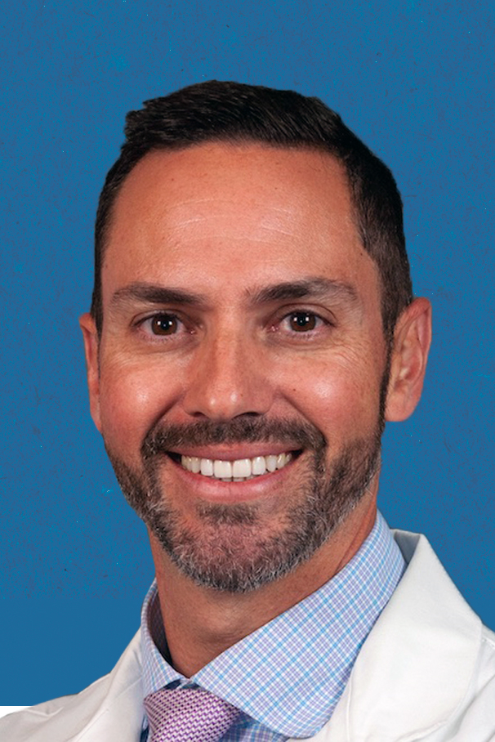
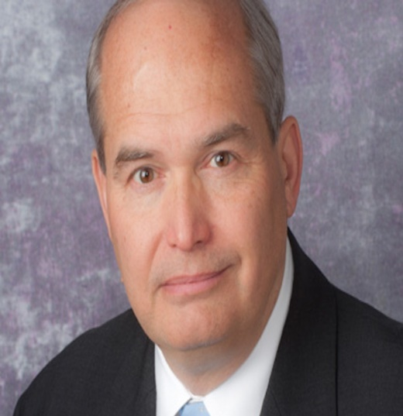
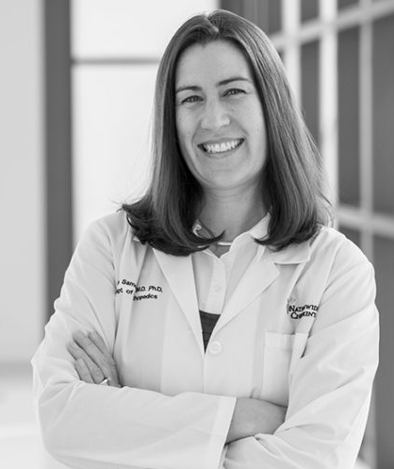
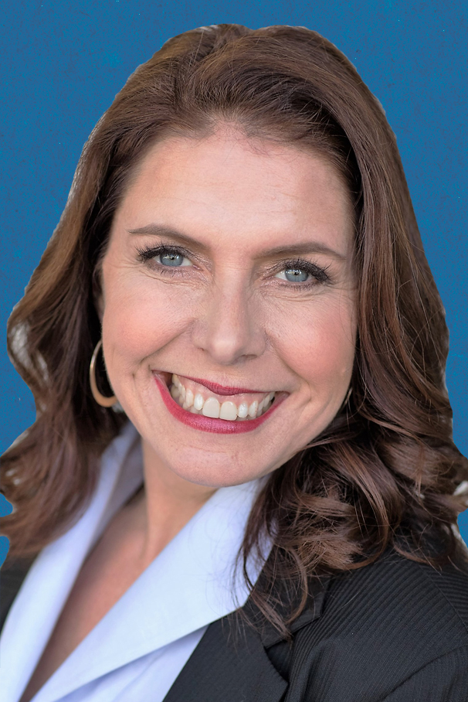
2024-2025 BOS Officers
Armando Vidal, MD, FAAOS
Chair
Adolph J. Yates, Jr., MD, FAAOS
Chair-Elect
Julie B. Samora, MD, PhD, MPH, FAAOS
BOS Secretary
Alexandra E. Page, MD, FAAOS
Past Chair
Notes:
The BOS elects a Secretary and the Chair-Elect automatically ascends to the Chair position at the conclusion of the BOS Business Meeting conducted at the AAOS Annual Meeting.
Elections for BOS Secretary occur at the Combined NOLC/Fall Meeting after a thorough vetting process. The BOS Nominating Committee is charged with oversight of this process and is chaired by the Immediate Past Chair.

Slide 4
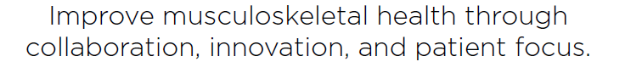



AAOS 2024-2028 Strategic Plan
aaos.org/StrategicPlan
Focused on members, patients, and leadership in improving health
Lead health system delivery and payment model transformation to increase value for all
Greater patient engagement and partnership across the MSK community
MSK = musculoskeletal
Notes:
Overall Elevator Speech:
AAOS approved its next Strategic Plan for 2024-2028, with a new five-year outcome statement and 4 overarching goals
The new Strategic Plan will guide our future direction and will be vital for AAOS to shape the changes that impact health and our profession and equip AAOS and its members for continued success
We are building on the strong foundation of the last five years and remain committed to exceptional member experience, quality and culture.
We are focused on our members and will continue to evolve our organization and culture, and this plan also reflects the intent to build greater patient engagement and deepen our partnerships across the MSK community.

Slide 5
AAOS Annual Meeting– February 2024 I Business
AAOS Presidential Address
AAOS Council / BOS Committee Reports
Open Mic
AAOS Leadership Specialty Societies Town Hall
OrthoPAC Update
2024-2028 Strategic Plan
Notes:
The Board of Specialty Societies held its Business Meeting on Thursday, February 15, 2024, in conjunction with the AAOS Annual Meeting in San Francisco, CA. The 2024 AAOS Annual Meeting was held February 12-16th 2024, in San Francisco, CA.
Armando F. Vidal, MD, FAAOS Chair of the Board of Specialty Societies (BOS) presided over the February 2024 BOC Business Meeting.
Typical with BOS Business Meetings, various BOS committees and representatives on AAOS Councils/Committees provided brief updates on their current work.
The AAOS Leadership led a Specialty Societies Town Hall to promote further collaboration between the AAOS and the specialty societies. Kevin J. Bozic, MD, MBA, FAAOS, AAOS Past President, Paul Tornetta III, MD, PhD, FAAOS, AAOS President, and Annunziato “Ned” Amendola, MD, FAAOS, AAOS First Vice-President, attended on behalf of the AAOS Leadership.

Slide 6
2024-2028
Strategic Plan Cascade for Board of Specialty Societies
February 2024

Slide 7
Setting the Stage
February 2024: Strategic Plan Approved
2024 Annual Meeting (AM): Initial Launch Publicly and For Councils and Committees and Events at AM
Feb – Apr 2024: Cascade to Councils, Committees, Partners, and AAOS Staff
2024 - 2028: Ongoing adoption and activation for AAOS, full membership, and the public
Notes:
New Strategic plan approved in Feb 2024 is a five-year strategic plan: 2024 - 2028
Feb - Apr: Strategic plan and cascade deck will be communicated to Board members and Council Chairs, and then cascaded to their Council members and Committee Chairs
All future meetings should be updated to include the new strategic plan in committee books, following 2024 Annual Meeting. Some committees will see the strategic plan and talking points at AM meetings… but not all committees meet at AM.
BOC and BOS are also cascading the strategic plan, starting at Annual Meeting.
We are continuing to align timing post-AM to send materials to Committee members that fall under the Councils as well as to all Committees that report in structures that go up to the Board and continuing to share details going forward during this five year period if any updates occur
Full membership / Public:
Initial launch at AM reflecting mission, vision, new five-year outcome statement, updated key enablers, and new four goals – not specific metrics and strategic objectives for each goal. Volunteer structure, but not the full membership and public, should see full plan details as the plan cascades to them, to help make decisions.

Slide 8

2024-2028 Strategic Plan
MISSION STATEMENT
VISION STATEMENT
CORE VALUES
Serving our profession to provide the highest quality musculoskeletal care
The trusted leaders in advancing musculoskeletal health
Leading to serve, Shaping the future, and Excellence together
5-YEAR OUTCOME STATEMENT
Improve musculoskeletal health through collaboration, innovation, and patient focus
MEMBERS
Be the professional home for our members throughout their lifetime
PATIENTS
Lead health transformation to optimize value for all
CULTURE
Modernize governance to ensure an adaptive, inclusive, and sustainable organization
MSK COMMUNITY
Engage the musculoskeletal community to advance knowledge and improve health
Metrics
Member satisfaction score (#)
% of members who participate in the AAOS Political Action Committee (OrthoPAC)
% member retention [across all categories]
% members engaged with AAOS
% growth in membership [across continuum]
Strategic Objectives
Recruit, develop, and retain a diverse membership of musculoskeletal professionals
Advocate for our members with agencies and organizations that affect their practices
Enhance two-way communication to provide members a personalized experience that meets their needs
Support career development by expanding opportunities for leadership growth and professional advancement
Metrics
Rate of utilization of AAOS Quality Resources [by members, practices, MSK professionals]
# patients engaged with AAOS
$ PAC donations
Increase recognition of health equity in orthopaedics
Strategic Objectives
Increase patient engagement, advocacy, and education
Empower actionable practice improvement through use of AAOS quality initiatives, including registries
Lead health system delivery and payment model transformation to increase value for patients
Advocate throughout the healthcare ecosystem to improve health and health equity
Metrics
% favorable on culture indicator (i.e., effectiveness, trust) among volunteers
% of AAOS member positions filled by first-time volunteers
(y/n) adoption or refinement of governance principles
% diversity
  In AAOS members
  In AAOS leadership roles
  In ortho profession
Strategic Objectives
Advance our governance to improve our organization’s efficacy
Establish inclusive and equitable pathways for all qualified candidates to thrive and develop as leaders
Build trust through data-driven strategic decision-making, two-way communication, and transparency
Metrics
# of active collaborations that adhere to partnership principles
  # with specialty societies
  # with other MSK-related organizations
  BOS communication
% favorability on the question, “I view AAOS as the leader in engaging the MSK community to advance knowledge and improve health.”
Brand awareness/perception [beyond membership]
Strategic Objectives
Partner with orthopaedic specialty societies on mutually beneficial goals
Collaborate and innovate with other clinicians and organizations involved with MSK health
Serve as the trusted voice to improve musculoskeletal health
KEY ENABLERS
Advocacy: Advocate to advance high value musculoskeletal health care, and support clinicians and patients to thrive in an evolving health care environment
Communication: Use efficient, bi-directional communication with members, patients, and the MSK community to advance our strategic goals
Partnerships: Use our partnership principles to collaborate across the evolving healthcare landscape to drive greater impact
Technology: Continue to modernize AAOS's technology platforms to offer personalized member experiences
Notes:
This full plan is available to AAOS governance volunteers – the strategic objectives and metrics are not to be distributed to the full membership or public
Introduce the new Strategic Plan – this is the one-page Strategic Plan approved by the Board of Directors in February 2024 and will guide AAOS efforts over the next five years.
- Reference the elevator speech and cascade deck that either have been provided or will be provided after annual meeting as additional internal resources to help answer questions about the plan
Review the high levels goals – Mission, Vision, Enablers, and details under each of the four goals will be broken out on subsequent slides for discussion.
If asked why we needed to change:
The larger healthcare ecosystem is evolving quickly. We must lead the way to define musculoskeletal care and influence future change for the profession and patient population. We began to change with the prior strategic plan, and must continue to evolve or risk losing relevance among orthopaedic surgeons and healthcare partners and patients. The new strategic plan builds upon the strong foundation of the prior one, adding a greater commitment to engaging patients and to partnering across the MSK community.
The Board of Directors conducted a thorough review of the current environment and the Academy’s position to sustain growth into the future. We want to provide greater value to the AAOS’ membership, help our members to define and advance quality, and be the voice for the orthopaedic profession. As a result, the Academy will become more focused, strategic and metric-driven by delivering on the goals of members, patients, culture, and MSK community to deliver tangible benefits to our members, position AAOS and its members as healthcare leaders, and improve patient health. This will not occur overnight, but requires steady effort over a multi-year approach.

Slide 9
Core Values and Supporting Behaviors
Leading to serve
Shaping the future
Excellence together
We relentlessly focus on enabling our profession to better serve our patients
We mentor and support our members to drive excellence in musculoskeletal health
We engage members, partners, and patients where they are, and lead them forward
We practice transparent decision-making and open communication
We use data and evidence to stay a step ahead
We advocate to promote quality musculoskeletal care
We proactively embrace disruptors, and develop innovative products and services
We empower and seek input from all people, not just the majority
We acknowledge unconscious biases, and seek to address barriers to inclusion
We collaborate based on mutual respect and trust
Approved on May 20, 2019
Notes:
These are the AAOS core values, developed and approved in the 2019 and which are staying consistent as part of the new 2024-2028 strategic plan
The core values reflect who AAOS is at our core and what makes us unique and different from others, what we aspire to be, and what guides how we work with each other and our partners.
Developing new core values is only the first step in a longer journey – these will be communicated consistently as part of the new strategic plan adoption plan and communications and reinforced in ongoing communication and actions.
The key going forward for the entire AAOS organization, including our Board and volunteer structure, is to live these core values and supporting behaviors and make decisions and guide our actions based upon these core values.

Slide 10
2024-2028 Strategic Plan
MISSION: Serving our profession to provide the
highest quality musculoskeletal care.
VISION: The trusted leaders in advancing musculoskeletal health.
  5-YEAR OUTCOME STATEMENT:
  Improve musculoskeletal health through collaboration, innovation, and patient focus
KEY ENABLERS
Advocacy: Advocate to advance high value musculoskeletal health care, and support clinicians and patients to thrive in an evolving health care environment
Communication: Use efficient, bi-directional communication with members, patients, and the MSK community to advance our strategic goals
Partnerships: Use our partnership principles to collaborate across the evolving healthcare landscape to drive greater impact
Technology: Continue to modernize AAOS's technology platforms to offer personalized member experiences
Notes:
Mission & Vision: The mission and vision have not changed in the new Strategic Plan. They should not change consistently – they are the foundation for the organization and its members.
The Mission is about why we exist as the AAOS. We strongly believe in our mission: Serving our profession to provide the highest quality musculoskeletal care.
The Vision is about who we want and aspire to be. The AAOS aspires to be MORE than A trusted leader in advancing musculoskeletal health. We want to be to be THE trusted leaders.
The 5-year outcome statement is a new component in the new strategic plan, meant to add another level of focus for what we want to work toward in the next 5 years rather than the ongoing vision. It outlines some of the key goals of the plan such as a focus on MSK health but with greater collaboration across orthopaedics and the healthcare ecosystem, innovation at AAOS and in healthcare, and in particular echoing a greater direct patient focus, while still supporting our members to also serve patients directly
Key Enablers: The enablers are not excluded from the four goals, but rather are vital to achievement across all of the goals – they enable AAOS to achieve the full plan, and so are listed as enablers vs. solely being within a goal.
Example: Advocacy is a major part of AAOS’ activities and commitment – it may be mentioned in several metrics or objectives, but also runs across almost all of what AAOS does and will be doing in the future
Utilize the enablers as a reminder when you are planning activities aligned to the strategic plan about the resources available or that should be considered to support achievement of strategic plan goals and overall execution

Slide 11
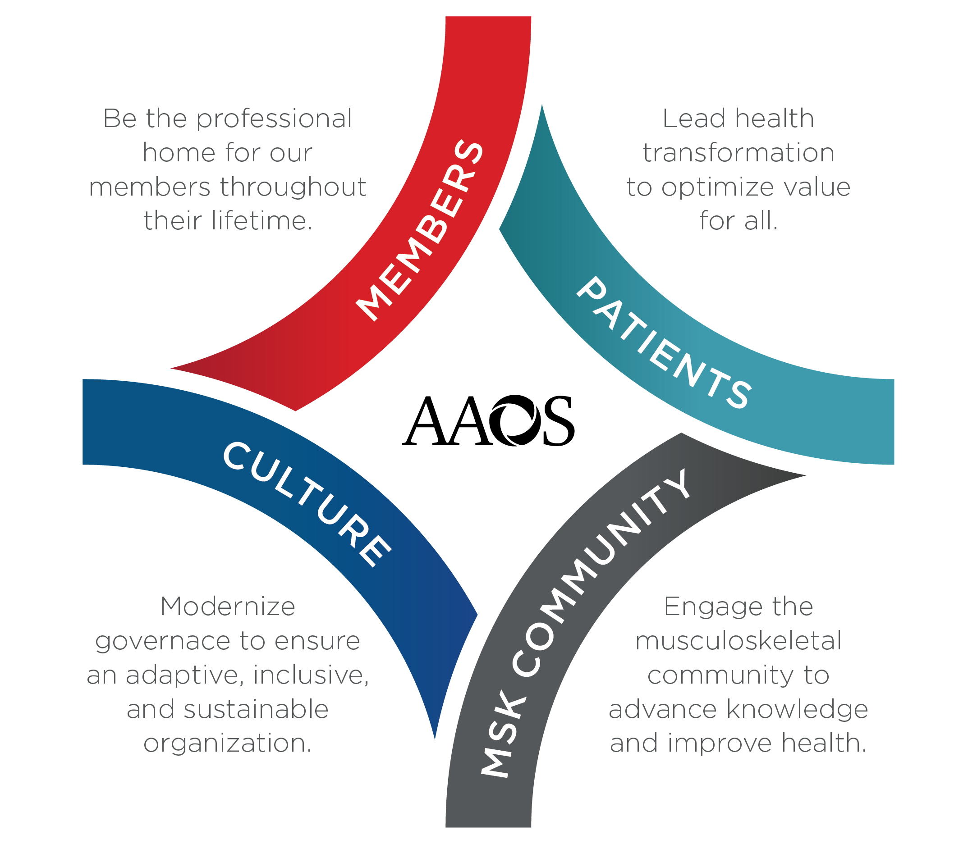
2024-2028 Strategic Plan
GOAL 1: MEMBERS
Be the professional home for our members throughout their lifetime
METRICS
Member satisfaction score (#)
% of members who participate in the AAOS Political Action Committee (OrthoPAC)
% member retention [across all categories]
% members engaged with AAOS
% growth in membership [across continuum]
STRATEGIC OBJECTIVES
Recruit, develop, and retain a diverse membership of musculoskeletal professionals
Advocate for our members with agencies and organizations that affect their practices
Enhance two-way communication to provide members a personalized experience that meets their needs
Support career development by expanding opportunities for leadership growth and professional advancement
AAOS should be members’ professional home, a touchstone across their profession to help improve care, create opportunities, and solve challenges
Strengthen engagement and retention through member value and continued advocacy and personalization
Notes:
Talking Points for Goal 1: MEMBERS – Be the professional home for our members throughout their lifetime
This plan will speak about patients and the MSK community, but members remain a vital focus for AAOS as the foundation of the organization and the leaders delivering care and innovating in healthcare
Members have varied interests and opportunities for professional support and relationships with many societies and organizations. However, AAOS should be their professional home, a touchstone across their profession to help improve care, create opportunities, and solve challenges
To keep connections and value with members and foster even greater engagement and retention, two-way communication will help AAOS to customize and personalize experiences, building on the commitment of the last strategic plan. Understanding member needs and hearing feedback, not just communicating out AAOS messages, will help us work to solve problems that matter to members and to streamline and enhance the ease of experience within AAOS products and services and engagement points
Making AAOS the overall home also means we need to strengthen engagement and retention through enhanced member value and continued advocacy and personalization that is meaningful to members
Supporting members also means advocating on their behalf, an existing commitment recognized more deeply within this goal to support members who are impacted every day in their individual practices

Slide 12
2024-2028 Strategic Plan
GOAL 2: PATIENTS
Lead health transformation to optimize value for all
METRICS
Rate of utilization of AAOS Quality Resources [by members, practices, MSK professionals]
# patients engaged with AAOS
$ PAC donations
Increase recognition of health equity in orthopaedics
STRATEGIC OBJECTIVES
Increase patient engagement, advocacy, and education
Empower actionable practice improvement through use of AAOS quality initiatives, including registries
Lead health system delivery and payment model transformation to increase value for patients
Advocate throughout the healthcare ecosystem to improve health and health equity
AAOS most often serves patients by supporting members who serve their patients
AAOS can expand its focus on the patient more directly and shape changes in healthcare to increase value for patients and maintain commitment to the highest quality care
Notes:
Talking Points for Goal 2: PATIENTS – Lead health transformation to optimize value for all
While AAOS has always had patients at the forefront of our thinking, we have most often served patients through advocacy and by supporting our members who see them directly
This new plan offers an opportunity to look at additional ways to engage them directly, as AAOS has traditionally done with Orthoinfo supporting patient/clinician education and mutual discourse on treatment
If AAOS can increase patient engagement, advocacy and education, it can have a greater impact on improving MSK health and more touchpoints and resources to shape the ongoing transformation to value and in health system delivery
Members are navigating a balance between old fee for service models and new value-based and population health models of health care, and AAOS can work to lead those transitions and increase value for patients, while also advocating for members as was referenced in the Members goal
AAOS quality initiatives like the registries and clinical practice guidelines are key to credibility as leaders and to having impact on practices in positive ways.
Advocacy remains a key strength of AAOS and is required throughout the healthcare ecosystem to support and help generate change that works for clinicians and patients. AAOS’ commitment to diversity is echoed here as well in the actual delivery of healthcare, not solely in member careers, membership, or leadership pathways, but in advocating to improve not just health, but also overcoming health disparities and improving health equity

Slide 13
2024-2028 Strategic Plan
GOAL 3: CULTURE
Modernize governance to ensure an adaptive, inclusive, and sustainable organization
METRICS
% favorable on culture indicator (i.e., effectiveness, trust) among volunteers
% of AAOS member positions filled by first-time volunteers
(y/n) adoption or refinement of governance principles
% diversity
  In AAOS members
  In AAOS leadership roles
  In ortho profession
STRATEGIC OBJECTIVES
Advance our governance to improve our organization’s efficacy
Establish inclusive and equitable pathways for all qualified candidates to thrive and develop as leaders
Build trust through data-driven strategic decision-making, two-way communication, and transparency
To achieve its vision and goals, AAOS must continue to modernize our culture and governance
Listening to our members and offering transparency and more accessible pathways to leadership will support such growth
Notes:
Talking Points for Goal 3: CULTURE – Modernize governance to ensure an adaptive, inclusive, and sustainable organization
To achieve our vision, 5-year outcome, and all of our goals, we must also evolve our own culture and governance. We must become more strategic, to focus and prioritize our efforts and act together–as a cohesive Board of Directors, volunteers and staff—in the best interests of the Academy. Use data to understand the world around us and make strategic decisions. Greater alignment and discipline will also allow AAOS to be more adaptive to the evolving healthcare and membership landscape, and build sustainable future success on a financial base capable of supporting the mission and member value. Transparency and advances in AAOS governance practices and principles will also help create a more aligned, nimble, stronger organization that can adapt and evolve as needed.
AAOS also remains committed to diversity, equity, and inclusion —not just through diversity of ethnicity, race, and gender, but also other demographics such as specialty, practice, and geography — both at AAOS, in the profession, and in healthcare delivery. Greater diversity and inclusion offers more opportunity to find the best ideas and recognize the needs of our membership and patients, to grow an engaged AAOS membership, develop future leadership, and build the pipeline of talent in orthopaedics, in particular around AAOS culture to ensure there are equitable pathways for AAOS talent to develop and grow into future leaders.

Slide 14
2024-2028 Strategic Plan
GOAL 4: MSK Community
Engage the MSK community to advance knowledge and improve health
METRICS
# of active collaborations that adhere to partnership principles
  # with specialty societies
  # with other MSK-related organizations
  BOS communication
% favorability on the question, “I view AAOS as the leader in engaging the MSK community to advance knowledge and improve health.”
Brand awareness/perception [beyond membership]
STRATEGIC OBJECTIVES
Partner with orthopaedic specialty societies on mutually beneficial goals
Collaborate and innovate with other clinicians and organizations involved with MSK health
Serve as the trusted voice to improve musculoskeletal health
AAOS has positive relationships today and the opportunity to collaborate even further
AAOS can be the MSK thought leader, educating and growing knowledge, improving health by engaging other societies, clinicians, and organizations across the healthcare ecosystem
Notes:
Talking Points for Goal 4: MSK COMMUNITY – Engage the MSK community to advance knowledge and improve health
To achieve the AAOS vision as The trusted leaders advancing musculoskeletal health, AAOS must navigate an evolving and diverse healthcare ecosystem, both within orthopaedics and tangentially with others impacting MSK
AAOS can engage others throughout that community to ultimately better serve patients, create value for everyone, and ultimately improve health – all connected to other goals in the plan
AAOS has positive existing relationships with many orthopaedic specialty societies and has recognized that specifically in this new strategic plan with the stated goal to continue partnership
Partner activities should align to the Partnership Principles previously established, including that partnership should offer mutual value
There are areas in which AAOS and specialty societies will compete, and that is ok. Areas like advocacy and quality may lend themselves most to partnership with mutually beneficial goals and value
Beyond orthopaedic surgeons, many other clinicians are involved in MSK health, from PCPs to specialists (e.g. cardiologists, neurologists, etc.) to physical therapists and even organizations like payers, employers, government, other associations, etc.
Orthopaedic surgeons should ideally have a greater role leading those interactions and coordinating such care and supporting other clinicians and orgs to deliver the highest quality musculoskeletal care
This can drive innovation and enhance connections between AAOS and other clinicians and may represent new activities and connections to form within this new plan
Lastly, to advance knowledge and improve health and to pursue AAOS’ vision as “The” trust leaders, AAOS should be the trusted voice in the space
Whether as a convener or providing education or clinical guidance, AAOS should be the most valued and credible voice in MSK and use that platform to improve health
All of those actions will help AAOS and its members achieve their goals and have strong impact in the healthcare community

Slide 15
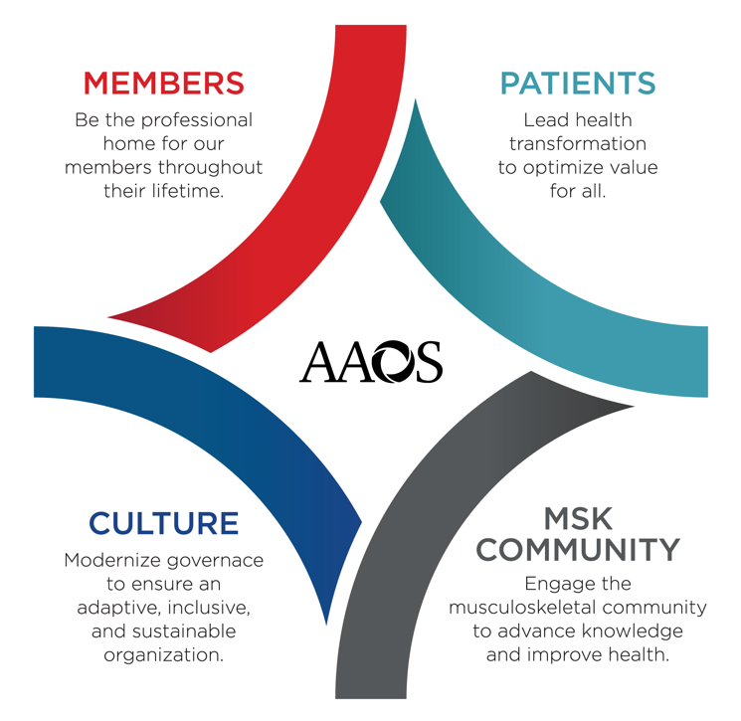
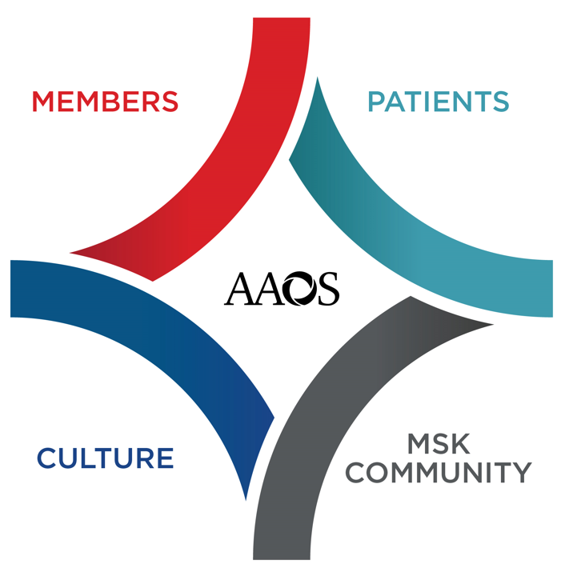
Strategic Plan Activation
Strategic Plan is launched at 2024 Annual Meeting and was a part of Dr. Kevin Bozic’s and Dr. Paul Tornetta’s Your Academy speeches.
Look for branding imagery onsite and in AAOS electronic materials (media wall, aaos.org, slides)
Cascade of new strategic plan started at AM 2024 in council, committee, and partner meetings
Communications and activation will continue in 2024 through 2028
Strategic Plan details and feedback link can be found at:
aaos.org/StrategicPlan
Notes:
Launch in this case means publicizing the new strategic plan for the full membership and public and cascading details and calls to action to activate the new plan with volunteers and Academy staff.
There will be an initial series of activities for strategic plan adoption at Annual Meeting, including presenting highlights of the new direction at council, committee, and partner meetings occurring at AM 2024, Your Academy speeches, and some visible branding such as on the Media Wall and on aaos.org/strategic plan which will be the home base website for information and details on the strategic plan.
We envision a feedback link also available on the website for anyone to provide thoughts or feedback on the new strategic plan that AAOS can take into consideration as the plan is activated and utilized for decision making in the next 5 years.

Slide 16
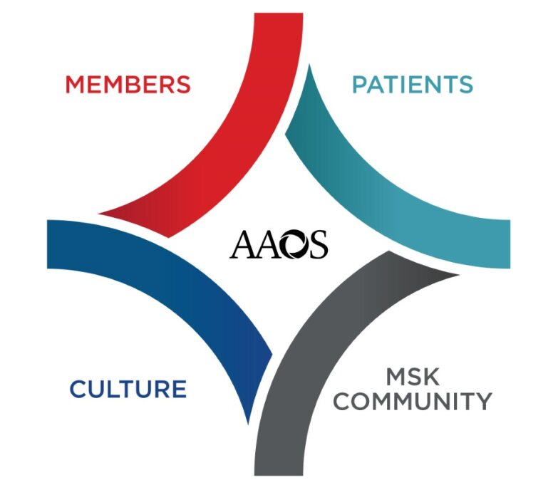
What The Plan Means To You
Overall Themes To Consider
Focused on members, patients, and leadership in improving health
Lead health system delivery and payment model transformation to increase value for all​
Diverse Membership
Advocate with Agencies & Orgs Affecting Practice​
Greater patient engagement and partnership across the MSK community
Build Trust and Transparency
Health & Health Equity
Partner with Specialty Societies
MSK = musculoskeletal
Notes:
Specific to the BOS
Calling out specific components of the new strategic plan that may resonate most or impact highest to the BOS – callouts color coded by the goal referenced (overall or from strategic objectives).
Diverse Membership: Member Goal – Objective to “Recruit, develop, and retain a diverse membership of musculoskeletal professionals”
The new strategic plan echoes the prior one with an ongoing AAOS commitment to diversity, not just at AAOS but across the profession and in the delivery of healthcare​
- In the case of AAOS membership, this goal supports metrics like gender and ethnic/racial diversity, but also among other factors like geographies, urban/rural, sub-specialties and practice types
- Many of those members will be dual members with BOS societies and we can all work to recruit, develop, and retain diverse membership and build the pipeline within orthopaedics
Advocate with Agencies and Orgs Affecting Practice: Member Goal – Objective to “Advocate for our members with agencies and organizations that affect their practices”
The BOS may find this section particularly relevant as well in the commitment to members within the current state and health transformations referred to in the Patient goal
- All of us as orthopaedic societies are working to protect and improve practices, and advocacy is an area of significant shared interest and collaboration
- This objective is focused on helping orthopaedic surgeons and our other members and advocating in ways that directly support them
- As we all work to innovate care delivery and practice management and treatments, how that occurs with orthopaedic surgeons helping shape it is also important to work in practice as intended in theory
Build Trust & Transparency: Culture Goal – Objective to “Build trust through data-driven strategic decision-making, two-way communication, and transparency”
-This Culture goal overall is about modernizing governance to ensure an adaptive, inclusive, and sustainable organization, and as we do that, AAOS needs to continue to build and maintain trust with members and partners… Using data to inform discussion and thinking strategically and promoting two-way communication and transparency are all part of that trust during any existing activities or potential changes
- Bi-directional communication is important directly with members, but the BOS also provides another route for communication both ways as we stay closely connected and sharing information as transparently as possible
- The BOS is another great source of feedback and shared experiences and best practices and working within AAOS governance to help shape the future of orthopaedics
Health & Health Equity: Patient Goal - Objective to “Advocate throughout the healthcare ecosystem to improve health and health equity”
- AAOS will have a greater focus on the patient in this plan, leading health transformation to optimize value for all​, and that focus on the patient should be another uniting factor for all of our societies as the patient remains at the center of everything we and our members do
- We also have the opportunity more specifically to further advocate throughout the healthcare ecosystem to improve health and health equity​
- We can all look at how our work improves health, not just MSK health, but also how diversity in the orthopaedic pipeline may support better care and reduce health disparities.
- We can also look to our advocacy specifically in this area – all of our advocacy resonates better with legislators and regulators when it is patient focused, but that is also another route to better serve patients and look for ways to improve health equity throughout MSK
- While the Patient goal includes an inherent reference to Quality, this is a new goal and AAOS will be working through different ways to activate better with the patient over the next five years, not all of which are identified yet, but this is a vital direction chosen in this plan
Partner with Specialty Societies: MSK Community Goal – Objective to “Partner with orthopaedic specialty societies on mutually beneficial goals​”
- This is the most direct goal in its relevance to the BOS as it specifically reflects the importance of our relationships within orthopaedics and desire to collaborate
- We will compete at times – that is the case, but that’s ok. We also collaborate in a myriad of ways all the time – and that may often work best in areas where we have the most alignment and mutually beneficial goals, such as Quality and Advocacy
- Ultimately, AAOS specifically differentiated partnership with specialty societies from the 2nd objective in that goal which is about collaborating with other clinicians and organizations because of our close knit partnerships today.
- We look forward to more partnership with you, guided by the Partnership Principles we all developed together during the prior strategic plan and we thank you in advance for that partnership in the future
Overall Themes
Same for all audiences – reminder in summary of some of the key themes shown in the plan discussion on earlier slides
Key Questions for the Future
Customize 3 key questions to ask the specific audience to help them start thinking about their charges, their major current focus and how it ties best to the new plan, how the current planned initiatives will need to be reprioritized or changes to reflect the goals of the new strategic plan, and asking for general feedback and thoughts on the plan and how the plan most excites the group in the room
Overall Elevator Speech:
In February 2024, AAOS approved its next Strategic Plan for 2024-2028, with a new five-year outcome statement and 4 overarching goals
The new Strategic Plan will guide our future direction and will be vital for AAOS to shape the changes that impact health and our profession and equip AAOS and its members for continued success
We are building on the strong foundation of the last five years and remain committed to exceptional member experience, quality and culture.
We are focused on our members and will continue to evolve our organization and culture, and this plan also reflects the intent to build greater patient engagement and deepen our partnerships across the MSK community.

Slide 17
AAOS Annual Meeting Oversight Committee Update
Matthew T. Provencher, MD, MBA, CAPT (ret.) MC USNR FAAOS
Annual Meeting Oversight Committee Chair

Slide 19
Partnership Principles
Board approved principles on how we engage our partners
Provide AAOS Member Value: All partnerships deliver value to AAOS members.
Align with the AAOS Strategic Plan: All partnerships support the AAOS Strategic Plan and enhance partner value.
Reinforce Effective Communication: Partners will establish and maintain clear, effective, and accountable two-way communication.
Thrive on Professionalism and Mutual Value: Interactions are centered around professionalism, respect, collegiality, trust, and appreciation of the relationship’s mutual value.
Negotiate Equitable, Clear, and Consistent Agreements: Partnership agreements are equitable and comprehensive.
Establish Effective Processes with Assigned Accountabilities: Partnership processes and roles are clear and utilized to increase efficiency and mutual accountability.
Review and Track Progress: Every partnership creates and tracks metrics that are reviewed, communicated, and revised as necessary. Lessons learned are documented and shared.

Slide 20







Annual Meeting | Overview
Anchoring: Specialty Society sessions on Monday and Friday
Marketing: Developed tool kit to support society’s marketing efforts
Meeting Format: Shifted meeting format in 2024 to a Monday-Friday format, will continue in 2025
Wins!
Session Time: Adjusted length of education sessions to include several 60-minute sessions (in addition to the existing 90-minute sessions)
OrthoDomeTM: Showcase for a 4K video experience; OrthoPitch launched
App Experience: Improved app launched at same time as registration, in-app purchasing, AI-driven session recommendations

Slide 21
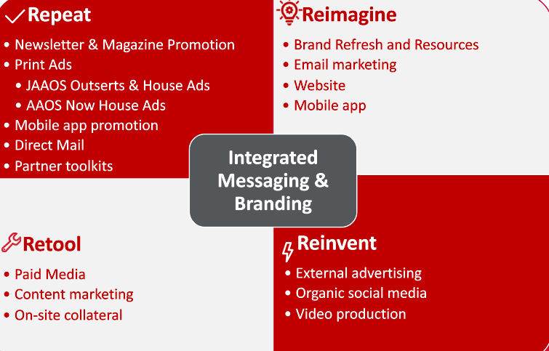
Marketing | Society Partner Toolkits
Repeat
Partnership Success Tools
Available to support outreach through the following key partners
AAOS and Specialty Staff work together early in the process
Get the word out soon and repeat
Communication and deadlines are important for success

Slide 22
Anchoring | BOS Societies
Monday
February 12
Friday
February 16
RJOS
AANA/ISAKOS Hip/Knee/AAHKS
AOSSM/ASES ASSH
OTA/AOFAS LLRS/SOMOS
MSTS

Slide 23
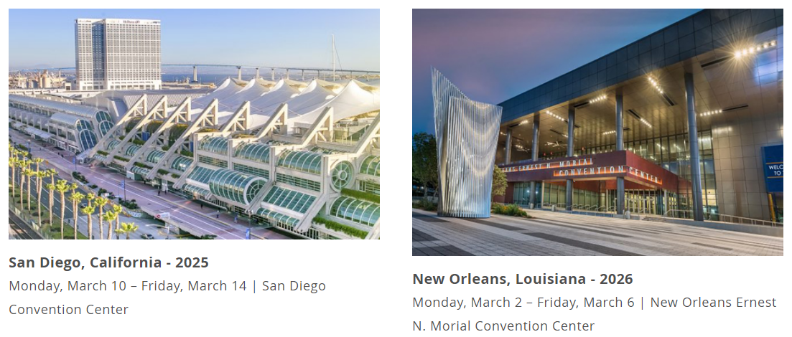
Annual Meeting | Future Dates
Repeat

Slide 24

Orthopaedic PAC Report to the BOS
Wayne A. Johnson, MD, MBA, FAAOS
Chair, Orthopaedic PAC
TEXT OrthoUnity to 41444

Slide 25



What’s at Stake? Why is OrthoPAC Important?
The current conditions demand that the AAOS take an active role in advocacy. The government is involved in all aspects of how our members practice:
How you get paid: MACRA, MIPS, Bundles
How you practice: Private, Employed, Academic, Government, Telemedicine
What you can do, and who else: Scope, Prior Authorization
Who you can treat: Networks, Medicare
What you can own: Hospital, Imaging, ASC
How you are insured: Liability, Medical
Without OrthoPAC
WITH OrthoPAC

Slide 26
Physician Rankings – Top 10 Specialty Physician Groups
What We’re Up Against…
Organization | 2023 Receipts
American Society of Anesthesiologists | $1,909,982
American Assn of Orthopaedic Surgeons | $1,079,533
American Academy of Dermatology | $1,000,769
American College of Radiology | $839,112
American College of Emergency Physicians | $785,665
American Academy of Ophthalmology | $420,376
American College of Ob-Gyns | $411,506
American Osteopathic Association | $369,029
American College of Cardiology | $334,128
American College of Surgeons | $299,177
Organization | 2023 Receipts
American Association for Justice (Trial Lawyers) | $3,378,194
American Hospital Association | $1,953,988
United Healthcare | $1,481,480
American Association of Orthopaedic Surgeons | $1,079,533
American Medical Association | $1,040,239
American Physical Therapy Association | $541,320
Federation of American Hospitals | $359,407
American Nurses Association | $228,694
American Podiatric Medical Association | $241,178
American Chiropractic Association | $129,953
We must stay ahead of the PACk!!!

Slide 27
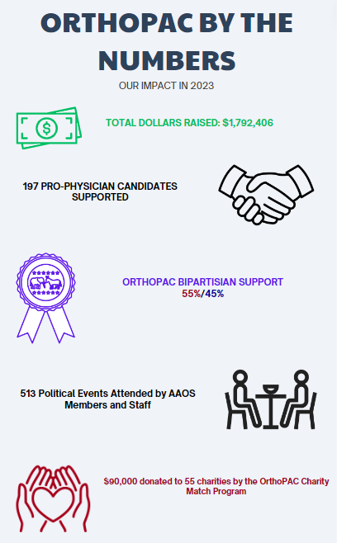
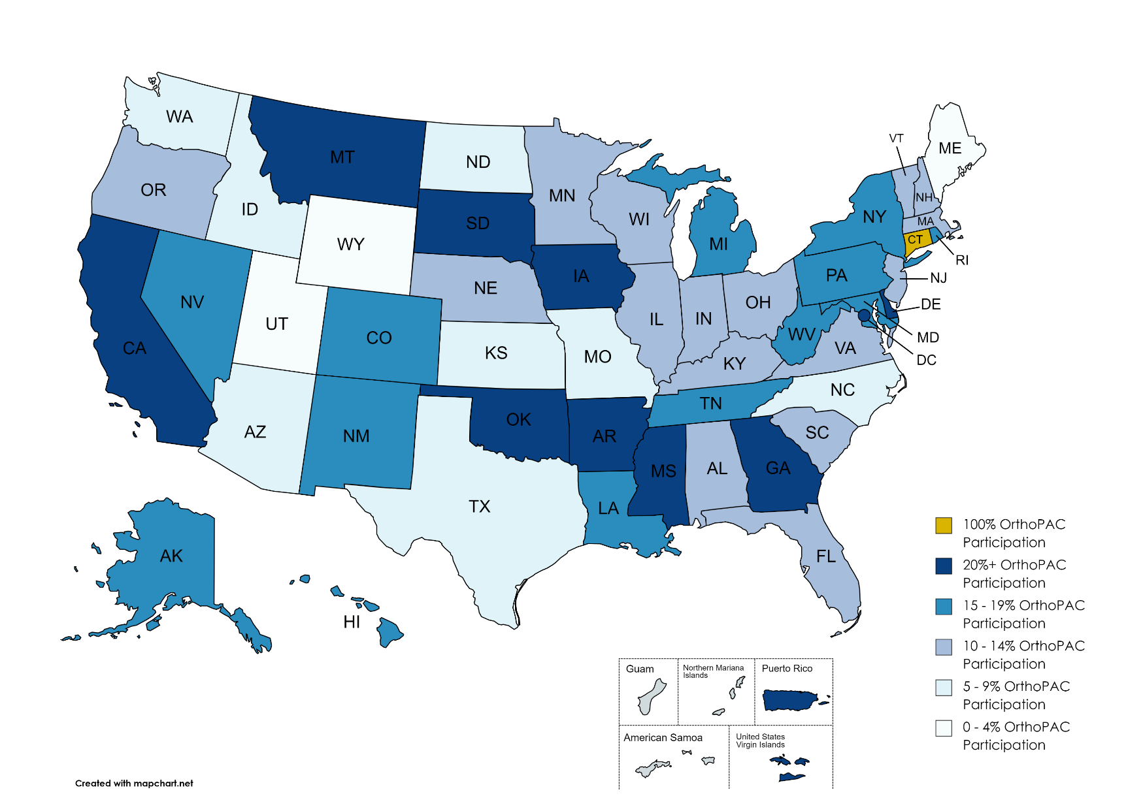
OrthoPAC State Participation for 2023

Slide 28
Thank You, BOS!
$5k MAX-OUT Member $3k Capitol Club Member Capitol Club Member
Peter C Amadio MD, FAAOS
Michael S Aronow MD, FAAOS
Lattisha Latoyah Bilbrew MD, FAAOS
Odion T Binitie MD, FAAOS
Michael P Bolognesi MD, FAAOS
Susan V Bukata MD, FAAOS
Anna Cohen-Rosenblum MD, FAAOS
Charles Hopkins Crawford III, MD, FAAOS
Xavier A Duralde MD, FAAOS
Eric I Ferkel MD, FAAOS
John G Finkenberg MD, FAAOS
Lawrence V Gulotta MD, FAAOS
William George Hamilton MD, FAAOS
Catherine G Hawthorne MD, FAAOS
Alan S Hilibrand MD, MBA, FAAOS
James Irvin Huddleston III, MD, FAAOS
Richard Iorio MD, FAAOS
Mani D Kahn MD, FAAOS
Dawn LaPorte MD, FAAOS
Raymond W Liu MD, FAAOS
Douglas W Lundy MD, MBA, FAAOS
Hassan Riaz Mir MD, MBA, FAAOS, FACS
Michael P Mott MD, FAAOS
Reid Boyce Nichols MD, FAAOS
Maureen A O'Shaughnessy MD, FAAOS
Alexandra Elizabeth Page MD, FAAOS
Mitchell Forest Reiter MD, FAAOS
Paul T Rubery Jr, MD, FAAOS
Julie B Samora MD, PhD, MPH, FAAOS
James Matthew Saucedo MD, MBA, FAAOS
Philip L Schneider MD, FAAOS, FACS
Kurt P Spindler MD, FAAOS
Scott P Steinmann MD, FAAOS
Armando Felipe Vidal MD, FAAOS
Merrick J Wetzler MD, FAAOS
Barrett Ivory Woods MD, FAAOS
Adolph J Yates Jr, MD, FAAOS
Raised in 2023: $37,455
2023 Participation: 74%
2022 Participation: 88%
2021 Participation: 98%
Capitol Club Donors: 27

Slide 29

Honoring 25 Years of OrthoPAC - United in Orthopaedics
Introducing AAOS Orthopaedic PAC’s new log
This logo was designed to reflect where we have been and where we are headed; united and rooted in orthopaedic advocacy.

Slide 30
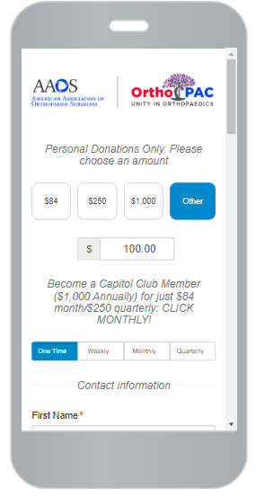
OrthoPAC: Unity in Orthopaedics
The current conditions demand that the AAOS take an active role in advocacy. The government is involved in all aspects of how our members practice:
How you get paid: MACRA, MIPS, Bundles
How you practice: Private, Employed, Academic, Government, Telemedicine
What you can do, and who else: Scope, Prior Authorization
Who you can treat: Networks, Medicare
What you can own: Hospital, Imaging, ASC
How you are insured: Liability, Medical
Text ‘OrthoUnity’ to 41444 and follow the prompts
Venmo @OrthoPAC
www.aaos.org/advocacy/pac
Federal law requires that we use our best efforts to collect and report the name, mailing address, occupation and name of employer of individuals who contribute to the AAOS Orthopaedic PAC. Checks or credit cards drawn on corporate accounts can be accepted but are deposited by law into a separate, non-federal account. Contributions are not deductible as charitable contributions for federal income purposes. Contributions are voluntary and do in no way affect membership or other status in the American Association of Orthopaedic Surgeons. Only AAOS members in the U.S. may contribute to the AAOS Orthopaedic PAC.

Slide 31
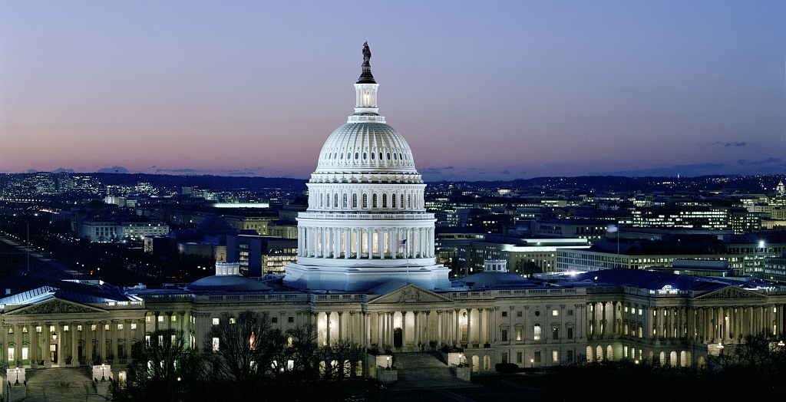
Future BOS Meetings - 2024
2024 Combined NOLC/Fall Meeting
The BOS will hold its next in-person Business Meeting at the 2024 Combined NOLC/Fall Meeting March 10-14th in Washington, DC. Exact date and time of Business Meeting TBD.

Slide 32

Future Meetings - 2025
2025 AAOS Annual Meeting
The BOS will hold an in-person meeting at the 2025 AAOS Annual Meeting, March 10th -14th in San Diego. The exact date and time is still TBD.

Slide 33
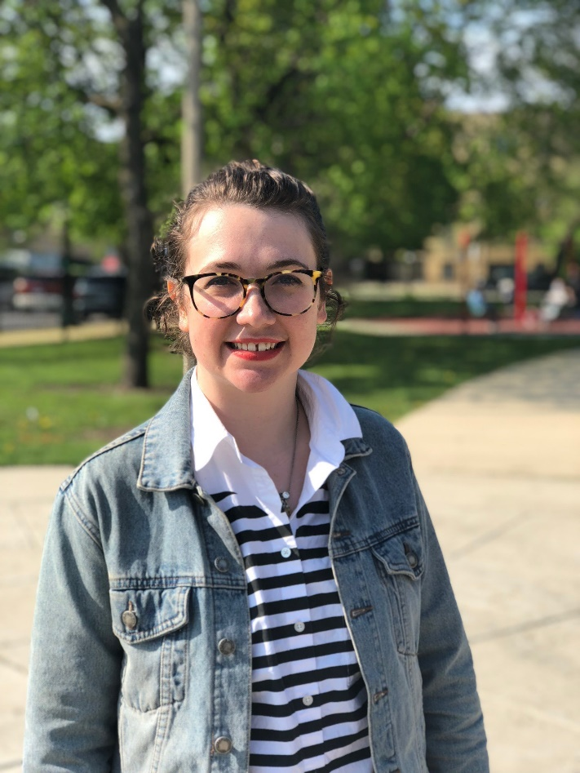


BOS Staff Liaison
Ellen Bushong, MA
847-384-4168
bushong@aaos.org
governance@aaos.org
Notes:
You may also reach an AAOS staff member at governance@aaos.org

