Slide 1

YOUR MEETING TOOLKIT

Slide 2

Your Meeting Toolkit
How to use this toolkit:
Simply copy the text in this toolkit and paste it into your newsletter template, social posts, or email communications. You can also use this toolkit as inspiration for your personalized messages that use your own voice.
Thank you for your contributions to the success of the AAOS 2026 Annual Meeting!
This toolkit includes communications you can use to promote your participation in the conference. Help us spread the word and pack the room for your presentation!

Slide 3
Your Meeting Toolkit
New Orleans hotels are booking now! Learn more at aaos.org/annual.
Please note these key dates and consider them when promoting the meeting to your friends and colleagues:
November 3: Registration opens, full program available online
December 7: Early bird registration deadline
January 25: Advance registration deadline
March 2-6: Meeting dates

Slide 4

Social Media

Slide 5
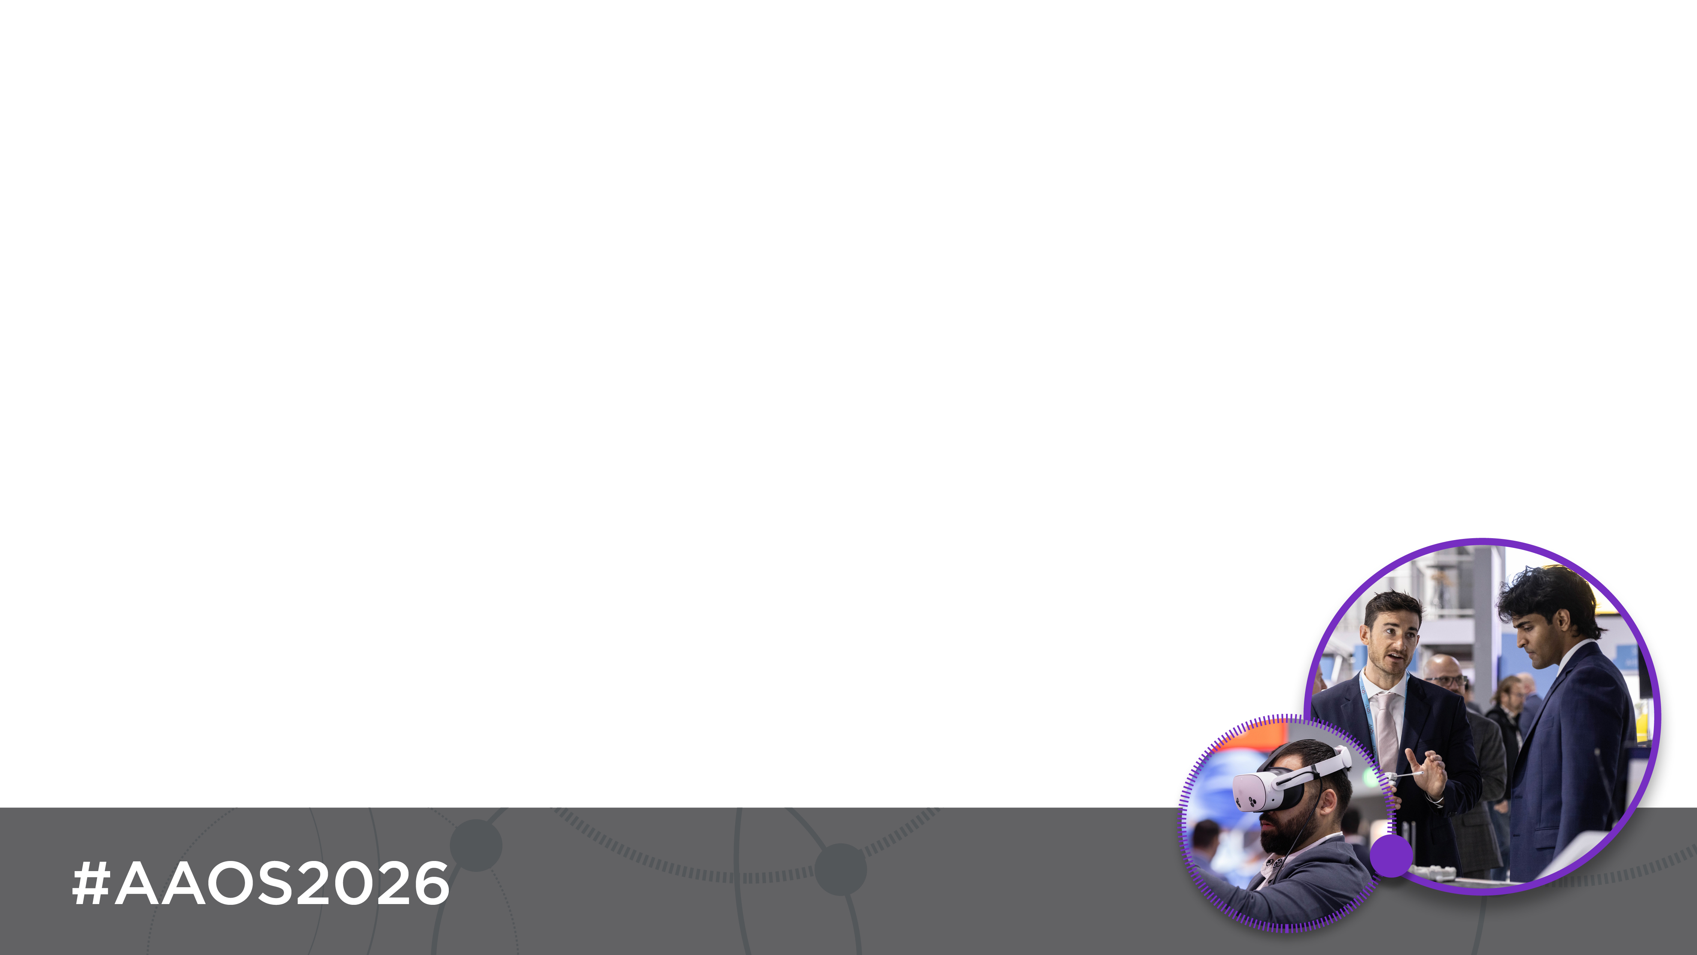
Connect with AAOS on Social Media
Follow AAOS on social media to help promote the AAOS 2026 Annual Meeting. Like and share our content to easily promote the event across your social networks!
Follow us on X
Follow and like us on Facebook
Follow and like us on Instagram
Follow and like us on LinkedIn

Slide 6

#AAOS2026
Use the hashtag #AAOS2026 on all social media posts featuring AAOS Annual Meeting content.
Why use hashtags?
Hashtags are searchable and our audience can click on hashtags to view a feed with all posts including the hashtag.
See for yourself!
Type “AAOS2026” into the X search bar to see the #AAOS2026 X feed.
Type “AAOS2026” into the LinkedIn search bar to see the #AAOS2026 LinkedIn feed.

Slide 7

Posting on LinkedIn & Facebook
Post 1
I’m presenting at #AAOS2026! Be part of the most influential, global forum for #orthopaedic care, and [attend my session OR check out my poster] on [topic]. Don’t miss your moment to register today and join us in New Orleans: https://bit.ly/joinme-am26
Post 2
Don’t miss your moment to experience the best event in #orthopaedics at #AAOS2026. I’m excited to share that I will be presenting the [session OR poster] titled [title]. Register today to join me at THE global orthopaedic meeting of the year, March 2-6, 2026, in New Orleans. https://bit.ly/joinme-am26
Post 3
I just registered for #AAOS2026, have you? I’m headed to New Orleans, March 2-6, and I’m presenting on [date] about [topic]. Join me for the latest innovations and ortho education at an incredible city known for its incredible cuisine and live music. https://bit.ly/joinme-am26
Personalize and share these posts to spread the word about #AAOS2026 throughout your network!

Slide 8
Posting on X
Post 1
@AAOS1 I’m presenting at #AAOS2026! Join me in New Orleans, Mar. 2-6, to hear about the latest findings in our field and connect with fellow #orthopaedic specialists from around the world (like me!): https://bit.ly/joinme-am26 #orthotwitter #ortho #orthopaedicsurgeon
Post 2
Experience the latest discoveries, insights & practices in the field + collaborate with a diverse audience of healthcare & industry professionals in orthopaedics at #AAOS2026. Learn more: https://bit.ly/joinme-am26 #orthotwitter #ortho #orthopaedicsurgeon @AAOS1
Post 3
[Attend my session OR Check out my poster] on [topic] during #AAOS2026. Learn more about the meeting and sign up today: https://bit.ly/joinme-am26 #orthotwitter #ortho @AAOS1
Personalize and share these posts to spread the word about #AAOS2026!

Slide 9


Use These Graphics on Social
Right-click the picture you’d like to use and select ‘Save as Picture’ or ‘Copy’ to save one of these images to your files and upload with your posts.

Slide 10
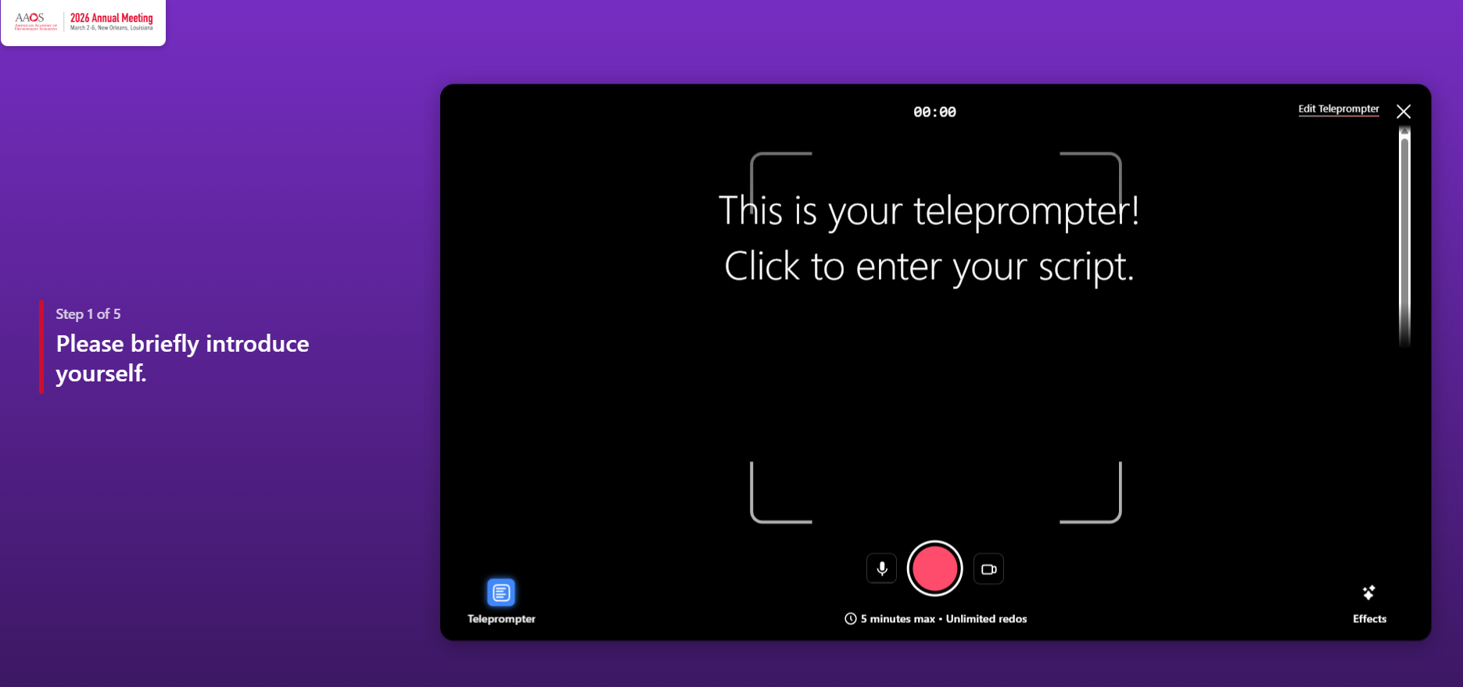
Record a Video Testimony
Click on this link to get started: https://bit.ly/am26-video
4 questions
1-1:30 min. max
Unlimited redos
Teleprompter feature available

Slide 11
Email

Slide 12
Personalized Email
Did you know?
92% of people trust recommendations from friends over any other type of advertising.
People are most likely to decide if they will attend the AAOS 2026 meeting between September and December 2025.
The top 4 reasons why ortho professionals register for the Annual Meeting are education, content quality, CMEs, and networking opportunities.
Personalize the email on the next slide then send it to your network to help spread the word about the AAOS 2026 Annual Meeting.
Be sure to include the hyperlinks so your contacts can view the program and register directly from your message.

Slide 13
Email Template
Suggested subject line: Let's Connect at #AAOS2026 in New Orleans!
[Your Colleague’s Name Here],
I’m reaching out to personally invite you to attend the AAOS 2026 Annual Meeting on March 2-6 in New Orleans. This year, Specialty Day is March 6! Our [Meeting Name] takes place [Your Organization's Time]. I hope to see you there!
AAOS is back and better than ever in 2026 with a refined program, excellent education, and powerful discussions. It's the only place where I can connect with a global network of orthopaedic surgeons and get the training I need to help impact my patient's care.
If you haven’t had a chance to do so yet, I encourage you to visit https://bit.ly/joinme-am26 and find out more about opportunities to learn, innovate, and collaborate with colleagues in New Orleans. I highly encourage you to browse the education program online to find the right learning opportunities for you.
Feel free to reach out to me with any questions. I hope to see you soon in New Orleans!
Sincerely,
[Your Name Here!]
Feel free to add your own experiences and customize this message.

Slide 14

Email Signature Line
How many emails do you send and receive a day?
Take advantage of your constant communication by sharing your support of the meeting and encouraging everyone in your professional network to attend! Choose from one of the options below or feel free to change things up where you see fit.
I’m presenting at the AAOS 2026 Annual Meeting. Will I see you there? Register today and join me in New Orleans, March 2–6!
Join leaders and innovators from around the world at the AAOS 2026 Annual Meeting to experience world-class education and build lifelong connections. Learn more & register!

Slide 15
Newsletters

Slide 16
Email Newsletter Story
Does your organization send a newsletter or have a virtual message board?
Use this suggested content to promote the meeting in these important locations.
Post 1
The AAOS 2026 Annual Meeting convenes the global musculoskeletal health community for a meeting dedicated to innovation, education, and collaboration. Attendees at all stages of their career will exchange insights, learn the latest practice techniques, experience state-of-the-art exhibits, and collaborate with a diverse audience of healthcare and industry professionals in orthopaedics. Explore the program and register today!
Post 2
The AAOS 2026 Annual Meeting returns March 2-6 in New Orleans and is better than ever! Be part of the most influential, global forum for orthopaedic surgery.
Register today for the opportunity to experience groundbreaking innovation, cutting-edge research, powerful collaboration and impactful education.

