Slide 2
Zoom Virtual Meetings 101
AAOS Office of Government Relations

Slide 3
Signing up and activating your Zoom account
Creating your own account
To sign up for your own free account, visit zoom.us/signup and enter your email address. You will receive an email from Zoom (no-reply@zoom.us). In this email, click Activate Account.
Signing into your Zoom account on the web
You can login to your Zoom account on the web at any time, at zoom.us/signin. Once you're logged in, use the panel on the left side to navigate the Zoom web portal. You can update your profile, schedule a meeting, edit your settings and more.

Slide 4
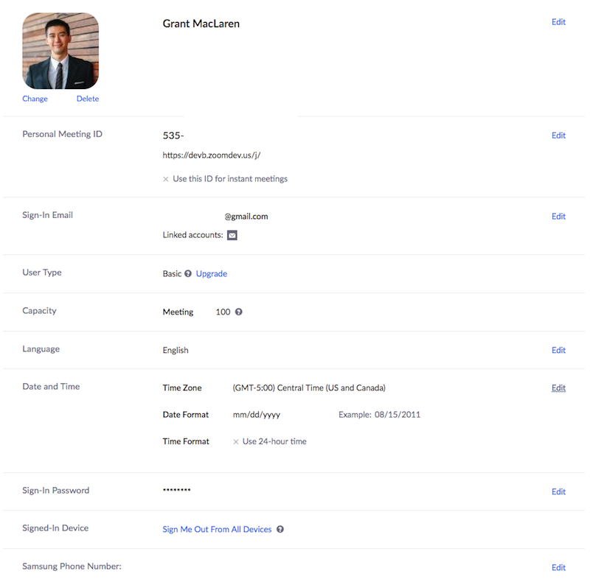
Signing up and activating your Zoom account
Updating your profile
You can update your profile by adding a profile picture, set your time zone, update your password and more. To access your Zoom profile, sign into the Zoom web portal and click Profile.

Slide 5
Scheduling your first meeting
There are many ways to schedule a meeting, including the Zoom web portal, through the Zoom client, or with one of the extensions or plugins. Here are some basic instructions for scheduling your first meeting:
Sign into your Zoom web portal.
Click Meetings.
Click Schedule a Meeting.
Choose the date and time for your meeting.
(Optional) Select any other settings you would like to use.
Click Save.

Slide 6
Scheduling your first meeting
Downloading the Zoom client
You can download the Zoom Desktop Client for Mac, Windows, ChromeOS and Linux, as well as the Zoom Mobile App for iOS and Android from our Downloads page.
Starting a test meeting
You can join a test Zoom meeting to familiarize yourself with the Zoom and test your microphone/speakers before joining a Zoom meeting. Visit zoom.us/test and click Join.

Slide 7
Starting your first meeting as the host
As the meeting host, there are several ways you can start your meeting. Your upcoming meetings will be listed in the Meetings tab of your Zoom desktop client or mobile app. You can click Start by the meeting name. You can also start your meetings from the Zoom web portal.
Login to My Meetings.
Under Upcoming Meetings, click Start next to the meeting you want to start.
The Zoom client should launch automatically to start the meeting.

Slide 8
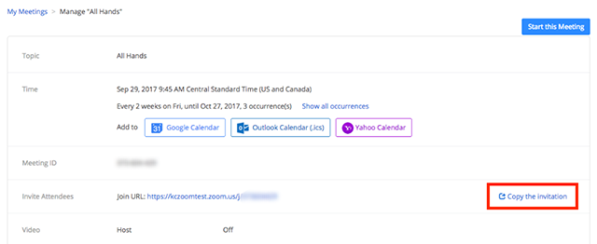
Inviting others to join your meeting
Inviting others to join your meeting is as simple as sharing the invitation or join link. You can do this after scheduling your meeting by clicking Copy the Invitation.

Slide 9
Joining another user's meeting
There are many ways to join a meeting, but the easiest way is to click the join link that the meeting host provided. You can also click Join in your Zoom client and enter the meeting ID.

Slide 10
Important Tips
Basic Zoom accounts:
Host up to 100 participants
Unlimited 1 to 1 meetings
40 mins limit on group meetings
Unlimited number of meetings

Slide 11
Have a great meeting!

