Slide 1
Treatment of
Pediatric Diaphyseal Femur Fractures:
Evidence-Based Clinical Practice Guideline
Adopted by the American Academy of Orthopaedic Surgeons (AAOS) Board of Directors
December 5, 2020
Notes:
This is a presentation on the American Academy of Orthopaedic Surgeons Treatment of Pediatric Diaphyseal Femur Fractures:
Evidence-Based Clinical Practice Guideline. This 2020 guideline reissue was adopted by the AAOS Board of Directors on December 5, 2020.

Slide 2
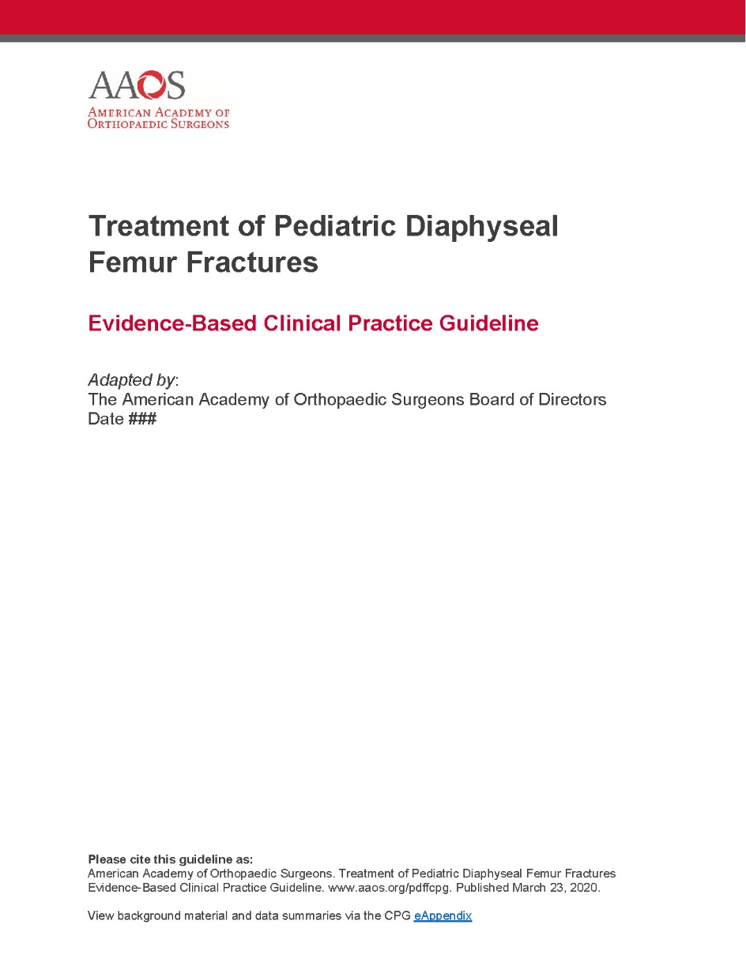
The American Academy of Orthopaedic Surgeons
2020 Clinical Practice Guideline
on the Treatment of Pediatric Diaphyseal Femur Fractures
2009 Development Group Roster: Mininder S. Kocher, MD, MPH; Ernest L. Sink, MD; R. Dale Blasier, MD; Scott J. Luhmann, MD; Charles T. Mehlman, DO, MPH; David M. Scher, MD; Travis Matheney, MD; James O. Sanders, MD. Non-Voting Members: William C. Watters, III, MD; Michael J. Goldberg, MD; Michael Warren Keith, MD. AAOS Staff (2009 Guideline): Robert H. Haralson, III, MD, MBA; Charles M. Turkelson, PhD; Janet L. Wies, MPH; Patrick Sluka, MPH; Kristin Hitchcock. 2015 Development Group Roster: David S. Jevsevar, MD, MBA; Kevin Shea, MD; AAOS Staff (2015 Update): William Shaffer, MD; Deborah Cummins, PhD; Jayson Murray, MA; Ben Brenton, MPH; Anne Woznica, Erica Linskey. 2020 Development Group Roster: Karl C. Roberts, MD, FAAOS; Benjamin J. Miller, MD, FAAOS; Henry Bone-Ellis, Jr., MD; FAAOS; Selina Poon, MD, FAAOS; Laura Lowe Tosi, MD, FAAOS. AAOS Staff (2020 Update): Danielle Schulte, MS; Tyler Verity; Kaitlyn Sevarino, MBA, CAE
Notes:
The American Academy of Orthopaedic Surgeons
2020 Clinical Practice Guideline
on the Treatment of Pediatric Diaphyseal Femur Fractures

Slide 3

WHAT IS A CLINICAL PRACTICE GUIDELINE?
Clinical Practice Guideline
A clinical practice guideline is a series of recommendations created to inform clinicians of best practices, based on best available evidence
Notes:
The definition of a clinical practice guideline is a series of recommendations created to inform clinicians of best practices, based on best available evidence. The next few slides will take you through the AAOS Clinical Practice Guideline development process.

Slide 4

GOALS AND RATIONALE OF A CLINICAL PRACTICE GUIDELINE
Improve treatment based on current best evidence
Guides qualified physicians through treatment decisions to improve quality and efficiency of care
Identify areas for future research
CPG recommendations are not meant to be fixed protocols; patients’ needs, local resources, and clinician independent medical judgement must be considered for any specific procedure or treatment
Notes:
Goals and Rationale
The purpose of a clinical practice guideline is to improve treatment based on current best evidence. A clinical practice guideline consists of a systematic review of all available literature on the topic, and demonstrates where there is good evidence, where evidence is lacking, and what topics require future research. AAOS staff and the physician work group systematically review available literature and subsequently write recommendations based on a rigorous, standardized process.
Musculoskeletal care is provided in many different settings by many different providers. A guideline was created as an educational tool to guide qualified physicians and orthopaedic surgeons through a series of treatment decisions in an effort to improve the quality and efficiency of care and should not be construed as including all proper methods of care or excluding methods of care reasonably directed to obtaining the same results. The ultimate judgment regarding any specific procedure or treatment must be made in light of all circumstances presented by the patient and the needs and resources particular to the locality or institution.

Slide 5
WHAT IS EVIDENCE-BASED MEDICINE?
Individual Clinical Experience
Best External Evidence
Patient Values and Expectations
Evidence-Based Medicine is a Combination of:
Individual Clinical Experience
Best External Evidence
Patient Values and Expectations
EBM
Notes:
What is Evidence-Based Medicine
What is evidence-based medicine? Clinical practice was historically viewed as the “art of medicine.” The use of the scientific method, as used in bench research, statistical analysis, and epidemiology, was rare in the world of medicine.
Expert opinion, experience, and authoritarian judgment were the foundation for decision making.
Habits, protocols, and traditions directed care.
However, Clinical decisions should be based on the best patient and population-based evidence.
Evidence based medicine applies the scientific method into healthcare decision-making. It is an approach to medical practice intended to optimize decision-making by emphasizing the use of evidence from well designed and conducted research
It classifies evidence by its strength, with the strongest types yielding the strongest recommendations.

Slide 6
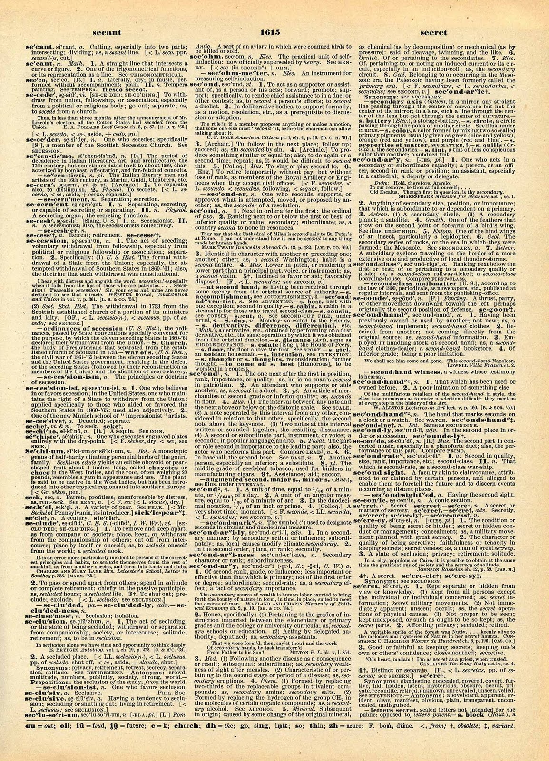
WHAT IS EVIDENCE-BASED MEDICINE?
Evidence-Based Medicine
Evidence-based medicine is the conscientious, explicit, and judicious use of current best evidence from clinical care research in the management of individual patients
Haynes, Sackett et al, 1996 Transferring evidence from research into practice
Sacket et al, 1996, BMJ EBM: what it is and isn’t
This Photo by Unknown Author is licensed under CC BY-NC-ND
Notes:
What is Evidence-based Medicine:
The definition of evidence-based medicine is the conscientious, explicit, and judicious use of current best evidence from clinical care research in the management of individual patients.
Evidence-Based Medicine combines:
Individual Clinical Experience
Best External Evidence, and
Patient Values and Expectations
All AAOS Clinical practice guidelines (CPG) provide evidence-based recommendations for current orthopaedic diagnostic, treatment, and postoperative procedures. Multidisciplinary clinician work groups and AAOS staff work together to synthesize published research with the aim of providing a transparent and robust summary of the research findings for a particular orthopaedic disease topic.

Slide 7

IOM STANDARDS FOR DEVELOPING TRUSTWORTHY GUIDELINES
Establish Transparency
Management of Conflict of Interest
Guideline Development Group Composition
Clinical Practice Guideline-Systematic Review Intersection
Establish Evidence of Foundations for and Rating Strength of Recommendations
Articulation of Recommendations
External Review
Updating
Notes:
IOM Standards
When treating patients, doctors and healthcare providers often are faced with difficult decisions. They are dependent on the scientific literature, in addition to their knowledge, experience, and patient preferences, to educate their decisions on how to treat. Clinical practice guidelines are statements that include recommendations intended to optimize patient care. Because of the expansive number of clinical practice guidelines available, users found it difficult to determine which guidelines were of high quality. Users needed a method to distinguish high caliber, trustworthy clinical practice guidelines to aide with their health-related decision making.
In 2008, U.S. Congress asked the Institute of Medicine (IOM) to undertake a study on the best methods used to develop clinical practice guidelines. Their efforts resulted in the development of eight standards for developing rigorous, trustworthy clinical practice guidelines. The AAOS uses these standards when developing their Clinical Practice Guidelines.

Slide 8
CLINICAL PRACTICE GUIDELINE
PROCESS FLOWCHART
5. Final Meeting
WG meets in-person to:
Review quality appraisals and evidence tables
Assign grade/rating for each recommendation based on evidence
Develop final recommendations
Construct risk/harms statements
Define future research needs
1. Select CPG Topic
4. Literature Review and Appraisal
AAOS staff methodologists, in conjunction with work group (WG) members, review and appraise literature
7. Approval Process
2. Assemble Work Group Members (WG)
8. Communication, Dissemination, and Implementation
3. WG formulates PICO questions, set inclusion criteria at Introductory Meeting
6. Review Periods
Peer Review and Public Comment review periods
Notes:
First Steps to Constructing a CPG
Clinical Practice Guidelines (CPG) and Systematic Reviews (SR) are prepared by physician CPG or SR Development Groups (clinical experts) with the assistance of the AAOS Department of Clinical Quality and Value. The difference between a CPG and a SR is the size of the project. CPGs can ask anywhere from 10-30 PICO questions, resulting in 10-30 separate literature reviews, whereas a SR asks 4-7 questions. The smaller scope of the SR lends itself to a quicker turnaround and involves less staff resources and clinician volunteer time commitments.
The initial step in creating Clinical Practice Guidelines is the nomination of CPG or SR Topics. These topics are then voted upon, via an electronic survey, by the AAOS Evidence-Based Quality and Value Committee (EBQV) members, thus choosing which of the topics will ultimately move forward as a new guideline or systematic review.
When reviewing and appraising the literature, the workgroup may decide that the quality and quantity of the evidenced included lends itself more to a SR rather than a CPG and decide to proceed with a SR instead. However, the workgroup does not have the option to choose to construct a systematic review for some recommendations and a clinical practice guidelines for other recommendations.

Slide 9
FORMULATING PICOs
“P” = Patient Population
“I” = Intervention or variable of Interest
“C” = Comparison
“O” = Outcome
Notes:
Formulating PICO Questions
The clinician work group commences their work on the Clinical Practice Guideline by constructing a set of PICO questions. These questions specify the patient population of interest (P), describing the most important characteristic of the patient such as age, disease or condition, and gender. Next is the intervention of interest (I), describe the main intervention, such as drug or other treatment, or diagnostic or screening test. The comparison (C), what is the main alternative being considered, such as placebo, standard therapy, no treatment, or the “gold” standard. And lastly, what is the outcome (O), what are you trying to accomplish, measure, improve or affect, such as reduce mortality, morbidity, improve memory. They function as questions for the systematic review, but not as final recommendations or conclusions.
These parameters provide clarity in defining inclusion criteria for the literature review and evaluating the evidence. Once established, these a priori PICO questions cannot be modified until the final guideline work group meeting.

Slide 10

INCLUSION/EXCLUSION CRITERIA
Standard inclusion criteria include:
Must study humans
Must be published in English
Must be published in or after 1966
Can not be performed on cadavers
Exclusion Criteria
Work group members define additional exclusion criteria based on PICO question
Notes:
Study Selection Criteria:
A priori article inclusion criteria is constructed for all CPGs and SRs. These criteria are our “rules of evidence” and articles that did not meet them are, for the purposes of this guideline, not evidence. The AAOS has standard inclusion criteria for guideline development and work group members further refine inclusion/exclusion criteria a priori at the introductory meeting.
To be included in a systematic review, all articles must be on the following:
Article must be a full peer-reviewed published article report of a clinical study.
For any included study that uses “paper-and-pencil” outcome measures (e.g., SF-36), only those outcome measures that have been validated will be included
For any given follow-up time point in any included study, there must be ≥ 50% patient follow-up (if the follow-up is >50% but <80%, the study quality will be downgraded by one Level)
Study must be of humans
Study must be published in English
Study results must be quantitatively presented Study must not be an in vitro study
Study must not be a biomechanical study
Study must not have been performed on cadavers
The following type of articles are excluded from guideline review:
Retrospective non-comparative case series, medical record reviews, meeting abstracts, meta-analyses, systematic reviews, historical articles, editorials, letters, and commentaries
Confounded studies that give patients the treatment of interest and along with another treatment
Case studies that have non-consecutive enrollment of patients
Controlled trials where patients were not stochastically assigned to groups, difference in patient characteristics or outcomes at baseline, and authors did not statistically adjust for these differences when analyzing the results
All studies evaluated as “very low quality”, and
Composite measures or outcomes even if they are patient-orientated
Study Inclusion Criteria for the AAOS Treatment of Pediatric Diaphyseal Femur Fractures Clinical Practice Guideline also contained the following criteria which was customized by the Work Group:
Evaluated a treatment for isolated pediatric diaphyseal femur fracture.
Was a full article published in the peer reviewed literature.
Was an English language article published after 1965.
Was not a cadaveric, animal, or in vitro study.
Was not a retrospective case series, medical records review, meeting abstract, unpublished study report, case report, historical article, editorial, letter, or commentary.
Was the most recent report of a study or the report with the largest number of enrolled patients in a study with multiple publications.
Enrolled ≥ 10 patients in each of its study groups.
Enrolled a patient population of at least 80% of patients with a diaphyseal femur fracture and were not skeletally mature (closure of proximal and distal femoral growth plates).
Reported quantified results.
Enrolled patients without the following conditions
subtrochanteric fractures, supracondylar femur fractures, physeal fractures, open fractures, compound fractures, pathologic fractures, or multiple lower extremity fractures.
co-existing abdominal or neurological injuries requiring surgical intervention (the physician work group chair and co-chair determined whether an article met inclusion criteria in cases when studies reported insufficient detail to determine whether co-existing injuries required surgical intervention).
osteogenesis imperfecta, cerebral palsy, myelodysplasia (spina bifida), metabolic bone diseases, or skeletal dysplasia.
The original guideline searched for all articles published up to October 1, 2008, the 2015 re-issued guideline searched for articles published up to November 27, 2013, and the 2020 updated guideline search for all articles published up to April 6, 2020.

Slide 11

LITERATURE SEARCHES
Databases used:
  PubMed
  EMBASE (Excerpta Medica dataBASE)
  Cochrane Central Register of Controlled Trials
Search using key terms from work group’s PICO questions and inclusion criteria
Secondary manual search of the bibliographies of all retrieved publications for relevant citations
Recalled articles evaluated for inclusion based on the study selection criteria
Notes:
Literature Searches
The medical librarian conducted a comprehensive search of PubMed, Embase, and the Cochrane Central Register of Controlled Trials based on key terms and concepts from the systematic literature review development group’s preliminary recommendations. Bibliographies of relevant systematic reviews were hand search for additional references.
Recalled articles were evaluated for possible inclusion based on the study selection criteria and were summarized for the work group who assisted with reconciling possible errors and omissions.

Slide 12


BEST EVIDENCE SYNTHESIS
Include only highest quality evidence for any given outcome if available
If there are fewer than two occurrences of an outcome of this quality, the next lowest quality is considered until at least two occurrences have been acquired.
Notes:
Best Evidence Synthesis
When addressing a recommendation, only the best available evidence for any given outcome is included. If available, the highest quality evidence for any given outcome is included first. In the absence of two or more occurrences of an outcome of this quality, the next lowest quality of an outcome is considered until at least two or more occurrences of an outcome have been acquired.
For example, if there were two ‘moderate’ quality occurrences of an outcome that addressed a recommendation, the ‘low’ quality occurrences of this outcome would not be included. A summary of the evidence that met the inclusion criteria but was not considered the best available evidence can be viewed by recommendation in Appendix IX of the guideline’s eAppendix pdf.

Slide 13



STRENGTH OF RECOMMENDATIONS
STRENGTH | OVERALL STRENGTH OF EVIDENCE | STRENGTH VISUAL
STRONG | Two or more HIGH Strength Studies with consistent findings
MODERATE | 1 HIGH or 2 MODERATE strength studies with consistent findings
LIMITED | One or more LOW strength studies and/or only 1 MODERATE strength study with consistent findings or evidence from a single, or the evidence is insufficient, or conflicting
CONSENSUS | Expert opinion (no studies) No supporting evidence in the absence of reliable evidence. Work group is making a recommendation based on their clinical opinion
Notes:
Defining the Strength of the Recommendations
Judging the quality of evidence is only a steppingstone towards arriving at the strength of a CPG or SR recommendation. The strength of recommendation also takes into account the quality, quantity, and the trade-off between the benefits and harms of a treatment, the magnitude of a treatment’s effect, and whether data exists on critical outcomes.
Strength of recommendation communicates the level of confidence one can have in a recommendation. Thusly, the strength expresses how conceivable it is that a recommendation will be overturned by future evidence. It is extremely difficult for future evidence to overturn a recommendation that is based on many high caliber randomized controlled trails that demonstrate a large effect. It is more probable that future evidence will overturn recommendations derived from a few small retrospective comparative studies. Consequently, recommendations based on the former kind of evidence are given a “strong” strength of recommendation and recommendations based on the latter kind of evidence are assigned a “limited” strength.
When making guidelines, each article that meets the inclusion criteria is appraised for quality and applicability and will be downgraded if there are flaws related to bias, lack of controls, insufficient power, or one of the other domains. Studies are designated as high, moderate or low strength based on the result of the Appraise methodology. Guideline recommendations are then rated as Strong, Moderate, Limited or Consensus based on the supporting evidence as outlined in this table.
Please note that the work group is only permitted to make a consensus-based recommendation when there is no evidence to support the recommendation and when not establishing a recommendation could have catastrophic consequences.

Slide 14
TRANSLATING RECOMMENDATIONS IN A CPG
STRENGTH OF RECOMMENDATION | PATIENT COUNSELING TIME | DECISION AIDS | IMPACT OF FUTURE RESEARCH
Strong | Least | Least important, unless the evidence supports no difference between two alternative interventions | Not likely to change
Moderate | Less | Less important | Less likely to change
Limited | More | More | Possible / Anticipates
Consensus | Most | Most Important | Impact unknown
Notes:
Translating Recommendations in a Clinical Practice Guideline:
As demonstrated in the table, with stronger recommendations, physicians will need to spend less time counseling patients, as they do not need to weigh the pros and cons of proposed treatments. Evidence is strongly favoring one treatment over another. The effect of future research is not likely to change the proposed treatment option. As the recommendation strength declines, the more probable the physician will need to provide additional time discussing treatment alternatives, in addition to providing decision aids to help patients see the pros and cons of treatments, so they can use their own preferences/values to determine the best course of treatment. Future research is more likely to impact the use of these recommendations.

Slide 15

ASSESSING QUALITY OF EVIDENCE
All included studies undergo a quality assessment
Each study’s design is evaluated for risk of bias and receives a final quality grade, depending on the number of study design flaws
Study quality tables are made available to the work group in the final data report and the final publication of the guideline/systematic review
Notes:
In accessing the quality of evidence, it is necessary that all included studies undergo a quality assessment, each study’s design is then evaluated for risk of bias and receives a final quality grade, depending on the number of study design flaws, and study quality tables are made available to the work group in the final data report and the final publication of the guideline or systematic review.

Slide 16
RESULTS OF QUALITY ASSESSMENT:
ORIGINAL 2008
STUDY ATTRITION
FLOWCHART
1153 citations identified by literature searches
883 citations not retrieved
270 articles retrieved for full-text review
224 articles did not meet inclusion criteria
46 articles considered for guideline recommendations
15 articles excluded
31 articles included
Notes:
Study Attrition Flowchart
The original guideline on the Treatment of Pediatric Diaphyseal Femur Fractures (PDFF) was the third guideline developed by the AAOS in-house. It had fourteen recommendations of varying strengths. However, per current AAOS policy, all recommendations in the original guideline identified as “inconclusive” were removed from this 2015 reissue (see Appendix XI for a full list of the inconclusive recommendations that were removed). Based on the current procedure for updating AAOS guidelines, the Medical Librarian ran a preliminary search to identify literature that could address and possibly change the original recommendations. The AAOS Evidence-Based Medicine Unit then used the inclusion criteria from the original guideline to determine if any articles published after the final literature search date of the original guideline were relevant to the original recommendations.
The study attrition diagram provides a detailed description of the number of identified abstracts and recalled and selected studies that were evaluated in the systematic review of the 2008 Treatment of Pediatric Diaphyseal Femur Fractures Clinical Practice Guideline. Of the initial 1,153 abstracts, only 31 were included after the full-text review and quality analysis. The literature search strategies used to identify the abstracts are included in the guideline’s full text pdf.

Slide 17
UPDATED 2013
STUDY ATTRITION FLOWCHART
316 citations identified by updated literature searches
10 articles recalled from abstract review
9 articles did not meet inclusion criteria
One article added to recommendation 4
Notes:
Study Attrition Flowchart
The study attrition diagram provides a detailed description of the number of identified abstracts and recalled and selected studies that were evaluated in the systematic review of the Treatment of Pediatric Diaphyseal Femur Fractures Clinical Practice Guideline. Of the initial 316 abstracts, only one article was added to recommendation 4 after the full-text review and quality analysis. The literature search strategies used to identify the abstracts are included in the guideline’s full text pdf.

Slide 18
UPDATED 2020
STUDY ATTRITION FLOWCHART
442 abstracts reviewed by search performed on April 16, 2020
332 articles did not meet inclusion criteria
110 articles recalled from abstract review
106 articles did not meet inclusion criteria
One article added to recommendation 3
Three articles added to recommendation 4
Notes:
Study Attrition Flowchart
The study attrition diagram provides a detailed description of the number of identified abstracts and recalled and selected studies that were evaluated in the systematic review of the Treatment of Pediatric Diaphyseal Femur Fractures Clinical Practice Guideline. Of the initial 442 abstracts, only one article was added to recommendation 3, and three articles added to recommendation four after the full-text review and quality analysis. The literature search strategies used to identify the abstracts are included in the guideline’s full eAppendix pdf.

Slide 19
WATERPROOF CAST LINER:
STUDY ATTRITION
FLOWCHART
48 citations identified by literature searches
43 citations not retrieved
5 articles retrieved for full-text review
4 articles excluded
1 articles included
Notes:
Study Attrition Flowchart
The original guideline on the Treatment of Pediatric Diaphyseal Femur Fractures (PDFF) was the third guideline developed by the AAOS in-house. It had fourteen recommendations of varying strengths. However, per current AAOS policy, all recommendations in the original guideline identified as “inconclusive” were removed from this 2015 reissue (see Appendix XI for a full list of the inconclusive recommendations that were removed). Based on the current procedure for updating AAOS guidelines, the Medical Librarian ran a preliminary search to identify literature that could address and possibly change the original recommendations. The AAOS Evidence-Based Medicine Unit then used the inclusion criteria from the original guideline to determine if any articles published after the final literature search date of the original guideline were relevant to the original recommendations.
For the recommendation on waterproof cast liners only, we considered for inclusion studies that included patients with conditions other than diaphyseal femur fractures
because the complications potentially avoided by using waterproof liners are not specific to diaphyseal femur fractures. Of the initial 48 abstracts, only 1 abstract was included after the full-text review and quality analysis. The literature search strategies used to identify the abstracts are included in the guideline’s full text pdf.

Slide 20

VOTING ON THE RECOMMENDATIONS
Recommendations and recommendation strengths voted on by work group during final meeting
Approved and adopted by simple majority (60%) when voting on every recommendation
If disagreement, further discussion to whether the disagreement could be resolved
Notes:
Voting on the Recommendations
The recommendations and their strength were voted on by the work group members during the final meeting. If disagreement between the work group occurred, further discussion, and up to three rounds of voting were conducted by the work group to resolve the disagreement(s). If disagreements were not resolved following the voting rounds, no recommendation was adopted.

Slide 21
GUIDELINE LANGUAGE STEMS
GUIDELINE LANGUAGE STEMS | STRENGTH OF RECOMMENDATION
Strong evidence supports that the practitioner should/should not do X, because… | STRONG
Moderate evidence supports that the practitioner could/could not do X, because… | MODERATE
Limited evidence supports that the practitioner might/might not do X, because… | LIMITED
In the absence of reliable evidence, it is in the opinion of this guideline work group that… | CONSENSUS
Notes:
Wording of the Final Recommendations
To prevent bias in the way recommendations are worded, the AAOS utilizes specific predetermined language stems that are governed by the evidence strengths. Each recommendation is composed using language that accounts for the final strength of the recommendation. For example, wording for a Strong Recommendation would begin “Strong evidence supports that the practitioner should/should not do X, because…”, while a recommendation labeled as Consensus would begin as “In the absence of reliable evidence, it is in the opinion of this guideline work group that…”

Slide 22

PEER REVIEW
Guideline draft sent for peer review to external experts
Comments and draft of responses reviewed by work group members
Recommendation changes required a majority vote by work group
A detailed report of all resulting revisions is published with the guideline document
Notes:
Peer Review
Following the final meeting, the guideline draft then undergoes a peer review, seeking additional input from external experts. All peer reviewers were required to disclose any conflicts of interest. To guide which groups participated, the work group identified all specialty societies at the introductory meeting. Organizations, not individuals, were specified.
The peer review stage provided external stakeholders an opportunity to provide evidence-based direction for modifications that they believed were overlooked. Since the draft was subject to revisions until its approval by the AAOS Board of Directors, confidentiality of all working drafts was essential.
To commence this review, approximately six weeks prior the final meeting, specialty societies were solicited to nominate individual peer reviewers. The peer review period was announced, and other interested parties were able to volunteer to also review the draft.
Initial responses to comments that addressed methodology were then drafted by the manager of Department Clinical Quality and Value (CQV) unit. These responses were then reviewed by the work group chair and vice-chair, who responded to all questions concerning clinical practice and techniques, with the CQV director also providing input. All comments were received, and initial drafts of the responses were then reviewed by all work group members. All changes to a recommendation as a result of peer review were based on the evidence and underwent a majority vote by the work group members via teleconference. Final revisions were summarized in a detailed report and were made part of the guideline document. Following final guideline approval, all individual responses were posted on the AAOS website with a point-by-point response to each non-editorial comment.

Slide 23

PUBLIC COMMENT
Following peer review modifications, CPG undergoes public commentary period
Comments are solicited from:
AAOS Board of Directors
AAOS Council on Research and Quality
AAOS Committee on Evidence-Based Quality and Value
AAOS Board of Councilors
AAOS Board of Specialty Societies
200 commentators have the opportunity to provide input
Notes:
Public Commentary
After modifying the draft in response to peer review, the Clinical Practice Guideline was subjected to a two-week period of “Public Commentary.” Comments were solicited from members of the AAOS Board of Directors, the AAOS Council on Research and Quality, AAOS Committee on Evidence-Based Quality and Value, the AAOS Board of Councilors, and the AAOS Board of Specialty Societies. Based on these bodies, over 200 commentators had the opportunity to provide input on this new Clinical Practice Guideline.

Slide 24

FINAL MEETING
The work group is charged with:
Review of data summaries
Final recommendation language
Rationale and risk/harm construction
Future research
Notes:
Prior to the Meeting:
AAOS staff conducts several webinars with the work group to reiterate their charges and ensure that all relevant literature has been included.
Using the PEER tool, work group members are responsible for reviewing the included and excluded literature for their assigned PICO questions.
Work group members draft recommendation and rationale for their assigned recommendations to catalyze the final meeting discussion.
During the Final Meeting:
Each member presents the data findings and their draft recommendations and rationales for their assigned recommendations.
The work group discusses data findings and composes the final recommendations and rationales, as needed. The strength of evidence will determine the AAOS predefined language stem that is used for the recommendation.
All edits to recommendations, rationales, benefits and harms sections, and future research sections should be completed by the end of the meeting.

Slide 25
TREATMENT OF PEDIATRIC DIAPHYSEAL FEMUR FRACTURES
CLINICAL PRACTICE GUIDELINE OVERVIEW
Based on a systematic review of published studies
Addresses the treatment of isolated diaphyseal femur fractures in children who have not yet reached skeletal maturity.
Highlights limitations in literature and areas requiring future research
Trained physicians and surgeons are intended users
Notes:
Overview
Patient Population
This document addresses the treatment of isolated diaphyseal femur fractures in children who have not yet reached skeletal maturity. The guideline provides information on pediatric patient management after diagnosis of a diaphyseal femur fracture. This guideline is not intended for use in pediatric patients who present with additional coexisting injuries that require formal surgical intervention or other life-threatening conditions that take precedence over the treatment of the diaphyseal femur fracture.
Burden of Disease
There are many components to consider when calculating the overall cost of treatment for pediatric femoral fracture. The main considerations for patients and third-party payers are the relative cost and effectiveness of each treatment option. But hidden costs for pediatric patients must also be considered. These costs include the additional home care required for a patient, the costs of rehabilitation and of missed school for the patient, childcare costs if both parents work, and time off of work required by one or both parents to care for the pediatric patient.
Etiology
The primary cause of diaphyseal femur fracture in children varies by age groups but includes falls, motor-vehicle accidents, and sports injuries. In addition, the Cincinnati Children’s Hospital Medical Center states, “In children less than one year of age, child abuse is the leading cause of femoral fractures and abuse remains a significant concern in toddlers up to about five years of age.”
Incidence and Prevalence
The annual rate of children who present with femoral shaft fracture has been estimated at 19 per 100,000.1 Boys have a higher risk of fracture than girls and this is consistent with participation of boys in sporting activites. Diaphyseal femur fractures account for 1.4%3 to 1.7% of all pediatric fractures.
Risk Factors
Occurrences of pediatric diaphyseal femur fractures are higher in boys than in girls in all age groups. This literature also suggests that the primary mechanism of fracture is age-related, including falls and child abuse for younger children, falls, motor vehicle-pedestrian, bicycle, and motor-vehicle collisions for school age children and motor-vehicle or sports related accidents in teenagers.
One study suggests increased risk of fracture for blacks over whites and one study suggests no difference by race/ethnicity. Both studies suggest that lower socioeconomic conditions also increase fracture risk.
Emotional and Physical Impact
The prolonged loss of mobility and absence from school often associated with the treatment of pediatric diaphyseal femur fractures can lead to adverse physical, social, and emotional consequences for the child as well as the child’s family. Treatments that minimize the child’s length of immobilization and time out of school are therefore desirable.
Potential Benefits, Harms, and Contraindications
Invasive and operative treatments are associated with known risks. Contraindications vary widely based on the treatment administered. Therefore, discussion of available treatments and procedures applicable to the individual patient rely on mutual communication between the patient’s guardian and physician, weighing the potential risks and benefits for that patient.
Further, the age groups referred to in the specific recommendations are general guides. Obviously, additional factors may affect the physician’s choice of treatment including but not limited to associated injuries the patient may present with as well as the individual’s comorbidities, skeletal maturity, and/or specific patient characteristics including obesity. The individual patient’s family dynamic will also influence treatment decisions; therefore, treatment decisions made for children who border any age group should be made on the basis of the individual. Decisions will always need to be predicated on guardian and physician communication with discussion of available treatments and procedures applicable to the individual patient. Once the patient’s guardian has been informed of available therapies and has discussed these options with his/her child’s physician, an informed decision can be made. Clinician input based on experience increases the probability of identifying patients who will benefit from specific treatment options.

Slide 26
2020 REPORT FOR THE UPDATE OF THE 2009 CLINICAL PRACTICE GUIDELINE ON THE TREATMENT OF PEDIATRIC DIAPHYSEAL FEMUR FRACTURES (REISSUED 2015)
Guideline greater than 5 years old and is reviewed very five years.
New studies were published.
Not sufficient to warrant changing scope of guideline.
Due to paucity of evidence and relevance of existing scope, guideline was approved via the AAOS Rapid Update Methodology.
New additions based on newly available evidence relevant to original PICO questions and resulting guideline recommendations.
Only recommendations were updated. All other information (e.g., methods, work group roster, recommendation rationales) remain that of original 2009 guideline.
Notes:
This guideline is greater than 5 years old and is reviewed every five years. New studies have been published since this guideline was developed, however the AAOS has determined that these studies are not sufficient to warrant changing the guideline scope at this time. Due to the paucity of evidence and the relevance of the existing scope, this guideline was approved to be updated via the AAOS Rapid Update Methodology. The 2020 additions to this document are outlined below and reflect additions based on newly available evidence relevant to the original PICO questions and resulting guideline recommendations. Only the recommendations have been updated, and all other information (e.g., the methods, work group roster, recommendation rationales) remain that of the original 2009 guideline. For the full AAOS Clinical Practice Guidelines Rapid Update Methodology please visit: aaos.org/quality
OVERVIEW OF 2020 UPDATES TO THE 2009 ORIGINAL GUIDELINE
1. Addition of the Siddiqui, et al, 2008 study findings to the Early or Delayed Spica Casting recommendation.
2. Addition of the Ahmad, et al, 2015, Naseem, et al, 2015, and Soleimanpour, et al, 2013 study findings to the Elastic Intramedullary Nails recommendation.
3. Updated the strength of recommendation of the Elastic Intramedullary Nails recommendation based on new study findings.
a. Based on the new strength of evidence; the recommendation language was updated from ‘Limited evidence supports the option for physicians to use flexible intramedullary nailing to treat children age five to eleven years diagnosed with diaphyseal femur fractures’ to ‘Strong evidence supports the use of flexible intramedullary nailing to treat children age five to eleven years diagnosed with diaphyseal femur fractures.’

Slide 27
CHILD ABUSE
Strong evidence supports that children younger than thirty-six months with a diaphyseal femur fracture be evaluated for child abuse.
Strength of Recommendation: Strong
Notes:
RATIONALE:
Our systematic review identified three high quality population-based studies that identified femur fractures in children caused by child abuse from three different registries. Two of these studies^{1,2} reported 14% and 12% of the fractures were the result of abuse in children zero to one year old and zero to three years old, respectively. The third study reported that only two (2%) of the fractures were caused by abuse among children zero to 15 years old, which would correspond to 13% if both of these fractures occurred in children zero to one year old.
The work group recognizes that the most important elements in evaluating a child for abuse are a complete history and physical exam with attention to the signs and symptoms of child abuse. The work group defines “evaluating” a child for abuse however, as not only these routine elements, but also including direct communication with the patient’s pediatrician or family doctor, consultation with the child abuse team at institutions where this may be available, and selective ordering of a skeletal survey by the orthopaedist when considered appropriate by the treating physician. In cases of possible child abuse, these professionals can add valuable input, based on experience, which increases the probability of identifying patients who may be at increased risk.¹⁵
In addition, the work group emphasizes that children who are not yet walking and sustain a femur fracture are at particular risk for abuse⁷, so one must make every attempt to identify these patients. One of the studies2 reports 48 of 49 child abuse-related femur fractures occurred in the less than three-year-old age group. This author found that in 332 femur fractures in children 0-3 years of age forty-eight of them were due to abuse.
Accordingly, there were 451 children, four to twelve years of age, who had femur fractures and only one child in this age group was confirmed as abused. There were no cases of child abuse identified in the thirteen- to seventeen-year-old age group. The work group acknowledges that this study is not exclusively reporting data on shaft fractures and has isolated the data specific to shaft fracture in the following data tables. However, the study does illustrate the need to focus on the patients who are less than three years old.
Estimates of child abuse suggest that the incidence is underreported and the consequences of missing it result in serious complications including death.²
Supporting Evidence
Three population-based studies reported data addressing this recommendation. Hinton et al.¹ used the Hospital Discharge Database of the Maryland Health Services Cost Review Commission from 1990-1996, Rewers et al.² used the Colorado Trauma Registry from 1998-2001, and Miettinen et al.¹⁶ used a medical information register for University Central Hospital in Kuopio, Finland from 1976-1985.
Hinton RY, Lincoln A, Crockett MM, Sponseller P, Smith G. Fractures of the femoral shaft in children. Incidence, mechanisms, and sociodemographic risk factors. J Bone Joint Surg Am. 1999;81:500-509.
Miettinen H, Makela EA, Vainio J. The incidence and causative factors responsible for femoral shaft fractures in children. Ann Chir Gynaecol. 1991;80:392-395.
Rewers A, Hedegaard H, Lezotte D et al. Childhood femur fractures, associated injuries, and sociodemographic risk factors: a population-based study. Pediatrics. 2005;115:e543-e552.

Slide 28
INFANT FEMUR FRACTURE
Limited evidence supports treatment with a Pavlik harness or a spica cast for infants six months and younger with a diaphyseal femur fracture, because their outcomes are similar.
Strength of Recommendation: Limited
Notes:
RATIONALE:
The first 6 months of a child’s life is a time of most rapid growth. Because of this, rapid healing of diaphyseal femur fractures and post-fracture skeletal remodeling is maximal. Hence spontaneous, complete correction after fracture healing is expected. Due to the rapid union and complete remodeling, treatment of diaphyseal femur fractures centers on assuring ease of patient care and minimizing treatment complications. Both Pavlik harnesses and spica casts result in good outcomes with minimal complications. In the studies we reviewed, the only identifiable difference between these two treatments was more frequent skin complications in the spica cast group. Because this is a minor and correctable issue that does not cause long-term problems or disability, either type of treatment is an option.
Supporting Evidence:
Two studies addressed this recommendation. One retrospective comparative study¹⁷ compared the Pavlik harness to a spica cast, and one case series examined Pavlik harnesses.¹⁸ The case series reported that all 16 patients achieved stable union by 5 weeks in a Pavlik harness. In the comparative study, the spica cast group had significantly more skin complications (p<.01) than the Pavlik harness group, but there were no other statistically significant differences between groups. The Pavlik harness group was significantly younger (p=.028), with an average age of 3.6 months versus an average age of 6.5 months in the spica cast group.
Podeszwa DA, Mooney JF, III, Cramer KE, Mendelow MJ. Comparison of Pavlik harness application and immediate spica casting for femur fractures in infants. J Pediatr Orthop. 2004;24:460-462.
Stannard JP, Christensen KP, Wilkins KE. Femur fractures in infants: a new therapeutic approach. J Pediatr Orthop. 1995;15:461-466.

Slide 29
EARLY OR DELAYED SPICA CASTING
Moderate evidence supports early spica casting or traction with delayed spica casting for children age six months to five years with a diaphyseal femur fracture with less than 2 cm of shortening.
Strength of Recommendation: Moderate
Notes:
RATIONALE
Two studies compared the use of early spica casting with traction followed by spica casting. There were significantly more infections in the traction group and more spica softening and plaster breakage in the early spica group.¹⁹ There were no statistically significant differences between the treatment groups in time to union, femoral shortening, malalignment, or malrotation.^{19,20}
Based on the summary of evidence, we did not find conclusive evidence that one modality of treatment (spica casting or traction) was superior, and no studies compared flexible nails to spica casting in this age group. We suggest using early spica casting for social and economic considerations, specifically in relative ease of care and decreased length of hospital stay.²¹ While the work group suggests early spica for children in this age group, traction may be appropriate in some cases. This recommendation does not suggest against the use of traction. In keeping with current best medical practice, we further suggest careful clinical and radiographic follow-up during the course of treatment.
In addition, no trial has specifically examined children in the age group of 4-5 years. A third study²² indicates that in children as young as four more malunions occur with spica casting than with external fixation. Treatment decisions made on children who border any age group should be made on the basis of the individual. Until further research clarifies the possible harms associated with any treatment in this age group, decisions will always need to be predicated on guardian and physician mutual communication with discussion of available treatments and procedures applicable to the individual patient.
Once the patient’s guardian has been informed of available therapies and has discussed these options with his/her child’s physician, an informed decision can be made. Clinician input based on experience increases the probability of identifying patients who will benefit from specific treatment options.
Supporting Evidence:
Two High Quality studies addressed this recommendation. One study²⁰ included patients 2-10 years old, with 54% of the patients between ages 2-5. The other study¹⁹ included patients 9 months – 10 years old, with a mean age in both groups of 3.5 years.
One High quality study,²² with a mean patient age of 6 years old, but that addressed harms in children as young as 4 was also included to address this recommendation.
Previously Published Systematic Reviews:
Two previous systematic reviews^{21,23} concluded that early spica casting was associated with shorter inpatient hospital stays and fewer adverse events than traction. Both of these reviews, however, were not specific to the population of interest for this recommendation, so we did not include them in our systematic review.
Rasool MN, Govender S, Naidoo KS. Treatment of femoral shaft fractures in children by early spica casting. S Afr Med J. 1989;76:96-99.
Burton VW, Fordyce AJ. Immobilization of femoral shaft fractures in children aged 2-10 years. Injury. 1972;4:47-53.
Wright JG, Wang EE, Owen JL et al. Treatments for paediatric femoral fractures: a randomised trial. Lancet. 2005;365:1153-1158
Siddiqui A. Pirwani, M, Naz, N, Rehman, A, Soomro, Y. Skin traction followed by Spica cast versus early Spica cast in femoral shaft fractures of children. Pak j surg, 2008, 24(1), 38-41.

Slide 30
ELASTIC INTRAMEDULLARY NAILS
Limited evidence supports the option for physicians to use flexible intramedullary nailing to treat children age five to eleven years diagnosed with diaphyseal femur fractures.
Strength of Recommendation: Strong
Notes:
2009 RATIONALE:
There are few statistically significant differences between treatments in healing of the fracture. The evidence reviewed included ten studies that examined one hundred varying outcomes. Of these one hundred outcomes twenty-one were significant. There were no studies that directly compared flexible nails to spica casting. When flexible nails were compared to external fixation and traction plus casting, nine outcomes were significant favoring flexible nails, one significant outcome favored external fixation and one significant outcome favored traction plus casting. (Please refer to Tables 6 and 7 below.)
The high quality study²² found to address this recommendation compared external fixation to spica casting. External fixation was favored over spica casting for malunions, including anterior/posterior angulation. Twelve other outcomes for this comparison had non-significant results.
In summary, the overall body of evidence considered for this recommendation indicates that there are few significant outcomes when all comparisons are considered. Further, important comparisons have not been investigated (spica casting and flexible nails).
Two moderate quality studies ^{24, 50} shows more rapid return to walking and school with flexible intramedullary nailing and one low quality study²⁵ illustrates less associated hospital costs when compared to traction and casting. The ability to mobilize the patient, return them to school rapidly, and suggested decrease in hospital costs leads the work group to suggest flexible intramedullary nailing over traction followed by casting. There is evidence that flexible intramedullary nailing has less adverse events and more rapid return to school than external fixation in both stable and unstable fractures.²⁶
In making this recommendation, the work group acknowledges that they are including their expert opinion and they have therefore, downgraded the Grade of this Recommendation to a “limited” recommendation. Based on the advantages suggested, less adverse events and more rapid return to school, flexible intramedullary nailing is a treatment option for children five to eleven years diagnosed with diaphyseal femur fractures.
There is currently insufficient literature in specially designed pediatric rigid intramedullary nails and bridge plating for inclusion in the current guideline.
Patients over age 11 or with weight over 49 kg are at increased risk of a poor outcome²⁷ with flexible intramedullary nailing. The mean weight between patients with a poor outcome and those with an excellent or satisfactory outcome was significant, but weight was not independent of age and had a sensitivity of only 59% in predicting poor outcomes.
Previously Published Systematic Reviews:
Two previous systematic reviews^{21,23} concluded that early spica casting was associated with shorter inpatient hospital stays and fewer adverse events than traction. One review²³ concluded that flexible nails reduced the malunion and adverse event rate compared to external fixation, and that external fixation reduced the malunion rate compared to early spica casting. This review also concluded that dynamic external fixation had a lower total adverse event rate compared to static external fixation, and that operative treatment reduced the malunion and total adverse event rates compared to nonoperative treatment. Both of these reviews, however, were not specific to the population of interest for this recommendation, so we did not include them in our systematic review.
2020 Update Supporting Evidence:
Ahmad, I, Gilani, H. U. R, Rasool, K, Rasool A. Comparison of titanium elastic nailing vs hip spica cast in treatment of femoral shaft fractures in children between 6-12 years of age. Pakistan Journal of Medical and Health Sciences. 2015 January;9(2): 717-719.
Naseem, M, Moton, R. Z, Siddiqui, M. A. Comparison of titanium elastic nails versus Thomas splint traction for treatment of pediatric femur shaft fracture. J Pak Med Assoc. 2015 Nov;65(11 Suppl 3):S160-2.
Soleimanpour, J, Ganjpour, J, Rouhani, S, Goldust, M. Comparison of titanium elastic nails with traction and spica cast in treatment of children's femoral shaft fractures. Pak J Biol Sci. 2013 Apr 15;16(8):391-5.
Wright JG, Wang EE, Owen JL et al. Treatments for paediatric femoral fractures: a randomised trial. Lancet. 2005;365:1153-1158
Flynn JM, Luedtke LM, Ganley TJ et al. Comparison of titanium elastic nails with traction and a spica cast to treat femoral fractures in children. J Bone Joint Surg Am. 2004;86-A:770-777.
Buechsenschuetz KE, Mehlman CT, Shaw KJ, Crawford AH, Immerman EB. Femoral shaft fractures in children: traction and casting versus elastic stable intramedullary nailing. J Trauma. 2002;53:914-921.
Barlas K, Beg H. Flexible intramedullary nailing versus external fixation of paediatric femoral fractures. Acta Orthop Belg. 2006;72:159-163.
Moroz LA, Launay F, Kocher MS et al. Titanium elastic nailing of fractures of the femur in children. Predictors of complications and poor outcome. J Bone Joint Surg Br. 2006;88:1361-1366.
Domb BG, Sponseller PD, Ain M, Miller NH. Comparison of dynamic versus static external fixation for pediatric femur fractures. J Pediatr Orthop. 2002;22:428-430.
Mehdinasab SA, Nejad SAM, Sarrafan N. Short term outcome of treatment of femoral shaft fractures in children by two methods: Traction plus casting, versus intramedullary pin fixation - A comparative study. Pak J Med Sci. 2008;24:147-151.
Ali M, Raza A. Union and complications after Thomas splint and early hip spica for femoral shaft fractures in children. J Coll Physicians Surg Pak. 2005;15:799-801.
Curtis JF, Killian JT, Alonso JE. Improved treatment of femoral shaft fractures in children utilizing the pontoon spica cast: a long-term follow-up. J Pediatr Orthop. 1995;15:36-40.
Nork SE, Hoffinger SA. Skeletal traction versus external fixation for pediatric femoral shaft fractures: a comparison of hospital costs and charges. J Orthop Trauma. 1998;12:563-568.
Song HR, Oh CW, Shin HD et al. Treatment of femoral shaft fractures in young children: comparison between conservative treatment and retrograde flexible nailing. J Pediatr Orthop B. 2004;13:275-280.
Hedin H, Borgquist L, Larsson S. A cost analysis of three methods of treating femoral shaft fractures in children: a comparison of traction in hospital, traction in hospital/home and external fixation. Acta Orthop Scand. 2004;75:241-248.
Rasit AH, Mohammad AW, Pan KL. The pattern of femoral diaphyseal fractures in children admitted in Sarawak General Hospital. Med J Malaysia. 2006;61 Suppl A:79-82.
Sturdee SW, Templeton PA, Dahabreh Z, Cullen E, Giannoudis PV. Femoral fractures in children, is early interventional treatment beneficial? Injury. 2007;38:937-944.
Wall EJ, Jain V, Vora V, Mehlman CT, Crawford AH. Complications of titanium and stainless steel elastic nail fixation of pediatric femoral fractures. J Bone Joint Surg Am. 2008;90:1305-1313.
Shemshaki,H.R., Mousavi,H., Salehi,G., Eshaghi,M.A. Titanium elastic nailing versus hip spica cast in treatment of femoral-shaft fractures in children. J Orthop Traumatol. 2011/3; 1: 45-48
Ahmad, I, Gilani, H. U. R, Rasool, K, Rasool A. Comparison of titanium elastic nailing vs hip spica cast in treatment of femoral shaft fractures in children between 6-12 years of age. Pakistan Journal of Medical and Health Sciences. 2015 January;9(2): 717-719.
Naseem, M, Moton, R. Z, Siddiqui, M. A. Comparison of titanium elastic nails versus Thomas splint traction for treatment of pediatric femur shaft fracture. J Pak Med Assoc. 2015 Nov;65(11 Suppl 3):S160-2.
Soleimanpour, J, Ganjpour, J, Rouhani, S, Goldust, M. Comparison of titanium elastic nails with traction and spica cast in treatment of children's femoral shaft fractures. Pak J Biol Sci. 2013 Apr 15;16(8):391-5.

Slide 31
ORIF PEDIATRIC FEMUR FRACTURES
Limited evidence supports rigid trochanteric entry nailing, submuscular plating, and flexible intramedullary nailing as treatment options for children age eleven years to skeletal maturity diagnosed with diaphyseal femur fractures, but piriformis or near piriformis entry rigid nailing are not treatment options.
Strength of Recommendation: Limited
Notes:
RATIONALE:
Skeletally immature patients are at increased risk for avascular necrosis of the femoral head when piriformis or near piriformis fossa entry nails are used. The rate of this potentially devastating complication is at least 4%.38 Every effort should be made to decrease the risk of avascular necrosis.
Fracture patterns that compromise post-reduction stability (i.e., axial and / or angular stability) as well as heavier patients may stimulate the surgeon to choose rigid trochanteric entry nailing or submuscular plating over flexible intramedullary nailing. One Low quality study demonstrated a five times higher risk of poor outcomes for flexible nailing in patients whose weight met or exceeded 49 kg (108 lbs.).27 In the expert opinion of the work group, external fixation is another option in the older patient with an unstable fracture pattern, but its significantly higher complication rates, as demonstrated in other age groups,23,26 make it less desirable than rigid trochanteric entry nailing or submuscular plating.
Supporting Evidence:
One High Quality and four Low quality studies addressed this recommendation. The High Quality study39 compared nonoperative treatment, mainly traction and cast bracing, to closed intramedullary nailing. Of the 20 patients (21 fractures) in the operative group, 16 were treated with piriformis entry rigid nailing. There was a statistically significant difference in favor of intramedullary nailing for two outcomes, time to healing and malunion. There were no other statistically significant differences between the two groups.
Of the four Low quality studies, one investigated flexible nailing,²⁷ one investigated rigid trochanteric entry nailing, ³⁸ one investigated near piriformis entry rigid nailing,^{38,40} and one investigated submuscular plating of comminuted fractures.⁴¹
The study of flexible nailing²⁷ also compared the weight of patients with an excellent or satisfactory outcome to the weight of patients with a poor outcome. Forty percent (40%) of the patients in this study were at least 11 years old. The 15 kg difference in mean weight between patients with a poor outcome and those with an excellent or satisfactory outcome was statistically significant according to the author’s calculations (p=.003). Moreover, using a cut-off point of 49 kg, heavier patients were about five times more likely than lighter patients to have poor outcomes. However, the investigators found that weight did not independently predict a poor outcome when age was also included in a logistic regression model. The investigators also found that the weight cut-off point had 78.5% specificity and 59% sensitivity for detecting a poor outcome.
Previously Published Systematic Reviews:
A previous systematic review²³ concluded that intramedullary nailing resulted in fewer malunions and adverse events than traction or subsequent casting. This review, however, was not specific to the population of interest for this recommendation, so we did not include it in our systematic review.
Moroz LA, Launay F, Kocher MS et al. Titanium elastic nailing of fractures of the femur in children. Predictors of complications and poor outcome. J Bone Joint Surg Br. 2006;88:1361-1366.
Buford D, Jr., Christensen K, Weatherall P. Intramedullary nailing of femoral fractures in adolescents. Clin Orthop Relat Res. 1998;85-89.
Herndon WA, Mahnken RF, Yngve DA, Sullivan JA. Management of femoral shaft fractures in the adolescent. J Pediatr Orthop. 1989;9:29-32.
Kanellopoulos AD, Yiannakopoulos CK, Soucacos PN. Closed, locked intramedullary nailing of pediatric femoral shaft fractures through the tip of the greater trochanter. J Trauma. 2006;60:217-222.
Agus H, Kalenderer O, Eryanilmaz G, Omeroglu H. Biological internal fixation of comminuted femur shaft fractures by bridge plating in children. J Pediatr Orthop. 2003;23:184-189.

Slide 32
PAIN CONTROL
Limited evidence supports regional pain management for patient comfort peri-operatively.
Strength of Recommendation: Limited
Notes:
RATIONALE
We identified one High quality study⁴⁵ of a hematoma block and one Low quality study⁴⁶ of a femoral nerve block, both of which were effective at reducing pain. In the expert opinion of the work group, the risks associated with regional pain management, such as femoral nerve neuritis and the complications associated with epidural anesthesia in lower extremity fractures (missed compartment syndrome), are less than with oral or IV systemic medicines.
Supporting Evidence:
One Moderate Quality study⁴⁵ investigating a hematoma block and one Low quality case series⁴⁶ investigating a femoral nerve block addressed this recommendation. The High-quality study compared patients who received a bupivacaine hematoma block after elastic nail fixation to patients who did not receive a hematoma block. Pain scale scores were not reported; however, patients who received a hematoma block received their first postoperative narcotic dose a mean of 5 hours later than patients in the control group (p = .008).
In the Low-quality case series, the authors reported that the nerve block was effective at reducing pain (Figure 38). The onset of analgesia occurred in 8.0 ± 3.5 minutes. The pain scale used in this study ranges from 0 (calm, no spontaneous pain or during handling, radiographs, or traction installation) to 4 (child is crying, major tachycardia (>60% normal rate in consideration to age) and high blood pressure, handling impossible). Table 17 lists the complications in this study.
Previously Published Systematic Reviews
A previous systematic review ⁴⁷ concluded that femoral nerve block effectively reduces pain in children with femoral shaft fractures. Although the stated subject of this systematic review was children, two of the three included studies included adults. Therefore, we did not include it in our systematic review.
Herrera JA, Wall EJ, Foad SL. Hematoma Block Reduces Narcotic Pain Medication after Femoral Elastic Nailing in Children. J Pediatr Orthop. 2004;24:254-256.
Ronchi L, Rosenbaum D, Athouel A et al. Femoral nerve blockade in children using bupivacaine. Anesthesiology. 1989;70:622-624.

Slide 33
WATERPROOF CASTING
Limited evidence supports waterproof cast liners for spica casts are an option for use in children diagnosed with pediatric diaphyseal femur fractures.
Strength of Recommendation: Limited
Notes:
RATIONALE:
Waterproof cast liners are often used when applying a spica cast for the management of femur fractures in children in order to improve ease of care.
We identified one High Quality study⁴⁸ that addressed the use of waterproof liners in spica casts. Use of a waterproof liner was associated with significantly fewer skin problems and unexpected cast changes. However, in this study spica casts were used for the management of developmental dysplasia of the hip, not specifically for diaphyseal femur fractures. In addition, other outcomes such as impact on family and financial considerations were not studied. Waterproof liners may make cast care easier for the family, thus decreasing the overall impact of treatment on family functioning. Cast liners add increased cost to overall management. Nevertheless, the patient ages were similar to the patient ages for spica cast management of diaphyseal femur fractures and the findings should be able to be extrapolated. The overall benefit in terms of skin problems, unplanned cast changes, and ease of care for the family likely obviates the increased costs from the use of waterproof cast liners in the expert opinion of the physician work group.
Supporting Evidence:
One High Quality study⁴⁸ addressed this recommendation. In this study, however, hip spica casts were applied to treat conditions other than diaphyseal femur fractures, such as developmental dysplasia. The study compared the use of hip spica casts with and without a waterproof liner. The use of a waterproof liner was associated with significantly fewer occurrences of skin excoriation and unplanned cast changes.
Wolff CR, James P. The prevention of skin excoriation under children's hip spica casts using the goretex pantaloon. J Pediatr Orthop. 1995;15:386-388.

Slide 34
FUTURE RESEARCH
The quality of scientific data regarding the management of femur fractures in children is clearly lacking. Controversy exists regarding the optimal management of pediatric femur fractures. A multitude of treatment options exist including Pavlik harness, spica casting, traction, external fixation, flexible intramedullary nailing, rigid intramedullary nailing, and bridge plating. Properly designed randomized clinical trials comparing treatment options are necessary to determine optimal treatment. These trials would benefit from being multicenter trials in terms of accrual of patients and external validity.
Notes:
FUTURE RESEARCH
The quality of scientific data regarding the management of femur fractures in children is clearly lacking. Controversy exists regarding the optimal management of pediatric femur fractures. A multitude of treatment options exist including Pavlik harness, spica casting, traction, external fixation, flexible intramedullary nailing, rigid intramedullary nailing, and bridge plating. Properly designed randomized clinical trials comparing treatment options are necessary to determine optimal treatment. These trials would benefit from being multicenter trials in terms of accrual of patients and external validity.

Slide 35
FUTURE RESEARCH
Specific trials which would be helpful include:
  Delayed spica casting versus immediate spica casting for femur fractures in children 6 months – 6 years old.
  Flexible intramedullary nailing versus immediate spica casting for femur fractures in children 5 and 6 years old, and even children younger than 5-6 years of age.
  External fixation versus bridge plating versus elastic nails versus rigid trochanteric nails for length unstable femur fractures in children 6 years old – skeletal maturity.
  Flexible intramedullary nailing versus rigid intramedullary nailing versus bridge plating for femur fractures in children 6 years old – skeletal maturity.
Notes:
FUTURE RESEARCH
Specific trials which would be helpful include:
Delayed spica casting versus immediate spica casting for femur fractures in children 6 months – 6 years old.
Flexible intramedullary nailing versus immediate spica casting for femur fractures in children 5 and 6 years old, and even children younger than 5-6 years of age.
External fixation versus bridge plating versus elastic nails versus rigid trochanteric nails for length unstable femur fractures in children 6 years old – skeletal maturity.
Flexible intramedullary nailing versus rigid intramedullary nailing versus bridge plating for femur fractures in children 6 years old – skeletal maturity.

Slide 36
FUTURE RESEARCH
Intermediate outcome measures are often used in studies regarding pediatric femur fractures such as radiographic parameters. Functional outcome measures and later development of osteoarthritis are difficult to measure and have a long-time course. However, the relationship between commonly accepted radiographic measures of malunion and functional outcome or later development of problems is not clear. Further research to validate accepted radiographic standards of malunion would be extremely valuable. Also, the inclusion of family function outcomes may improve recommendations
for those younger patients that may either get intramedullary nailing versus immediate spica casting.
Notes:
FUTURE RESEARCH
Intermediate outcome measures are often used in studies regarding pediatric femur fractures such as radiographic parameters. Functional outcome measures and later development of osteoarthritis are difficult to measure and have a long-time course. However, the relationship between commonly accepted radiographic measures of malunion and functional outcome or later development of problems is not clear. Further research to validate accepted radiographic standards of malunion would be extremely valuable. Also, the inclusion of family function outcomes may improve recommendations
for those younger patients that may either get intramedullary nailing versus immediate spica casting.

Slide 37
PLEASE CITE CLINICAL PRACTICE GUIDELINE AS:
American Academy of Orthopaedic Surgeons Evidence-Based Clinical Practice Guideline on the Treatment of Pediatric Diaphyseal Femur Fractures http://www.orthoguidelines.org/topic?id=1015. Published December 5, 2020
Notes:
References
American Academy of Orthopaedic Surgeons Evidence-Based Clinical Practice Guideline on the Treatment of Pediatric Diaphyseal Femur Fractures http://www.orthoguidelines.org/topic?id=1015. Published December 5, 2020.

Slide 38
TREATMENT OF PEDIATRIC DIAPHYSEAL FEMUR FRACTURES
CASE STUDY
Isolated pediatric femoral shaft fractures occur at an annual rate of 19 per 100,000 and represent the most frequent pediatric orthopaedic injury requiring hospitalization. The treatment of these fractures is dictated by various factors. The orthopaedic surgeon caring for these fractures must take into account the patients age, weight, family circumstances, and fracture pattern to determine the best treatment options. The cost for these various treatment options can also come into consideration.
The treatment options available for pediatric femoral diaphyseal fractures include: Pavlik harnessing, Spica casting, traction with subsequent casting, external fixation, intramedullary flexible or rigid nailing, and plating (locked and unlocked methods). The desire for early mobilization in order to allow for earlier return to school for the patient, decrease in the burden of home bound children on the families, and decrease the duration of hospitalization has prompted the use of surgical intervention over non-surgical interventions.
Notes:
Isolated pediatric femoral shaft fractures occur at an annual rate of 19 per 100,000 and represent the most frequent pediatric orthopaedic injury requiring hospitalization. The treatment of these fractures is dictated by various factors. The orthopaedic surgeon caring for these fractures must take into account the patients age, weight, family circumstances, and fracture pattern to determine the best treatment options. The cost for these various treatment options can also come into consideration.
The treatment options available for pediatric femoral diaphyseal fractures include: Pavlik harnessing, Spica casting, traction with subsequent casting, external fixation, intramedullary flexible or rigid nailing, and plating (locked and unlocked methods). The desire for early mobilization in order to allow for earlier return to school for the patient, decrease in the burden of home bound children on the families, and decrease the duration of hospitalization has prompted the use of surgical intervention over non-surgical interventions.
Loder, R., Patrick W. O`Donnell, MD, PhD, and Judy R. Feinberg, PhD. Epidemiology and Mechanisms of Femur Fractures in Children. J Pediatr Orthop 2006;26:561-566.
Hinton, R., Andrew Lincoln, Michele Crockett, Paul Sponseller, Gordon Smith. Fractures of the Femoral Shaft in Children: Incidence, Mechanisms, and Sociodemographic Risk Factors*. The Journal of Bone & Joint Surgery. 1999 Apr;81(4):500-7
Flynn, John, MD. And Richard M. Schwend. Managament of Pediatric Femoral Shaft Fractures. Journal of the American Academy of Orthopaedic Surgeons. 2004; 12:347-349.
Treatment of Pediatric Diaphyseal Fractures Guidline and Evidence Report. The American Academy of Orthopaedic Surgeons. June 2009.

Slide 39
TREATMENT OF PEDIATRIC DIAPHYSEAL FEMUR FRACTURES
CASE STUDY
While the vast majority of pediatric femoral fractures will progress to union without complications, the advantages and disadvantages of the available treatments must be weighed carefully when determining the best option for each patient, particularly when considering patients that are on the borders of either weight or the general age groupings. The American Academy of Orthopaedic Surgeons Clinical Practice Guideline: Treatment of Pediatric Diaphyseal Femur Fractures provides the current evidence based guidelines to help guide the practioner when treating these injuries.
Notes:
While the vast majority of pediatric femoral fractures will progress to union without complications, the advantages and disadvantages of the available treatments must be weighed carefully when determining the best option for each patient, particularly when considering patients that are on the borders of either weight or the general age groupings. The American Academy of Orthopaedic Surgeons Clinical Practice Guideline: Treatment of Pediatric Diaphyseal Femur Fractures provides the current evidence based guidelines to help guide the practioner when treating these injuries.
Loder, R., Patrick W. O`Donnell, MD, PhD, and Judy R. Feinberg, PhD. Epidemiology and Mechanisms of Femur Fractures in Children. J Pediatr Orthop 2006;26:561-566.
Hinton, R., Andrew Lincoln, Michele Crockett, Paul Sponseller, Gordon Smith. Fractures of the Femoral Shaft in Children: Incidence, Mechanisms, and Sociodemographic Risk Factors*. The Journal of Bone & Joint Surgery. 1999 Apr;81(4):500-7
Flynn, John, MD. And Richard M. Schwend. Managament of Pediatric Femoral Shaft Fractures. Journal of the American Academy of Orthopaedic Surgeons. 2004; 12:347-349.
Treatment of Pediatric Diaphyseal Fractures Guidline and Evidence Report. The American Academy of Orthopaedic Surgeons. June 2009.

Slide 40

HISTORY AND PHYSICAL
A 3-year-old male is brought into the trauma bay after being hit by a motor vehicle while he was walking on a sidewalk. His only complaint on arrival is of thigh and abdominal pain. He had no loss of consciousness. His triage vital signs are BP 96/68, HR 209, RR 30, O2 Saturation 99%, weight 15kg. The patient is treated as per advanced trauma life support (ATLS) protocol by the general surgery trauma service with orthopaedic consultation.
On physical examination, he has superficial abrasions over the abdomen without peritoneal signs or deep tenderness. He has tenderness to palpation over the left upper thigh with soft compartments and intact pulses. The remainder of the physical exam is benign.
Notes:
A 3-year-old male is brought into the trauma bay after being hit by a motor vehicle while he was walking on a sidewalk. His only complaint on arrival is of thigh and abdominal pain. He had no loss of consciousness. His triage vital signs are BP 96/68, HR 209, RR 30, O2 Saturation 99%, weight 15kg. The patient is treated as per advanced trauma life support (ATLS) protocol by the general surgery trauma service with orthopaedic consultation.
On physical examination, he has superficial abrasions over the abdomen without peritoneal signs or deep tenderness. He has tenderness to palpation over the left upper thigh with soft compartments and intact pulses. The remainder of the physical exam is benign.

Slide 41
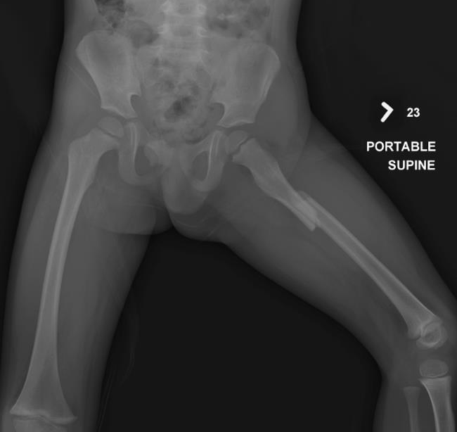
IMAGING STUDIES
X-rays of the pelvis and left thigh as well as CT of the abdomen and pelvis reveal a left proximal third femur fracture with displacement and > 2cm of shortening, and a left pelvic wing subtle plastic deformity. This image shows the presentation x-ray. The soft tissues of the abdomen and pelvis on CT are negative.
Notes:
X-rays of the pelvis and left thigh as well as CT of the abdomen and pelvis reveal a left proximal third femur fracture with displacement and > 2cm of shortening, and a left pelvic wing subtle plastic deformity. This image shows the presentation x-ray. The soft tissues of the abdomen and pelvis on CT are negative.

Slide 42
TREATMENT
The AAOS clinical guideline groups treatment of pediatric femur fractures into four categories based on age: 0 to 6 months treat with Pavlik harnessing, 6 months to 5 years treat with Spica casting, 5 years to 11 years treat with flexible nailing, 11 years to skeletal maturity treat with trochanteric entry rigid nail, plating or flexible nailing. Treatment is not solely based on the patient’s age, but should also consider patient’s weight, and family dynamics. Considering all of the treatment recommendations, a diaphyseal femur fracture with >2cm of shortening in the 6 months to 5 year age group has no supporting evidence. The amount of acceptable shortening remains controversial. No studies were identified in the literature specifically addressing whether spica casting should be utilized in this population or comparing spica casting with other treatment modalities.
Notes:
The AAOS clinical guideline groups treatment of pediatric femur fractures into four categories based on age: 0 to 6 months treat with Pavlik harnessing, 6 months to 5 years treat with Spica casting, 5 years to 11 years treat with flexible nailing, 11 years to skeletal maturity treat with trochanteric entry rigid nail, plating or flexible nailing. Treatment is not solely based on the patient’s age, but should also consider patient’s weight, and family dynamics. Considering all of the treatment recommendations, a diaphyseal femur fracture with >2cm of shortening in the 6 months to 5 year age group has no supporting evidence. The amount of acceptable shortening remains controversial. No studies were identified in the literature specifically addressing whether spica casting should be utilized in this population or comparing spica casting with other treatment modalities.

Slide 43
TREATMENT
The patient is admitted to the pediatric intensive care unit and placed in Buck’s traction pending definitive orthopaedic treatment. The following morning, the patient is deemed stable to undergo Spica casting of his left femur fracture. The Spica cast is applied without difficulty. During the afternoon on the day of cast application, the patient develops tachycardia and increasing abdominal pain that prompts a repeat abdominal CT scan. The repeat CT scan shows focal thickening and peritoneal enhancement with free fluid and air in the terminal ilium. At this point, the Spica cast is removed and he is taken to the OR by trauma surgery for exploratory laparotomy and is found to have a 1cm jejunal injury that requires repair along with an appendectomy. The patient is returned to the PICU for postoperative recovery and Bucks’ traction is reinitiated.
Notes:
The patient is admitted to the pediatric intensive care unit and placed in Buck’s traction pending definitive orthopaedic treatment. The following morning, the patient is deemed stable to undergo Spica casting of his left femur fracture. The Spica cast is applied without difficulty. During the afternoon on the day of cast application, the patient develops tachycardia and increasing abdominal pain that prompts a repeat abdominal CT scan. The repeat CT scan shows focal thickening and peritoneal enhancement with free fluid and air in the terminal ilium. At this point, the Spica cast is removed and he is taken to the OR by trauma surgery for exploratory laparotomy and is found to have a 1cm jejunal injury that requires repair along with an appendectomy. The patient is returned to the PICU for postoperative recovery and Bucks’ traction is reinitiated.

Slide 44
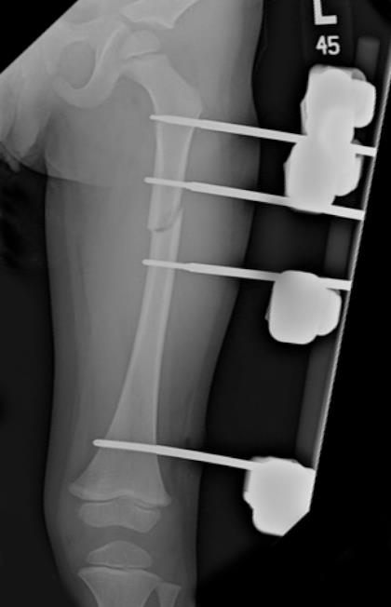
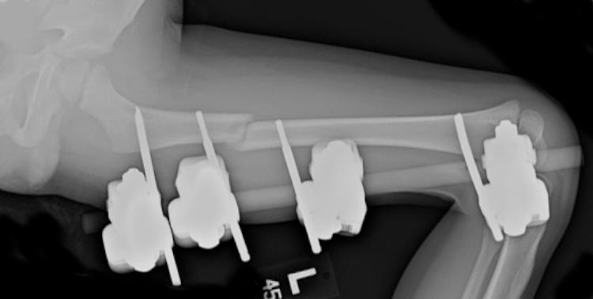
TREATMENT
On the next hospital day, the patient is again cleared to return to the OR for femur fracture stabilization via external fixator. His pelvis is stable to exam under anesthesia. His hospital course is complicated by abdominal wound dehiscence requiring operative debridement and IV antibiotics. His pin sites and thigh remain benign during this time and the parents are instructed on pin site care, which is initiated on POD 6. He is discharged on POD 12 to home with follow up 1 week later in the orthopaedic clinic. He is discharged with a wheelchair for protected weight bearing.
Notes:
On the next hospital day, the patient is again cleared to return to the OR for femur fracture stabilization via external fixator. His pelvis is stable to exam under anesthesia. His hospital course is complicated by abdominal wound dehiscence requiring operative debridement and IV antibiotics. His pin sites and thigh remain benign during this time and the parents are instructed on pin site care, which is initiated on POD 6. He is discharged on POD 12 to home with follow up 1 week later in the orthopaedic clinic. He is discharged with a wheelchair for protected weight bearing.

Slide 45
POST HOSPITALIZATION
The patient is seen in clinic one week after discharge without complaints. He has normal GI function. His pin sites are benign, and x-rays demonstrate maintained alignment and interval callus formation. He is seen one month later and there are no problems. He is now walking on the leg. X-rays demonstrate sufficient callus present for ex-fix removal, which is performed that week. He was to follow-up post external fixator removal, but the family has not returned for follow-up. He has been seen in the primary care clinic since removal of the external fixator without leg complaints or documentation of significant leg length discrepancy and is now almost 3 years out from injury.
Notes:
The patient is seen in clinic one week after discharge without complaints. He has normal GI function. His pin sites are benign and x-rays demonstrate maintained alignment and interval callus formation. He is seen one month later and there are no problems. He is now walking on the leg. X-rays demonstrate sufficient callus present for ex-fix removal, which is performed that week. He was to follow-up post external fixator removal, but the family has not returned for follow-up. He has been seen in the primary care clinic since removal of the external fixator without leg complaints or documentation of significant leg length discrepancy and is now almost 3 years out from injury.

Slide 46
DISCUSSION
While the AAOS clinical practice guideline for the treatment of pediatric diaphyseal femur fractures outlines current evidence-based treatment options, there remains a plea for additional scientific research in this area to improve the available recommendations. This case highlights a number of the management and treatment options for pediatric femur fractures.
First, higher energy injuries can result in additional bony and soft tissue injures not initially noted in early presentation. ATLS recommends secondary and tertiary evaluations to prevent missing these injuries. It is important to communicate this with families and to be cognitive and vigilant that they may exist. Appropriate and timely communications with families and other treating services has the potential to improve time to diagnosis and treatment.
Notes:
While the AAOS clinical practice guideline for the treatment of pediatric diaphyseal femur fractures outlines current evidence-based treatment options, there remains a plea for additional scientific research in this area to improve the available recommendations. This case highlights a number of the management and treatment options for pediatric femur fractures.
First, higher energy injuries can result in additional bony and soft tissue injures not initially noted in early presentation. ATLS recommends secondary and tertiary evaluations to prevent missing these injuries. It is important to communicate this with families and to be cognitive and vigilant that they may exist. Appropriate and timely communications with families and other treating services has the potential to improve time to diagnosis and treatment.

Slide 47
DISCUSSION
In this situation, the initial decision to treat the child with the femur fracture was based on the age less than 5 years. However, with the evolution of peritoneal signs and persistent abnormal vitals, the initial treatment plan needed to be modified to be able to have access to the abdomen and still have bony stabilization. In children, as with adults, external fixators can provide initial stabilization as well as definitive treatment.
Spica casting remains an option for treatment of isolated femur fractures in children less than 5. Shortening and angulation can be accepted, as there remains extensive remodeling potential in this age group. The precise extent of allowable shortening or deformity remains unanswered. Open plating and flexible nailing, although less commonly performed in this age group, also remain options to the treating surgeon if dictated by the clinical scenario and are within the armamentarium of that treating surgeon’s expertise and training.
Notes:
In this situation, the initial decision to treat the child with the femur fracture was based on the age less than 5 years. However, with the evolution of peritoneal signs and persistent abnormal vitals, the initial treatment plan needed to be modified to be able to have access to the abdomen and still have bony stabilization. In children, as with adults, external fixators can provide initial stabilization as well as definitive treatment.
Spica casting remains an option for treatment of isolated femur fractures in children less than 5. Shortening and angulation can be accepted, as there remains extensive remodeling potential in this age group. The precise extent of allowable shortening or deformity remains unanswered. Open plating and flexible nailing, although less commonly performed in this age group, also remain options to the treating surgeon if dictated by the clinical scenario and are within the armamentarium of that treating surgeon’s expertise and training.

Slide 48

Free for both iOS and Android
or at www.orthoguidelines.org
Provides easy access to all AAOS:
Clinical Practice Guidelines
Full Guideline PDF’s
Appropriate Use Criteria
Case Studies
Clinician Checklists
Impactful Statements
Plain Language Summaries
Evidence-based Databases
Evidence-based Methods, Appraisals and Standards
Notes:
The AAOS OrthoGuidelines app is an easy way to access Clinical Practice Guidelines right from your smartphone. Free for both Android and iOS users, this app not only contains all AAOS CPG’s, but also contains Appropriate Use Criteria, guideline case studies, full text pdfs, clinician checklists, impactful statements, along with other useful tools.

Slide 49


Clinical Practice Guidelines Now Available on Your Smartphone
Download on the App Store
Get it on Google play
Easier access to AAOS Guidelines:
Sort Alphabetically by Topic
Sort Recommendations by Strength
(Strong, Moderate, Limited, Consensus)
Sort by Stage of Care
Search Across all CPGs via a Single Keyword Search
Easier Access to Individual Recommendations:
View recommendations via shortened titles
Access to full recommendation & rationale
Links to references (PubMed)
Notes:
OrthoGuidelines
OrthoGuidelines furnishes the user with easy access to all AAOS guidelines. Guidelines can be sorted either alphabetically, by strength of recommendation, or stage of care. All CPG’s are able to be located via a single keyword search. OrthoGuidelines additionally enables the user to view recommendations via abbreviated titles and enables access to full recommendations and rationale. The user may likewise interface with PubMed references.

Slide 50

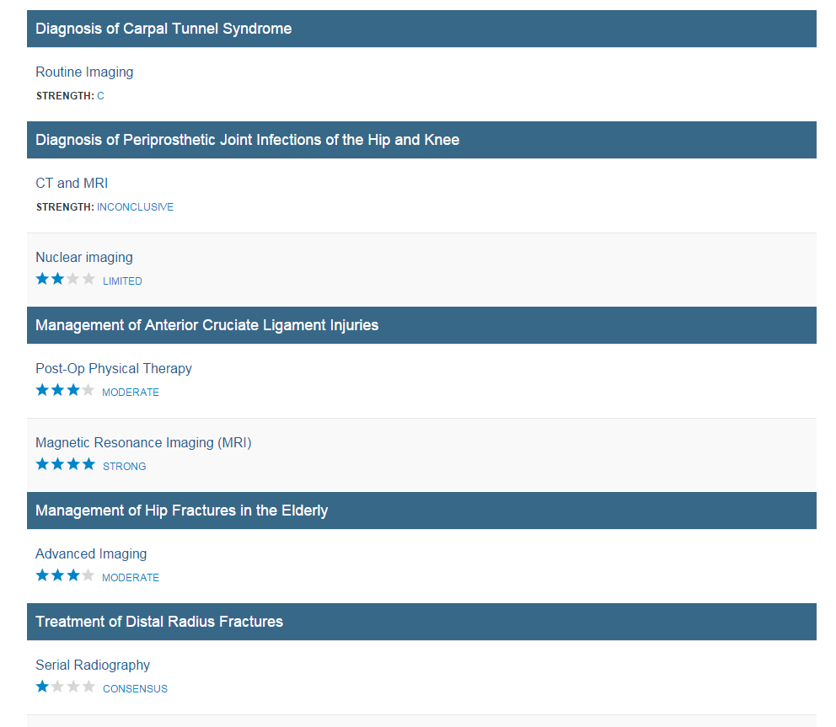
Imaging
Search across all CPG and AUC
Via a Single Keyword Search
Notes:
OrthoGuidelines allows the user to search across ALL Clinical Practice Guidelines and Appropriate Use Criteria via a single keyword search.

Slide 51
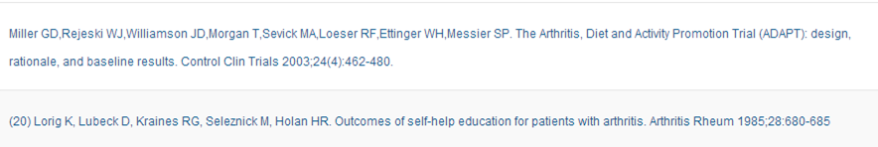
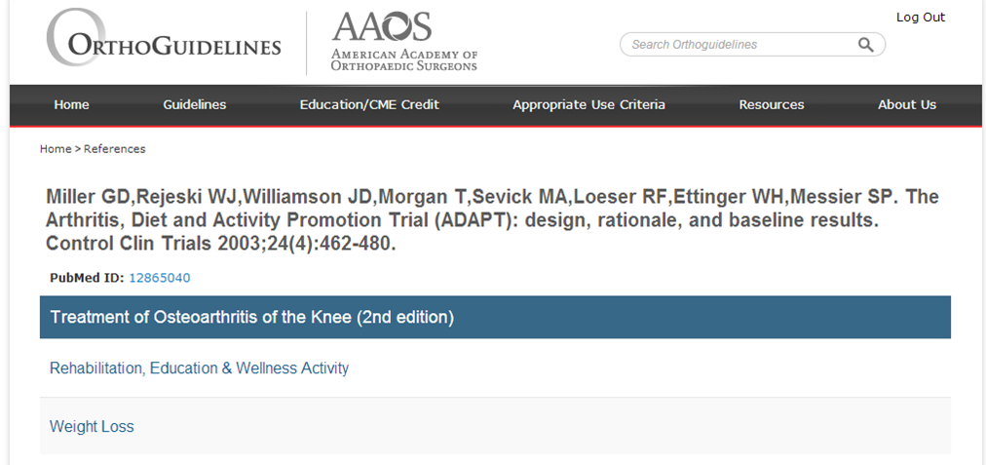
References provided for each recommendation
Links to PubMed
Notes:
The user is able to access all references for each recommendation via PubMed.

Slide 52
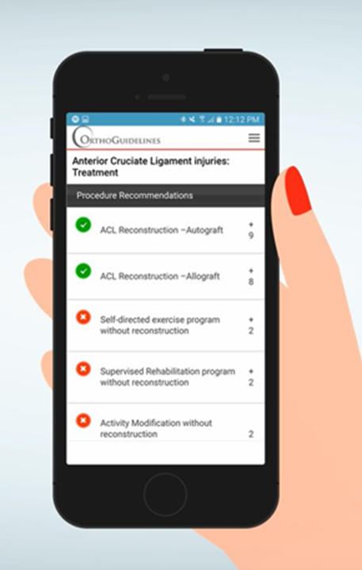
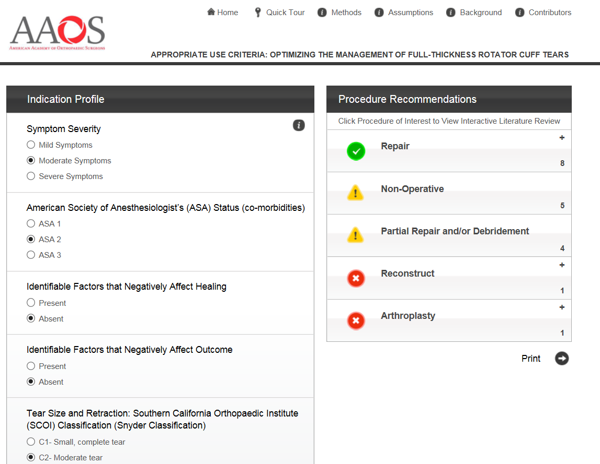
Appropriate Use Criteria Tool
Notes:
The American Academy of Orthopaedic Surgeons began developing Appropriate Use Criterias in 2011 as a tool to implement Evidence-based Clinical Practice Guidelines. Appropriate Use Criteria are created to inform clinicians for whom a procedure should be done. This involves using clinician expertise and experience, in conjunction with the relevant evidence, to rate the appropriateness of various treatments in a set of hypothetical, but clinically realistic, patient scenarios. Users can easily access this valuable tool via OrthoGuidlines.

Slide 53

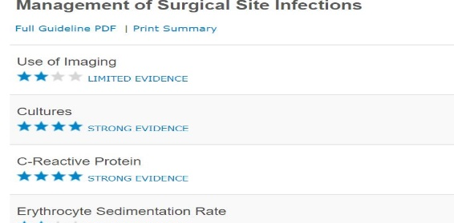
PUBLISHED CLINICAL PRACTICE GUIDELINES
Acute Compartment Syndrome
Anesthesia and Analgesia in TJA (Endorsement)
Anterior Cruciate Ligament Injuries
Carpal Tunnel Syndrome
Distal Radius Fractures
Glenohumeral Joint Osteoarthritis
Hip Fractures in the Elderly
Limb Salvage or Early Amputation
Osteoarthritis of the Hip
Osteoarthritis of the Knee (Arthroplasty)
Osteoarthritis of the Knee (Non-Arthroplasty)
Osteochondritis Dissecans
Pediatric Developmental Dysplasia of the Hip in infants up to Six Months
Pediatric Diaphyseal Femur Fractures
Pediatric Supracondylar Humerus Fractures
Periprosthetic Joint Infections
Prevention of Orthopaedic Implant Infections in Patients Undergoing Dental Procedures
Psychosocial Factors Influencing Trauma Recovery
Rotator Cuff Injuries
Surgical Site Infections
VTE Disease in Patients Undergoing Elective Hip & Knee Arthroplasty
Tranexamic Acid in Total Joint Arthroplasty (Endorsement)
Treatment of Metastatic Carcinoma of the Femur (Endorsement)
Use of Imaging Prior to Referral to a Musculoskeletal Oncologist (Endorsement)
For additional information, please visit http://www.orthoguidelines.org/
Notes:
Published Clinical Practice Guidelines
Acute Compartment Syndrome
Anesthesia and Analgesia in TJA (Endorsement)
Anterior Cruciate Ligament Injuries
Carpal Tunnel Syndrome
Distal Radius Fractures
Glenohumeral Joint Osteoarthritis
Hip Fractures in the Elderly
Limb Salvage or Early Amputation
Osteoarthritis of the Hip
Osteoarthritis of the Knee (Arthroplasty)
Osteoarthritis of the Knee (Non-Arthroplasty)
Osteochondritis Dissecans
Pediatric Developmental Dysplasia of the Hip in infants up to Six Months
Pediatric Diaphyseal Femur Fractures
Pediatric Supracondylar Humerus Fractures
Periprosthetic Joint Infections
Prevention of Orthopaedic Implant Infections in Patients Undergoing Dental Procedures
Psychosocial Factors Influencing Traum Recovery
Rotator Cuff Injuries
Surgical Site Infections
VTE Disease in Patients Undergoing Elective Hip & Knee Arthroplasty
Tranexamic Acid in Total Joint Arthroplasty (Endorsement)
Treatment of Metastatic Carcinoma and Myeloma of the Femur (Endorsement)
Use of Imaging Prior to Referral to a Musculoskeletal Oncologist (Endorsement)

