Slide 1
Management of Surgical Site Infections: Evidence-Based Systematic Literature Review
Adopted by the American Academy of Orthopaedic Surgeons (AAOS) Board of Directors
June 9, 2018

Slide 2
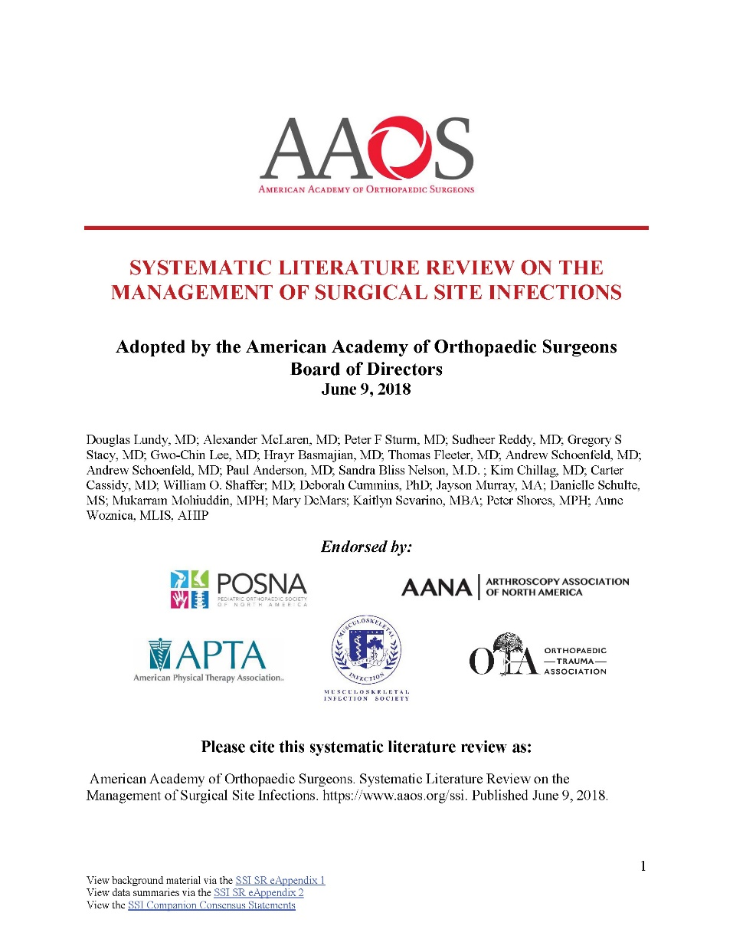
The American Academy of Orthopaedic Surgeons
2019 Clinical Practice Guideline
on the Management of Surgical Site Infections
Douglas Lundy, MD; Alexander McLaren, MD; Peter F. Sturm, MD; Sudheer Reddy, MD; Gregory S. Stacy, MD; Gwo-Chin Lee, MD; Hrayr Basmajian, MD; Thomas Fleeter, MD; Paul Anderson, MD; Sandra B. Nelson, MD; Joseph Hsu, MD; Kim Chillag, MD; Carter Cassidy, MD; Douglas Osmon, MD; Eric Hume, MD; Robert Brophy, MD. AAOS Staff: William O. Shaffer, MD; Deborah S. Cummins, PhD; Jayson N. Murray, MA; Mukaram Mohiuddin, MPH; Danielle Schulte, MS; Mary DeMars; Kaitlyn Sevarino, MBA; Anne Woznica, MLIS, AHIP; Peter Shores, MPH

Slide 3
WHAT IS A CLINICAL PRACTICE GUIDELINE?
Clinical Practice Guideline
A clinical practice guideline is a series of recommendations created to inform clinicians of best practices, based on best available evidence
Notes:
The definition of a clinical practice guideline is a series of recommendations created to inform clinicians of best practices, based on best available evidence. The next few slides will take you through the AAOS Clinical Practice Guideline development process.

Slide 4
GOALS AND RATIONALE OF A CLINICAL PRACTICE GUIDELINE
Improve treatment based on current best evidence
Guides qualified physicians through treatment decisions to improve quality and efficiency of care
Identify areas for future research
CPG recommendations are not meant to be fixed protocols; patients’ needs, local resources, and clinician independent medical judgement must be considered for any specific procedure or treatment
Notes:
Goals and Rationale
The purpose of a clinical practice guideline is to improve treatment based on current best evidence. A clinical practice guideline consists of a systematic review of all available literature on the topic, and demonstrates where there is good evidence, where evidence is lacking, and what topics require future research. AAOS staff and the physician work group systematically review available literature and subsequently write recommendations based on a rigorous, standardized process.
Musculoskeletal care is provided in many different settings by many different providers. A guideline was created as an educational tool to guide qualified physicians and orthopaedic surgeons through a series of treatment decisions in an effort to improve the quality and efficiency of care, and should not be construed as including all proper methods of care or excluding methods of care reasonably directed to obtaining the same results. The ultimate judgment regarding any specific procedure or treatment must be made in light of all circumstances presented by the patient and the needs and resources particular to the locality or institution.

Slide 5
WHAT IS EVIDENCE-BASED MEDICINE?
Individual Clinical Experience
Best External Evidence
Patient Values and Expectations
Evidence-Based Medicine is a Combination of:
Individual Clinical Experience
Best External Evidence
Patient Values and Expectations
EBM
Notes:
What is Evidence-Based Medicine
What is evidence-based medicine? Clinical practice was historically viewed as the “art of medicine.” The use of the scientific method, as used in bench research, statistical analysis, and epidemiology, was rare in the world of medicine.
Expert opinion, experience, and authoritarian judgment were the foundation for decision making.
Habits, protocols, and traditions directed care.
However, Clinical decisions should be based on the best patient and population-based evidence.
Evidence based medicine applies the scientific method into healthcare decision-making. It is an approach to medical practice intended to optimize decision-making by emphasizing the use of evidence from well designed and conducted research
It classifies evidence by its strength, with the strongest types yielding the strongest recommendations.

Slide 6
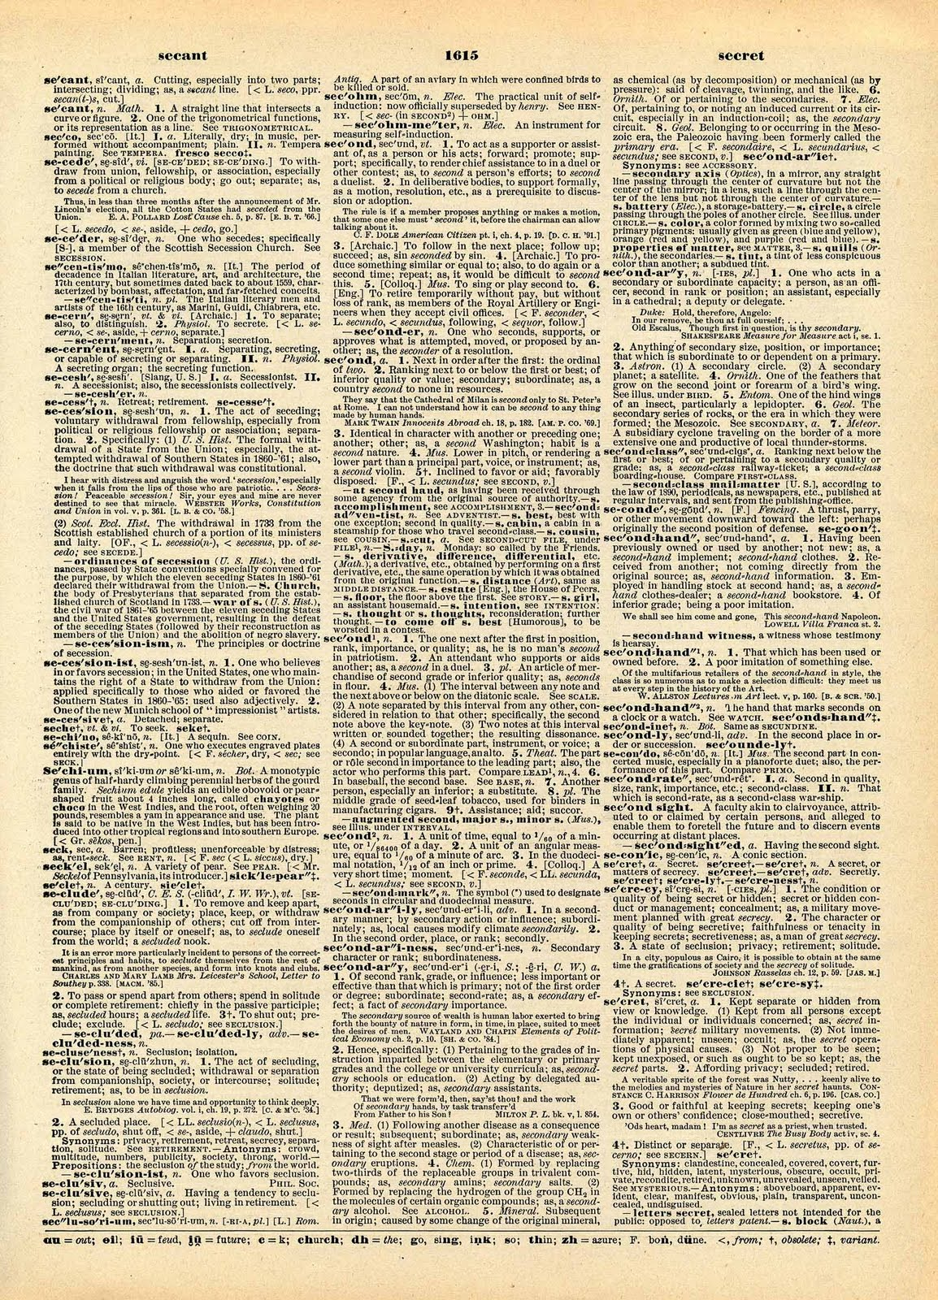
WHAT IS EVIDENCE-BASED MEDICINE?
Evidence-Based Medicine
Evidence-based medicine is the conscientious, explicit, and judicious use of current best evidence from clinical care research in the management of individual patients
Haynes, Sackett et al, 1996 Transferring evidence from research into practice
Sacket et al, 1996, BMJ EBM: what it is and isn’t
This Photo by Unknown Author is licensed under CC BY-NC-ND
Notes:
What is Evidence-based Medicine:
The definition of evidence-based medicine is the conscientious, explicit, and judicious use of current best evidence from clinical care research in the management of individual patients.
Evidence-Based Medicine combines:
Individual Clinical Experience
Best External Evidence, and
Patient Values and Expectations
All AAOS Clinical practice guidelines (CPG) provide evidence-based recommendations for current orthopaedic diagnostic, treatment, and postoperative procedures. Multidisciplinary clinician work groups and AAOS staff work together to synthesize published research with the aim of providing a transparent and robust summary of the research findings for a particular orthopaedic disease topic.

Slide 7
IOM STANDARDS FOR DEVELOPING TRUSTWORTHY GUIDELINES
Establish Transparency
Management of Conflict of Interest
Guideline Development Group Composition
Clinical Practice Guideline-Systematic Review Intersection
Establish Evidence of Foundations for and Rating Strength of Recommendations
Articulation of Recommendations
External Review
Updating
Notes:
IOM Standards
When treating patients, doctors and healthcare providers often are faced with difficult decisions. They are dependent on the scientific literature, in addition to their knowledge, experience, and patient preferences, to educate their decisions on how to treat. Clinical practice guidelines are statements that include recommendations intended to optimize patient care. Because of the expansive number of clinical practice guidelines available, users found it difficult to determine which guidelines were of high quality. Users needed a method to distinguish high caliber, trustworthy clinical practice guidelines to aide with their health-related decision making.
In 2008, U.S. Congress asked the Institute of Medicine (IOM) to undertake a study on the best methods used to develop clinical practice guidelines. Their efforts resulted in the development of eight standards for developing rigorous, trustworthy clinical practice guidelines. The AAOS uses these standards when developing their Clinical Practice Guidelines.

Slide 8
Clinical Practice Guideline
Process Flowchart
5. Final Meeting
WG meets in-person to:
Review quality appraisals and evidence tables
Assign grade/rating for each recommendation based on evidence
Develop final recommendations
Construct risk/harms statements
Define future research needs
1. Select CPG Topic
4. Literature Review and Appraisal
AAOS staff methodologists, in conjunction with work group (WG) members, review and appraise literature.
7. Approval Process
2. Assemble Work Group Members (WG)
8. Communication, Dissemination, and Implementation
3. WG formulates PICO questions, set inclusion criteria at Introductory Meeting
6. Review Periods
Peer Review and Public Comment review periods.
Notes:
First Steps to Constructing a CPG
Clinical Practice Guidelines (CPG) and Systematic Reviews (SR) are prepared by physician CPG or SR Development Groups (clinical experts) with the assistance of the AAOS Department of Clinical Quality and Value. The difference between a CPG and a SR is the size of the project. CPGs can ask anywhere from 10-30 PICO questions, resulting in 10-30 separate literature reviews, whereas a SR asks 4-7 questions. The smaller scope of the SR lends itself to a quicker turnaround and involves less staff resources and clinician volunteer time commitments.
The initial step in creating Clinical Practice Guidelines is the nomination of CPG or SR Topics. These topics are then voted upon, via an electronic survey, by the AAOS Evidence-Based Quality and Value Committee (EBQV) members, thus choosing which of the topics will ultimately move forward as a new guideline or systematic review.
When reviewing and appraising the literature, the workgroup may decide that the quality and quantity of the evidenced included lends itself more to a SR rather than a CPG, and decide to proceed with a SR instead. However, the workgroup does not have the option to choose to construct a systematic review for some recommendations and a clinical practice guidelines for other recommendations.

Slide 9
Formulating PICOs
“P” = Patient Population
“I” = Intervention or variable of Interest
“C” = Comparison
“O” = Outcome
Notes:
Formulating PICO Questions
The clinician work group commences their work on the Clinical Practice Guideline by constructing a set of PICO questions. These questions specify the patient population of interest (P), describing the most important characteristic of the patient such as age, disease or condition, and gender. Next is the intervention of interest (I), describe the main intervention, such as drug or other treatment, or diagnostic or screening test. The comparison (C), what is the main alternative being considered, such as placebo, standard therapy, no treatment, or the “gold” standard. And lastly, what is the outcome (O), what are you trying to accomplish, measure, improve or affect, such as reduce mortality, morbidity, improve memory. They function as questions for the systematic review, but not as final recommendations or conclusions.
These parameters provide clarity in defining inclusion criteria for the literature review and evaluating the evidence. Once established, these a priori PICO questions cannot be modified until the final guideline work group meeting.

Slide 10
Inclusion/Exclusion
Criteria
Standard inclusion criteria include:
Must study humans
Must be published in English
Must be published in or after 1966
Can not be performed on cadavers
Exclusion Criteria
Work group members define additional exclusion criteria based on PICO question
Notes:
Study Selection Criteria:
A priori article inclusion criteria is constructed for all CPGs and SRs. These criteria are our “rules of evidence” and articles that did not meet them are, for the purposes of this guideline, not evidence. The AAOS has standard inclusion criteria for guideline development and work group members further refine inclusion/exclusion criteria a priori at the introductory meeting.
To be included in a systematic review, all articles must be on the following:
Article must be a full article report of a clinical study
Studies must appear in peer-reviewed publication.
For studies that used “paper-and-pencil” outcome measures, only those that have been validated are included.
For any given follow-up time point in any included study, there must be patient ≥ 50% patient follow-up. If the follow-up is >50% but <80%, the quality will be downgraded by one level.
Must have >10 patients per group
Must study humans
Must be published in English
Must be published in or after 1966
All results must be quantitatively presented
Can not be an in vitro study
Can not be biomechanical study
Can not be performed on cadavers
Surrogate outcomes are evaluated only when no patient oriented outcomes are available.
The following type of articles are excluded from guideline review:
Retrospective non-comparative case series, medical record reviews, meeting abstracts, meta-analyses, systematic reviews, historical articles, editorials, letters, and commentaries
Confounded studies that give patients the treatment of interest and along with another treatment
Case studies that have non-consecutive enrollment of patients
Controlled trials where patients were not stochastically assigned to groups, difference in patient characteristics or outcomes at baseline, and authors did not statistically adjust for these differences when analyzing the results
All studies evaluated as “very low quality”, and
Composite measures or outcomes even if they are patient-orientated
Additional inclusion/exclusion criteria a priori as established by work group members at the introductory meeting include:
Study must be of an <Post-Op Surgical Site Infection> injury or prevention thereof
• Study must be published in or after <1966 > for surgical treatment, rehabilitation, bracing, prevention and MRI
• Study must be published in or after < 1966 > for x rays and non-operative treatment
• Study must be published in or after < 1966 > for all others non specified
• Study should have 10 or more patients per group (Work group may further define sample size)
• For surgical treatment a minimum of 3 months follow up duration.
• Antibiotic prophylaxis, anticoagulations, mode of anesthesia: all follow-ups
• For non-operative treatment a minimum of 1 month follow-up.

Slide 11
Literature Searches
Databases used:
PubMed
EMBASE (Excerpta Medica dataBASE)
CINAHL (Cumulative Index of Nursing and Allies Health Literature)
Cochrane Central Register of Controlled Trials
Search using key terms from work group’s PICO questions and inclusion criteria
Secondary manual search of the bibliographies of all retrieved publications for relevant citations
Recalled articles evaluated for inclusion based on the study selection criteria
Notes:
Literature Searches
The systematic review commences with a comprehensive search of the literature by the medical librarian. Articles considered are published in four electronic databases; PubMed, EMBASE (Excerpta Medica dataBASE), CINAHL (Cumulative Index of Nursing and Allies Health Literature), and The Cochrane Central Register of Controlled Trials. The search is conducted by using only the key terms which were previously established from the work group’s a priori inclusion criteria and PICO questions.
The search is then supplemented with a manual search of the bibliographies of all retrieved publications, recent systematic reviews, and other review articles for potentially relevant citations. Recalled articles were evaluated for possible inclusion based on the study selection criteria and were summarized for the work group who assisted with reconciling possible errors and omissions.

Slide 12
Best Evidence Synthesis
Include only highest quality evidence for any given outcome if available
If there are fewer than two occurrences of an outcome of this quality, the next lowest quality is considered until at least two occurrences have been acquired.
Notes:
Best Evidence Synthesis
When addressing a recommendation, only the best available evidence for any given outcome is included. If available, the highest quality evidence for any given outcome is included first. In the absence of two or more occurrences of an outcome of this quality, the next lowest quality of an outcome is considered until at least two or more occurrences of an outcome have been acquired.
For example, if there were two ‘moderate’ quality occurrences of an outcome that addressed a recommendation, the ‘low’ quality occurrences of this outcome would not be included. A summary of the evidence that met the inclusion criteria, but was not considered the best available evidence can be viewed by recommendation in Appendix XII of the guideline’s full text pdf.

Slide 13
STRENGTH OF RECOMMENDATIONS
STRENGTH | OVERALL STRENGTH OF EVIDENCE | STRENGTH VISUAL
STRONG | Two or more HIGH Strength Studies with consistent findings
MODERATE | 1 HIGH or 2 MODERATE strength studies with consistent findings
LIMITED | One or more LOW strength studies and/or only 1 MODERATE strength study with consistent findings or evidence from a single, or the evidence is insufficient, or conflicting
CONSENSUS | Expert opinion (no studies) No supporting evidence in the absence of reliable evidence. Work group is making a recommendation based on their clinical opinion
Notes:
Defining the Strength of the Recommendations
Judging the quality of evidence is only a stepping stone towards arriving at the strength of a CPG or SR recommendation. The strength of recommendation also takes into account the quality, quantity, and the trade-off between the benefits and harms of a treatment, the magnitude of a treatment’s effect, and whether data exists on critical outcomes.
Strength of recommendation communicates the level of confidence one can have in a recommendation. Thusly, the strength expresses how conceivable it is that a recommendation will be overturned by future evidence. It is extremely difficult for future evidence to overturn a recommendation that is based on many high caliber randomized controlled trails that demonstrate a large effect. It is more probable that future evidence will overturn recommendations derived from a few small retrospective comparative studies. Consequently, recommendations based on the former kind of evidence are given a “strong” strength of recommendation and recommendations based on the latter kind of evidence are assigned a “limited” strength.
When making guidelines, each article that meets the inclusion criteria is appraised for quality and applicability and will be downgraded if there are flaws related to bias, lack of controls, insufficient power, or one of the other domains. Studies are designated as high, moderate or low strength based on the result of the Appraise methodology. Guideline recommendations are then rated as Strong, Moderate, Limited or Consensus based on the supporting evidence as outlined in this table.
Please note that the work group is only permitted to make a consensus-based recommendation when there is no evidence to support the recommendation and when not establishing a recommendation could have catastrophic consequences.

Slide 14
TRANSLATING RECOMMENDATIONS IN A CPG
STRENGTH OF RECOMMENDATION | PATIENT COUNSELING TIME | DECISION AIDS | IMPACT OF FUTURE RESEARCH
Strong | Least | Least important, unless the evidence supports no difference between two alternative interventions | Not likely to change
Moderate | Less | Less important | Less likely to change
Limited | More | More | Possible / Anticipates
Consensus | Most | Most Important | Impact unknown
Notes:
Translating Recommendations in a Clinical Practice Guideline:
As demonstrated in the table, with stronger recommendations, physicians will need to spend less time counseling patients, as they do not need to weigh the pros and cons of proposed treatments. Evidence is strongly favoring one treatment over another. The effect of future research is not likely to change the proposed treatment option. As the recommendation strength declines, the more probable the physician will need to provide additional time discussing treatment alternatives, in addition to providing decision aids to help patients see the pros and cons of treatments, so they can use their own preferences/values to determine the best course of treatment. Future research is more likely to impact the use of these recommendations.

Slide 15
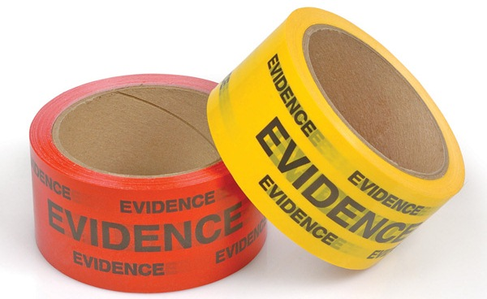
Assessing Quality of Evidence
All included studies undergo a quality assessment.
Each study’s design is evaluated for risk of bias and receives a final quality grade, depending on the number of study design flaws.
Study quality tables are made available to the work group in the final data report and the final publication of the guideline/SR
Notes:
In accessing the quality of evidence, it is necessary that all included studies undergo a quality assessment, each study’s design is then evaluated for risk of bias and receives a final quality grade, depending on the number of study design flaws, and study quality tables are made available to the work group in the final data report and the final publication of the guideline or systematic review.

Slide 16
Results of Quality Assessment:
Study Attrition Flowchart
10804 abstracts reviewed. Search performed on 3/13/17
8341 articles excluded from title and abstract review
2463 articles recalled for full text review
2233 articles excluded after full text review for not meeting the inclusion criteria or not best available evidence
230 articles included after full text review and quality analysis
Notes:
Study Attrition Flowchart
The study attrition diagram provides a detailed description of the number of identified abstracts and recalled and selected studies that were evaluated in the systematic review of the Management of Surgical Site Infections Clinical Practice Guideline. Of the initial 10804 abstracts, only 230 were included after the full-text review and quality analysis. The literature search strategies used to identify the abstracts are included in the eAppendix 1 section of the guideline’s full text pdf, and is available for review in AAOS’ OrthoGuidelines.

Slide 17
Voting on the Recommendations
Recommendations and recommendation strengths voted on by work group during final meeting
Approved and adopted by simple majority (60%) when voting on every recommendation
If disagreement, further discussion to whether the disagreement could be resolved
Notes:
Voting on the Recommendations
The recommendations and their strength were voted on by the work group members during the final meeting. If disagreement between the work group occurred, further discussion, and up to three rounds of voting were conducted by the work group to resolve the disagreement(s). If disagreements were not resolved following the voting rounds, no recommendation was adopted.

Slide 18
GUIDELINE LANGUAGE STEMS
GUIDELINE LANGUAGE STEMS | STRENGTH OF RECOMMENDATION
Strong evidence supports that the practitioner should/should not do X, because… | STRONG
Moderate evidence supports that the practitioner could/could not do X, because… | MODERATE
Limited evidence supports that the practitioner might/might not do X, because… | LIMITED
In the absence of reliable evidence, it is in the opinion of this guideline work group that… | CONSENSUS
Notes:
Wording of the Final Recommendations
To prevent bias in the way recommendations are worded, the AAOS utilizes specific predetermined language stems that are governed by the evidence strengths. Each recommendation is composed using language that accounts for the final strength of the recommendation. For example, wording for a Strong Recommendation would begin “Strong evidence supports that the practitioner should/should not do X, because…”, while a recommendation labeled as Consensus would begin as “In the absence of reliable evidence, it is in the opinion of this guideline work group that…”

Slide 19
Peer Review
Guideline draft sent for peer review to external experts.
Comments and draft of responses reviewed by work group members
Recommendation changes required a majority vote by work group
A detailed report of all resulting revisions is published with the guideline document
Notes:
Peer Review
Following the final meeting, the guideline draft then undergoes a peer review, seeking additional input from external experts. All peer reviewers were required to disclose any conflicts of interest. To guide which groups participated, the work group identified all specialty societies at the introductory meeting. Organizations, not individuals, were specified.
The peer review stage provided external stakeholders an opportunity to provide evidence-based direction for modifications that they believed were overlooked. Since the draft was subject to revisions until its approval by the AAOS Board of Directors, confidentiality of all working drafts was essential.
To commence this review, approximately six weeks prior the final meeting, specialty societies were solicited to nominate individual peer reviewers. The peer review period was announced and other interested parties were able to volunteer to also review the draft.
Initial responses to comments that addressed methodology were then drafted by the manager of Department Clinical Quality and Value (CQV) unit. These responses were then reviewed by the work group chair and vice-chair, who responded to all questions concerning clinical practice and techniques, with the CQV director also providing input. All comments were received and initial drafts of the responses were then reviewed by all work group members. All changes to a recommendation as a result of peer review were based on the evidence and underwent a majority vote by the work group members via teleconference. Final revisions were summarized in a detailed report and were made part of the guideline document. Following final guideline approval, all individual responses were posted on the AAOS website with a point-by-point response to each non-editorial comment.

Slide 20
PUBLIC COMMENT
Following peer review modifications, CPG undergoes public commentary period
Comments are solicited from:
AAOS Board of Directors
AAOS Council on Research and Quality
AAOS Committee on Evidence-Based Quality and Value
AAOS Board of Councilors
AAOS Board of Specialty Societies
200 commentators have the opportunity to provide input
Notes:
Public Commentary
After modifying the draft in response to peer review, the Clinical Practice Guideline was subjected to a two-week period of “Public Commentary.” Comments were solicited from members of the AAOS Board of Directors, the AAOS Council on Research and Quality, AAOS Committee on Evidence-Based Quality and Value, the AAOS Board of Councilors, and the AAOS Board of Specialty Societies. Based on these bodies, over 200 commentators had the opportunity to provide input on this new Clinical Practice Guideline.

Slide 21
FINAL MEETING
The work group is charged with:
Review of data summaries
Final recommendation language
Rationale and risk/harm construction
Future research
Notes:
Prior to the Meeting:
AAOS staff conducts several webinars with the work group to reiterate their charges and ensure that all relevant literature has been included.
Using the PEER tool, work group members are responsible for reviewing the included and excluded literature for their assigned PICO questions.
Work group members draft recommendation and rationale for their assigned recommendations to catalyze the final meeting discussion.
During the Final Meeting:
Each member presents the data findings and their draft recommendations and rationales for their assigned recommendations.
The work group discusses data findings and composes the final recommendations and rationales, as needed. The strength of evidence will determine the AAOS predefined language stem that is used for the recommendation.
All edits to recommendations, rationales, benefits and harms sections, and future research sections should be completed by the end of the meeting.

Slide 22
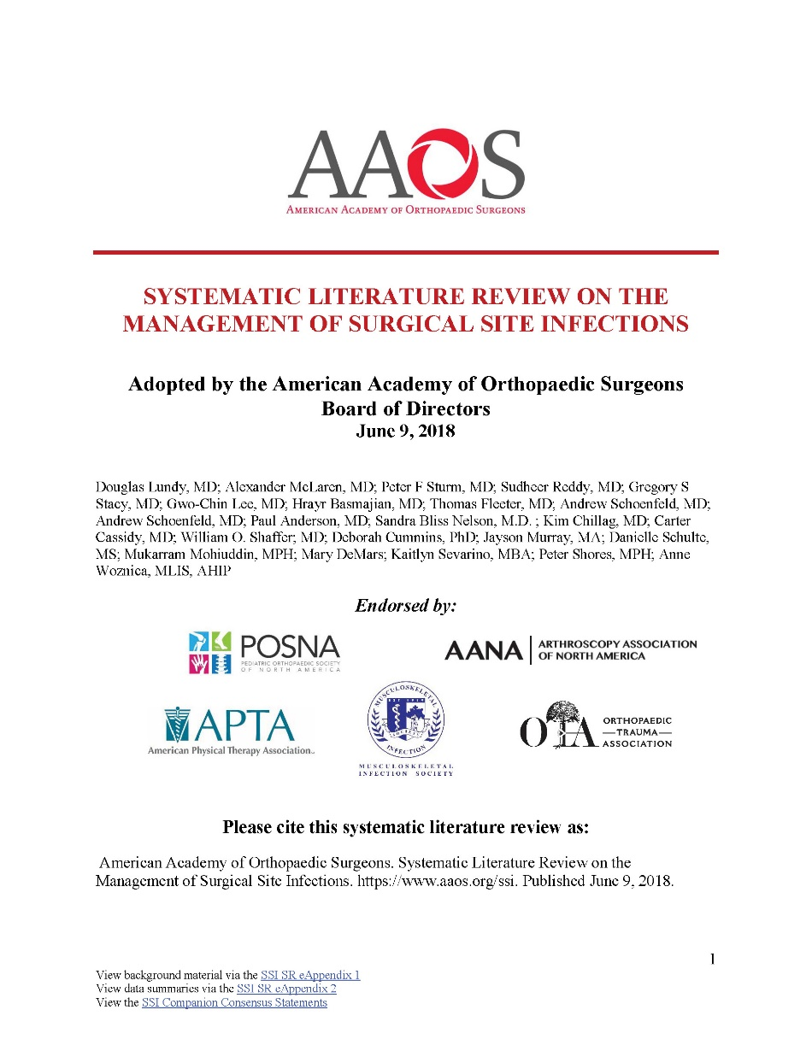
Management of Surgical Site Infections Systematic Literature Review Overview
Based on a systematic review of published studies
Addresses the management of surgical site infections occurring in patients who have undergone orthopaedic surgery
Highlights limitations in literature and areas requiring future research
Trained physicians and surgeons are intended users
Notes:
Overview
Surgical site infections occur following a small percentage of surgical procedures. Approximately 1% of patients undergoing orthopaedic procedures will develop an infection at the surgical site. For this systematic review, the Centers for Disease Control and Prevention (CDC) definitions of superficial, deep and organ space surgical site infection were used. In 2011, the CDC estimated that there were 157,500 surgical site infections from all inpatient surgeries performed in the United States.
Surgical site infections are the result of disease-causing bacteria or fungi which enter the body through a surgical wound. Since the definition of “surgical site infection” can be interpreted differently, the AAOS used the standard definition from the Centers for Disease Control described in the previous paragraph. The CDC describes a surgical site infection as “… an infection that occurs after surgery in the part of the body where the surgery took place. Surgical site infections can sometimes be superficial infections involving the skin only. Other surgical site infections are more serious and can involve tissues under the skin, organs, or implanted material.”
During the time when the reviewed studies were being performed the definition of a SSI change from infections occurring during the 12 months following the procedure to infections that occurred within 3 months of the procedure.
This does not represent a change in fundamental condition that was studied or lead to a change in the conclusions drawn from the data; more that the small proportion of cases that occur after the first 3 months does not meaningfully change the analysis but is associated with onerous logistics and an unjustified expense. The findings were not stratified reports that include or do not include cases from 3 -12 months post op.
Most treatments for a surgical site infection are associated with some known risks, especially invasive and operative treatments. Contraindications vary widely based on the treatment for an SSI and the patient. A particular concern when managing surgical site infections is the potential for the underlying orthopaedic treatment to be compromised resulting in increased morbidity or decreased function compared to initial expectations. Additional factors may affect the physician’s choice of treatment, including co-morbidities such as low bone mass or arthropathy in other joints. Provider judgement based on clinical experience increases the probability of identifying the treatment options for each individual patient that have the most favorable risk/benefit expectation.

Slide 23
Use of Imaging
Limited evidence supports the use of medical imaging in the diagnostic evaluation of patients with a suspected organ/space (i.e. bone, joint, and implant) surgical site infection.
Strength of Recommendation: Limited
Notes:
Rationale
Radiography There was one moderate quality study (Bernard 2004) evaluating the use of radiography for patients with suspected hip and knee prosthesis infection. This study showed poor agreement of radiography with the confirmed infections as both a “rule in” test and a “rule out” test. However Radiography is widely available and inexpensive relative to other imaging modalities, and the consensus of the workgroup is that radiographs be considered as the initial imaging exam for suspected cases of bone and/or implant infection interpreted in combination by a provider with skill and experience in interpretation of musculoskeletal radiographs to assess any and all radiographic features of infection, or other causes of the patient’s symptoms, without commenting on or recommending any single finding or combination of findings. Radiolabeled Leukocyte Imaging There were five high quality (Scher 2000, Simonsen 2007, Rand 1990, Pelosi 2004, Joseph 2001) and 10 moderate quality (Pons 1999, Glithero 1993, Kim 2014, Love 2004, Segura 2004, Chik 1996, El Espera 2004, Bernard 2004, Fuster 2011, Wolf 2003) studies evaluating the use of radiolabeled leukocyte imaging (with Indium-111 or Tc-99m hexamethylpropyleneamine oxine) for patients with suspected surgical site infections, predominantly patients with suspected hip and knee prosthesis infection. The duration of time between the initial surgery and the performance of the scan was either unclear or greater than 1 year, on average, for most of these studies. These studies showed inconsistent agreement of radiolabeled leukocyte imaging with the confirmed infections as “rule in” and “rule out” tests. For example, two high quality studies (Scher 2000, Simonsen 2007) showed moderate-strong agreement of radiolabeled leukocyte imaging with the reference standard as a “rule in” test, and weak-moderate agreement as a “rule out” test, for patients with suspected infected hip prostheses. By contrast, two high quality studies (Rand 1990, Scher 2000) showed only weak-moderate agreement of radiolabeled leukocyte imaging with the confirmed infections as a “rule in” test for patients with suspected infected knee prostheses. Stronger agreement with the reference test might be possible in combination with single photon emission computed tomography (Kim 2014) or Tc-99m sulfur colloid bone marrow scintigraphy (Love 2004). The consensus of the workgroup is that radiolabeled leukocyte imaging can be useful as a diagnostic tool (i.e., among other tests) as a “rule in” or “rule out” test for prosthetic joint infection, but its routine use for diagnosis of such infection is not justified, as there may be difficulties diagnosing insidious infections or differentiating infection from aseptic loosening. When radiolabeled leukocyte imaging is performed, the addition of bone marrow scintigraphy can help increase specificity. Tc-99m-Diphosphonate Skeletal Scintigraphy (“Bone Scan”) There were three moderate quality studies (Nagoya 2008, Battaglia 2011 and Segura 2004) evaluating the use of skeletal scintigraphy for patients with suspected hip and knee prosthesis infection occurring, on average, greater than one year following surgery. Although one study (Segura 2004) showed strong agreement of two-phase (blood pool and delayed imaging) skeletal scintigraphy with the confirmed infections as a “rule out” test, other studies showed moderate (Nagoya 2008, 3-phase scintigraphy) or weak (Battaglia 2011, unknown number of phases) agreement. Two of the studies (Battaglia 2011, Segura 2004) showed poor agreement of skeletal scintigraphy with the confirmed infections as a “rule in” test, while Nagoya 2008 showed moderate agreement of (3-phase scintigraphy) as a “rule in” test. Skeletal scintigraphy can be useful as a diagnostic tool (i.e., among other tests) as a “rule out” test for delayed (>1 year) prosthetic joint infection if radiolabeled leukocyte imaging is not available, but its role in the diagnosis of such infection is limited. Positron Emission Tomography (PET) Imaging There were four high quality (Chacko 2002, Chryssikos 2008, Aksoy 2014, DeWinter 2003) and 3 moderate quality (Kobayashi 2011, Love 2004, Wenter 2015, 2017) studies evaluating the use of F-18 fluorodeoxyglucose (FDG) PET imaging for patients with suspected surgical site infections, with most patients having suspected infection of orthopaedic implants including joint prostheses. The duration of time between the initial surgery and the performance of the scan was either unclear or greater than one year, on average, for most of these studies. These studies showed inconsistent agreement of PET imaging with the confirmed infections as a “rule in” test. For example, two high quality studies (Chacko 2002, Chryssikos 2008) showed strong agreement of FDG-PET imaging with the confirmed infections as a “rule in” test for prosthetic hip joint infection when uptake at the prosthesis-bone interface was used as the criterion for infection. However, another high-quality study (Aksoy 2014) showed that 39/39 hip and knee prostheses with aseptic loosening also showed increased FDG uptake, resulting in poor agreement with the confirmed infections as a “rule in” test for infection. A couple of high quality studies (Chacko 2002, DeWinter 2003) suggest that FDG-PET imaging may be useful as a “rule out” test, showing strong agreement with the confirmed infections; however, other studies show inconsistent results. Better agreement with the reference test might be possible in combination with computed tomography (Wenter 2015). The presence of metallic implants may also affect the diagnostic ability of FDG PET; one high quality study (DeWinter 2003) evaluating the use of FDG PET imaging for patients with suspected surgical site infections of the spine showed weak agreement of PET with the confirmed infections as a “rule in” test when metallic implants were present, but strong agreement as a “rule in” test when implants were not present. Although FDG-PET can be useful as a diagnostic tool (i.e., among other tests) as a “rule in” or “rule out” test for infection, its availability, expense, and current issues with reimbursement are limiting factors, and its routine use is not justified in this setting. Cross-Sectional Imaging (Magnetic Resonance Imaging, Computed Tomography, Ultrasonography) There is a lack of data regarding the use of cross-sectional imaging for the diagnosis of orthopaedic surgical site infection. Two moderate quality studies (Li 2016, Plodkowski 2013) evaluating the use of magnetic resonance imaging (MRI) for patients with suspected knee prosthesis infection showed moderate-strong agreement of MRI with the confirmed infections as a “rule in” test, but poor-moderate agreement as a “rule out” test. However, artifacts caused by metallic implants can be significant and limit detection of adjacent bone and soft tissue infection on MRI as well as on computed tomography (CT). Cross-sectional imaging can potentially be useful as a diagnostic tool in certain patients with suspected surgical site infection (e.g., to identify soft-tissue fluid collections) or to guide aspiration/biopsy procedures in such patients, but the potential value of a given imaging exam should be considered on a case-by-case basis.
Chacko,T.K., Zhuang,H., Stevenson,K., Moussavian,B., Alavi,A. The importance of the location of fluorodeoxyglucose uptake in periprosthetic infection in painful hip prostheses. Nucl.Med Commun. 2002/9; 9: 851-855
Chik,K.K., Magee,M.A., Bruce,W.J., Higgs,R.J., Thomas,M.G., Allman,K.C., van der Wall,H. Tc-99m stannous colloid-labeled leukocyte scintigraphy in the evaluation of the painful arthroplasty. Clin Nucl.Med 1996/11; 11: 838-843
Chryssikos,T., Parvizi,J., Ghanem,E., Newberg,A., Zhuang,H., Alavi,A. FDG-PET imaging can diagnose periprosthetic infection of the hip. Clin Orthop Relat Res 2008/6; 6: 1338-1342
De,Winter F., Gemmel,F., Van de Wiele,C., Poffijn,B., Uyttendaele,D., Dierckx,R. 18-Fluorine fluorodeoxyglucose positron emission tomography for the diagnosis of infection in the postoperative spine. Spine (Phila Pa 1976) 2003/6/15; 12: 1314-1319
El Espera,I, Blondet,C., Moullart,V., Saidi,L., Havet,E., Mertl,P., Canarelli,B., Schmit,J.L., Meyer,M.E. The usefulness of 99mTc sulfur colloid bone marrow scintigraphy combined with 111In leucocyte scintigraphy in prosthetic joint infection. Nucl.Med Commun. 2004/2; 2: 171-175
Fuster,D., Soriano,A., Garcia,S., Piera,C., Suades,J., Rodriguez,D., Martinez,J.C., Mensa,J., Campos,F., Pons,F. Usefulness of 99mTc-ciprofloxacin scintigraphy in the diagnosis of prosthetic joint infections. Nucl.Med Commun. 2011/1; 1: 44-51
Glithero,P.R., Grigoris,P., Harding,L.K., Hesslewood,S.R., McMinn,D.J. White cell scans and infected joint replacements. Failure to detect chronic infection. J Bone Joint Surg Br 1993/5; 3: 371-374
Joseph,T.N., Mujtaba,M., Chen,A.L., Maurer,S.L., Zuckerman,J.D., Maldjian,C., Di Cesare,P.E. Efficacy of combined technetium-99m sulfur colloid/indium-111 leukocyte scans to detect infected total hip and knee arthroplasties. J Arthroplasty 2001/9; 6: 753-758
Kim,H.O., Na,S.J., Oh,S.J., Jung,B.S., Lee,S.H., Chang,J.S., Bin,S.I., Ryu,J.S. Usefulness of adding SPECT/CT to 99mTc-hexamethylpropylene amine oxime (HMPAO)-labeled leukocyte imaging for diagnosing prosthetic joint infections. J Comput Assist Tomogr. 2014/3; 2: 313-319
Kobayashi,N., Inaba,Y., Choe,H., Ike,H., Fujimaki,H., Tezuka,T., Hirata,Y., Tateishi,U., Inoue,T., Saito,T. Use of F-18 fluoride PET to differentiate septic from aseptic loosening in total hip arthroplasty patients. Clin Nucl.Med 2011/11; 11: e156-e161
Li,A.E., Sneag,D.B., Greditzer,H.G., Johnson,C.C., Miller,T.T., Potter,H.G. Total Knee Arthroplasty: Diagnostic Accuracy of Patterns of Synovitis at MR Imaging. 2016/11; 2: 499-506
Love,C., Marwin,S.E., Tomas,M.B., Krauss,E.S., Tronco,G.G., Bhargava,K.K., Nichols,K.J., Palestro,C.J. Diagnosing infection in the failed joint replacement: a comparison of coincidence detection 18F-FDG and 111In-labeled leukocyte/99mTc-sulfur colloid marrow imaging. J Nucl.Med 2004/11; 11: 1864-1871
Nagoya,S., Kaya,M., Sasaki,M., Tateda,K., Yamashita,T. Diagnosis of peri-prosthetic infection at the hip using triple-phase bone scintigraphy. J Bone Joint Surg Br 2008/2; 2: 140-144
Pelosi,E., Baiocco,C., Pennone,M., Migliaretti,G., Varetto,T., Maiello,A., Bello,M., Bisi,G. 99mTc-HMPAO-leukocyte scintigraphy in patients with symptomatic total hip or knee arthroplasty: improved diagnostic accuracy by means of semiquantitative evaluation. J Nucl.Med 2004/3; 3: 438-444
Plodkowski,A.J., Hayter,C.L., Miller,T.T., Nguyen,J.T., Potter,H.G. Lamellated hyperintense synovitis: potential MR imaging sign of an infected knee arthroplasty. 2013/1; 1: 256-260
Pons,M., Angles,F., Sanchez,C., Matamala,A., Cuchi,E., Salavert,M., Forcada,P., Ferrer,H. Infected total hip arthroplasty--the value of intraoperative histology. Int Orthop 1999; 1: 34-36
Aksoy,S.Y., Asa,S., Ozhan,M., Ocak,M., Sager,M.S., Erkan,M.E., Halac,M., Kabasakal,L., Sonmezoglu,K., Kanmaz,B. FDG and FDG-labelled leucocyte PET/CT in the imaging of prosthetic joint infection. Eur J Nucl.Med Mol Imaging 2014/3; 3: 556-564
Battaglia,M., Vannini,F., Guaraldi,F., Rossi,G., Biondi,F., Sudanese,A. Validity of preoperative ultrasound-guided aspiration in the revision of hip prosthesis. Ultrasound Med Biol 2011/12; 12: 1977-1983
Bernard,L., Lubbeke,A., Stern,R., Bru,J.P., Feron,J.M., Peyramond,D., Denormandie,P., Arvieux,C., Chirouze,C., Perronne,C., Hoffmeyer,P. Value of preoperative investigations in diagnosing prosthetic joint infection: retrospective cohort study and literature review. Scand.J Infect.Dis 2004; 6: 410-416
Rand,J.A., Brown,M.L. The value of indium 111 leukocyte scanning in the evaluation of painful or infected total knee arthroplasties. Clin Orthop Relat Res 1990/10; 259: 179-182
Scher,D.M., Pak,K., Lonner,J.H., Finkel,J.E., Zuckerman,J.D., Di Cesare,P.E. The predictive value of indium-111 leukocyte scans in the diagnosis of infected total hip, knee, or resection arthroplasties. J Arthroplasty 2000/4; 3: 295-300
Segura,A.B., Munoz,A., Brulles,Y.R., Hernandez Hermoso,J.A., Diaz,M.C., Bajen Lazaro,M.T., Martin-Comin,J. What is the role of bone scintigraphy in the diagnosis of infected joint prostheses?. Nucl.Med Commun. 2004/5; 5: 527-532
Simonsen,L., Buhl,A., Oersnes,T., Duus,B. White blood cell scintigraphy for differentiation of infection and aseptic loosening: a retrospective study of 76 painful hip prostheses. Acta Orthop 2007/10; 5: 640-647
Wenter,V., Albert,N.L., Brendel,M., Fendler,W.P., Cyran,C.C., Bartenstein,P., Friederichs,J., Muller,J.P., Militz,M., Hacker,M., Hungerer,S. [18F]FDG PET accurately differentiates infected and non-infected non-unions after fracture fixation. Eur.J.Nucl.Med.Mol.Imaging 2017/3; 3: 432-440
Wenter,V., Muller,J.P., Albert,N.L., Lehner,S., Fendler,W.P., Bartenstein,P., Cyran,C.C., Friederichs,J., Militz,M., Hacker,M., Hungerer,S. The diagnostic value of [F]FDG PET for the detection of chronic osteomyelitis and implant-associated infection. Eur J Nucl.Med Mol Imaging 2015/11/7; 0: -
Wolf,G., Aigner,R.M., Schwarz,T., Lorbach,M.P. Localization and diagnosis of septic endoprosthesis infection by using 99mTc-HMPAO labelled leucocytes. Nucl.Med Commun. 2003/1; 1: 23-28

Slide 24
Cultures
Strong evidence supports that synovial fluid and tissue cultures are strong rule-in tests for the diagnosis of infection; negative synovial fluid and tissue cultures do not reliably exclude infection.
Strength of Recommendation: Strong
Notes:
Rationale
RATIONALE Ten high quality studies were identified that addressed the role of culture in the diagnosis of surgical site infection; notably only two of the studies (Holinka, Puig-Verdie) included patients with infections involving orthopaedic sites other than hip or knee arthroplasties. SYNOVIAL FLUID CULTURES Three high quality studies (Gallo, Tomas, Spangehl) evaluated the yield of synovial fluid cultures in the diagnosis of prosthetic joint infection. Two of the studies found strong evidence to support fluid culture in the diagnosis of PJI (Tomas, Spangehl) while one found moderate evidence in support (Gallo). INTRAOPERATIVE TISSUE CULTURES Seven high quality studies evaluated the yield of intra-operative tissue cultures in the diagnosis of surgical site infection (Aggarwal, Holinka, Hughes, Panousis, Puig-Verdie, Spangehl, Trampuz). Of these, six of the seven studies revealed strong evidence in support of tissue culture to rule in the diagnosis of infection; one found the evidence to be moderate (Holinka). Additionally, the method by which the organism was grown was relevant. In these seven studies, there was variability in the performance of tissue culture in excluding infection. One high quality study evaluated the value of positive culture only from enrichment broth (Smith). Broth-only positive cultures showed poor correlation as a rule-in or rule-out test for infection. Two high-quality studies evaluated the performance of tissue cultures compared with swab cultures (Aggarwal, Spangehl). Both demonstrated better accuracy of tissue cultures over swab cultures. NUMBER OF INTRAOPERATIVE CULTURES Multiple tissue cultures should be collected to improve the accuracy of infection diagnosis. One moderate quality study (Atkins) quantified the number of samples needed to confirm the diagnosis of infection. A single positive culture for an organism of limited virulence was shown to have poor predictive value as a rule-in test. Two distinct positive cultures for the same organism provided strong evidence of periprosthetic infection. DURATION OF CULTURE INCUBATION One high quality (Schafer) and one moderate quality (Butler-Wu) study reviewed the duration of culture incubation for chronic periprosthetic infection. Both studies demonstrated improved yield when both aerobic and anaerobic cultures were incubated for 14 days. PRIOR ANTIBIOTIC EXPOSURE One high quality study evaluated the effect of prior antibiotic therapy on the yield of sonicate and tissue culture. The yield of culture was reduced when antibiotic therapy was administered within 14 days of culture collection.
Aggarwal,V.K., Higuera,C., Deirmengian,G., Parvizi,J., Austin,M.S. Swab cultures are not as effective as tissue cultures for diagnosis of periprosthetic joint infection. Clin Orthop Relat Res 2013/10; 10: 3196-3203
Atkins,B.L., Athanasou,N., Deeks,J.J., Crook,D.W., Simpson,H., Peto,T.E., McLardy-Smith,P., Berendt,A.R. Prospective evaluation of criteria for microbiological diagnosis of prosthetic-joint infection at revision arthroplasty. The OSIRIS Collaborative Study Group. J Clin Microbiol. 1998/10; 10: 2932-2939
Butler-Wu,S.M., Burns,E.M., Pottinger,P.S., Magaret,A.S., Rakeman,J.L., Matsen,F.A.,III, Cookson,B.T. Optimization of periprosthetic culture for diagnosis of Propionibacterium acnes prosthetic joint infection. J Clin Microbiol. 2011/7; 7: 2490-2495
Gallo,J., Kolar,M., Dendis,M., Loveckova,Y., Sauer,P., Zapletalova,J., Koukalova,D. Culture and PCR analysis of joint fluid in the diagnosis of prosthetic joint infection. New Microbiol. 2008/1; 1: 97-104
Holinka,J., Bauer,L., Hirschl,A.M., Graninger,W., Windhager,R., Presterl,E. Sonication cultures of explanted components as an add-on test to routinely conducted microbiological diagnostics improve pathogen detection. J Orthop Res 2011/4; 4: 617-622
Hughes,H.C., Newnham,R., Athanasou,N., Atkins,B.L., Bejon,P., Bowler,I.C. Microbiological diagnosis of prosthetic joint infections: a prospective evaluation of four bacterial culture media in the routine laboratory. Clin Microbiol.Infect. 2011/10; 10: 1528-1530
Puig-Verdie,L., Alentorn-Geli,E., Gonzalez-Cuevas,A., Sorli,L., Salvado,M., Alier,A., Pelfort,X., Portillo,M.E., Horcajada,J.P. Implant sonication increases the diagnostic accuracy of infection in patients with delayed, but not early, orthopaedic implant failure. Bone Joint J 2013/2; 2: 244-249
Schafer,P., Fink,B., Sandow,D., Margull,A., Berger,I., Frommelt,L. Prolonged bacterial culture to identify late periprosthetic joint infection: a promising strategy. Clin Infect.Dis 2008/12/1; 11: 1403-1409
Spangehl,M.J., Masri,B.A., O'Connell,J.X., Duncan,C.P. Prospective analysis of preoperative and intraoperative investigations for the diagnosis of infection at the sites of two hundred and two revision total hip arthroplasties. J Bone Joint Surg Am 1999/5; 5: 672-683
Tomas,X., Bori,G., Garcia,S., Garcia-Diez,A.I., Pomes,J., Soriano,A., Rios,J., Almela,M., Mensa,J., Gallart,X., Martinez,J.C., Riba,J. Accuracy of CT-guided joint aspiration in patients with suspected infection status post-total hip arthroplasty. Skeletal Radiol 2011/1; 1: 57-64
Trampuz,A., Piper,K.E., Hanssen,A.D., Osmon,D.R., Cockerill,F.R., Steckelberg,J.M., Patel,R. Sonication of explanted prosthetic components in bags for diagnosis of prosthetic joint infection is associated with risk of contamination. J Clin Microbiol. 2006/2; 2: 628-631
Smith,E.B., Cai,J., Wynne,R., Maltenfort,M., Good,R.P. Performance characteristics of broth-only cultures after revision total joint arthroplasty. Clin Orthop Relat Res 2014/11; 11: 3285-3290
Panousis,K., Grigoris,P., Butcher,I., Rana,B., Reilly,J.H., Hamblen,D.L. Poor predictive value of broad-range PCR for the detection of arthroplasty infection in 92 cases. Acta Orthop 2005/6; 3: 341-346

Slide 25
C-Reactive Protein
Strong evidence supports that C-reactive Protein is a strong rule-in and rule-out marker for patients with suspected surgical site infections
Strength of Recommendation: Strong
Notes:
Rationale
Multiple high-quality studies and meta-analysis of the study data support the use of C-reactive protein in the diagnosis of surgical site infection (Bottner et al 2007, Glehr et al 2013, Cipriano et al 2012, Jacovides et al 2011). Several moderate quality studies (Yi et al 2015, Piper et al 2009, 2010, Bedair et al 2011) also support its use. It was found to be both sensitive and specific in detecting periprosthetic infection and served as an accurate screening tool, with a positive or negative value demonstrating the likelihood of the presence or absence of infection. Studies vary with respect to the timing and thresholds used to diagnose infection. Both Yi et al 2015 and Bedair et al 2011 confirmed its utility during the early postoperative period. Despite this variation, it has proven its accuracy across investigations. While cutoff values at which an infection is diagnosed vary between studies, and based on time postoperatively it has been shown to be a superior screening test relative to other serological studies.
Bedair,H., Ting,N., Jacovides,C., Saxena,A., Moric,M., Parvizi,J., Della Valle,C.J. The Mark Coventry Award: diagnosis of early postoperative TKA infection using synovial fluid analysis. Clin Orthop Relat Res 2011/1; 1: 34-40
Bottner,F., Wegner,A., Winkelmann,W., Becker,K., Erren,M., Gotze,C. Interleukin-6, procalcitonin and TNF-alpha: markers of peri-prosthetic infection following total joint replacement. J Bone Joint Surg Br 2007/1; 1: 94-99
Cipriano,C.A., Brown,N.M., Michael,A.M., Moric,M., Sporer,S.M., Della Valle,C.J. Serum and synovial fluid analysis for diagnosing chronic periprosthetic infection in patients with inflammatory arthritis. J Bone Joint Surg Am 2012/4/4; 7: 594-600
Glehr,M., Friesenbichler,J., Hofmann,G., Bernhardt,G.A., Zacherl,M., Avian,A., Windhager,R., Leithner,A. Novel biomarkers to detect infection in revision hip and knee arthroplasties. Clin Orthop Relat Res 2013/8; 8: 2621-2628
Jacovides,C.L., Parvizi,J., Adeli,B., Jung,K.A. Molecular markers for diagnosis of periprosthetic joint infection. J Arthroplasty 2011/9; 6: 99-103
Piper,K.E., Jacobson,M.J., Cofield,R.H., Sperling,J.W., Sanchez-Sotelo,J., Osmon,D.R., McDowell,A., Patrick,S., Steckelberg,J.M., Mandrekar,J.N., Fernandez,Sampedro M., Patel,R. Microbiologic diagnosis of prosthetic shoulder infection by use of implant sonication. J Clin Microbiol. 2009/6; 6: 1878-1884
Yi,P.H., Cross,M.B., Moric,M., Levine,B.R., Sporer,S.M., Paprosky,W.G., Jacobs,J.J., Della Valle,C.J. Do serologic and synovial tests help diagnose infection in revision hip arthroplasty with metal-on-metal bearings or corrosion?. Clin Orthop Relat Res 2015/2; 2: 498-505

Slide 26
Erythrocyte Sedimentation Rate
Limited strength evidence does not support the use of ESR, alone, to rule in and rule out surgical site infections due to conflicting data
Strength of Recommendation: Limited
Notes:
Rationale
Multiple high-quality studies (Bottner et al 2007, Cipriano et al 2012, Panousis et al 2005) have demonstrated moderate to weak ability of ESR as a solitary test to diagnose or exclude surgical site infection. It is felt to be too variable with respect to time from surgery and in the presence of other confounding factors (such as inflammatory arthropathy) to be considered an accurate tool in diagnosis alone but may be considered as a tool to be used in conjunction with other tests.
Bottner,F., Wegner,A., Winkelmann,W., Becker,K., Erren,M., Gotze,C. Interleukin-6, procalcitonin and TNF-alpha: markers of peri-prosthetic infection following total joint replacement. J Bone Joint Surg Br 2007/1; 1: 94-99
Cipriano,C.A., Brown,N.M., Michael,A.M., Moric,M., Sporer,S.M., Della Valle,C.J. Serum and synovial fluid analysis for diagnosing chronic periprosthetic infection in patients with inflammatory arthritis. J Bone Joint Surg Am 2012/4/4; 7: 594-600
Panousis,K., Grigoris,P., Butcher,I., Rana,B., Reilly,J.H., Hamblen,D.L. Poor predictive value of broad-range PCR for the detection of arthroplasty infection in 92 cases. Acta Orthop 2005/6; 3: 341-346

Slide 27
Clinical Exam for Diagnosis of Surgical Site Infections
Moderate strength evidence supports that clinical exam (i.e. pain, drainage, fever) is a moderate to strong rule-in test (i.e. high probability of presence of infection, if test is positive) for patients with suspected surgical site infections, but a weak rule-out test
Strength of Recommendation: Moderate
Notes:
Rationale
Patients with suspected surgical site infections should be assessed by a history and physical examination. Specific data were available for a structured history, presence of fever, and persistent wound drainage. One study of moderate evidence by Pons 1999 used a structured interview to evaluate 80 patients undergoing revision total hip arthroplasty of whom 16 patients had proven infection by histology and microbiology culture. A positive clinical examination was the presence of one of the following: current painful joint, history of chronic joint pain; or a history of wound drainage or fever lasting greater than 48 hours in the first month after primary surgery. A positive history had a sensitivity of 0.625 and specificity of 0.98. One moderate strength study by Bernard 2004 evaluated the presence of fever and persistent drainage against the confirmed infections of positive culture in 230 patients undergoing revision joint surgery. Fever had a sensitivity of 0.53 and specificity of 0.90, and persistent drainage had a sensitivity of 0.53 and specificity of 0.90.
Bernard,L., Lubbeke,A., Stern,R., Bru,J.P., Feron,J.M., Peyramond,D., Denormandie,P., Arvieux,C., Chirouze,C., Perronne,C., Hoffmeyer,P. Value of preoperative investigations in diagnosing prosthetic joint infection: retrospective cohort study and literature review. Scand.J Infect.Dis 2004; 6: 410-416
Pons,M., Angles,F., Sanchez,C., Matamala,A., Cuchi,E., Salavert,M., Forcada,P., Ferrer,H. Infected total hip arthroplasty--the value of intraoperative histology. Int Orthop 1999; 1: 34-36

Slide 28
Strong Evidence of Factors Associated with Increased Risk of SSI
Strong evidence supports that the following factors are associated with an increased risk of infection:
Anemia
Duration of Hospital Stay
Immunosuppressive Medications
History of Alcohol Abuse
Obesity
Depression
History of Congestive Heart Failure
Dementia
HIV/AIDS
Strength of Recommendation: Strong
Notes:
Rationale
Anemia There were eight high quality studies on the association of Anemia with the risk of SSI. Of these, five revealed an association between anemia and SSI. Four studies reviewed the risk of PJI and the 5th study reviewed the risk of infection and cervical spine fusion. Determinations were based on regression analyses of large data bases. Greenky et al 2012 identified the significant risk of anemia in PJI of development of SSI. Duration of Hospital Stay There were 11 high quality studies that examined the association between the length of hospital stay and the risk of SSI. Of these, seven revealed an association between increased length of stay and the risk of SSI. The studies were a range of multi-variant analysis and regression analysis. Three studies revealed that prolonged preoperative inpatient stays were related to increased risk of infection. Four studies revealed that prolonged post op hospitalization correlated with an increased risk of SSI. Longer hospital stays, including both pre-op and post-op stays correlated with increasing risk of SSI development. Immunosuppressive Medication Ten high quality studies were reviewed that looked at the effects of immunosuppressive agents. Of these, seven revealed a strong correlation between the use of immunosuppressive medications and an increased risk of SSI. These studies reviewed the effects of these medications on the risk of SSI associated with total joint replacement, spine surgery and ACL reconstruction. Momohara 2011 identified specifically that infliximab and etanercept combined with prolonged disease duration were associated with increased SSI risk. Giles 2006 identified increased risks of SSI associated with taking Tumor Necrosis Factor medications. Alcohol abuse Five high quality articles were reviewed. Three revealed a strong correlation between alcohol abuse and the risk of SSI. The articles used multi-variant analysis and looked a range of orthopaedic procedures and the effect of alcohol abuse on the risk of SSI on these procedures. Large multivariate studies from Cavanaugh 2015, Grammatico 2015 and Jain 2015, surveying thousands of patients, consistently show increased risks associated with increased alcohol consumption. Obesity Fourteen high quality studies showed a correlation between obesity and the risk of SSI. These studies used multivariant analysis showing that increasing BMI correlated strongly with the risk of post op infection. All of the studies showed significantly increased risk of SSI that correlate well with increased BMI. Several studies identified additional risks associated with increased BMI over 40. These risks include cardiac, pulmonary and systemic complications in additional to the increased SSI risks. Depression Four high quality studies confirmed a correlation between depression and the risk of SSI. All four studies used regression analysis. In each of the multivariate studies a correlation between clinically detected depression and increased risks of surgical site infection was identified. Congestive Heart Failure Two high quality studies revealed a strong correlation between the risk of CHF and SSI. These studies were all multi-variant regression analysis studies. Patients with CHF also have a higher risk of other vascular problems. Dementia Two large high quality studies using regression analysis revealed a strong correlation between Dementia and the risk of SSI in geriatric fractures patients. Dementia is an independent risk factor for occurrence of a surgical site infection HIV/AIDS Four high quality studies revealed a high correlation between the diagnosis of HIV/AIDs and the risks of SSI. There was a strong correlation between the diagnosis of HIV/AIDs and the risk of infection. Boylan revealed an increased risk of SSI of 17%.
Cavanaugh,P.K., Chen,A.F., Rasouli,M.R., Post,Z.D., Orozco,F.R., Ong,A.C. Complications and Mortality in Chronic Renal Failure Patients Undergoing Total Joint Arthroplasty: A Comparison Between Dialysis and Renal Transplant Patients. J Arthroplasty 2015/9/9; 0: -
Giles,J.T., Bartlett,S.J., Gelber,A.C., Nanda,S., Fontaine,K., Ruffing,V., Bathon,J.M. Tumor necrosis factor inhibitor therapy and risk of serious postoperative orthopedic infection in rheumatoid arthritis. Arthritis Rheum. 2006/4/15; 2: 333-337
Grammatico-Guillon,L., Baron,S., Rosset,P., Gaborit,C., Bernard,L., Rusch,E., Astagneau,P. Surgical Site Infection After Primary Hip and Knee Arthroplasty: A Cohort Study Using a Hospital Database. Infect.Control Hosp Epidemiol. 2015/10; 10: 1198-1207
Greenky,M., Gandhi,K., Pulido,L., Restrepo,C., Parvizi,J. Preoperative anemia in total joint arthroplasty: is it associated with periprosthetic joint infection?. Clin Orthop Relat Res 2012/10; 10: 2695-2701
Jain,R.K., Shukla,R., Singh,P., Kumar,R. Epidemiology and risk factors for surgical site infections in patients requiring orthopedic surgery. Eur J Orthop Surg Traumatol. 2015/2; 2: 251-254
Momohara,S., Kawakami,K., Iwamoto,T., Yano,K., Sakuma,Y., Hiroshima,R., Imamura,H., Masuda,I., Tokita,A., Ikari,K. Prosthetic joint infection after total hip or knee arthroplasty in rheumatoid arthritis patients treated with nonbiologic and biologic disease-modifying antirheumatic drugs. Mod.Rheumatol. 2011/10; 5: 469-475

Slide 29
Increased Associated Risk of SSI
Moderate strength evidence supports that patients meeting one or more of the following criteria are at an increased risk of infection after hip and knee arthroplasty:
Chronic Kidney Disease
Diabetes (conflicting evidence)
Tobacco Use/Smoking (conflicting evidence)
Malnutrition (conflicting evidence)
Strength of Recommendation: Moderate
Notes:
Rationale
Chronic Kidney Disease The risk of SSI in patients with chronic kidney disease (CKD) correlates positively with the severity of renal disease. Five high quality studies revealed using multivariate analysis and to identify the increased risk of SSI in patients with CKD. The severity of CKD and the description of dialysis and transplant patients were not identifiable within the studies. Diabetes 26 high quality studies were reviewed. 13 of the studies showed a correlation between diabetes and the risk of SSI. 13 studies showed no correlation between diabetes and the risk of SSI. The strength of the recommendation was classified as “moderate” due to the divergence between the study findings. The impact of quality diabetic control could not be determined on the outcomes of the studies. Tobacco Use 22 high quality studies were reviewed. 9 studies showed an association between tobacco use and increased risk of SSI. 12 studies showed no statistically significant differences between smokers and nonsmokers regarding associated risk of SSI. Many of the studies do not define the amount of tobacco used, description of current versus former smokers, or the length of time for use of tobacco. While tobacco use is widely accepted as a risk factor for increasing the risk of SSI, of 22 HQ studies, 9 confirmed the correlation and 12 failed to confirm the correlation, and one showed a negative association with smoking and risk of SSI. This may be due to the definition of magnitude, effect size, heterogeneity of populations between studies. Malnutrition Malnutrition is a known risk factor for patients undergoing surgical procedures. Patients with malnutrition can suffer from a range of poor outcomes including increased risk of death, sepsis and poor wound healing. Six high quality articles were reviewed. Of these, three articles identified a correlation with increased risk of SSI. Bohl et al 2016 identified significantly increased risks of SSI associated with hypoalbuminemia. Grammatico et al 2015 also showed higher risks of SSI due to malnutrition.
Bohl,D.D., Shen,M.R., Mayo,B.C., Massel,D.H., Long,W.W., Modi,K.D., Basques,B.A., Singh,K. Malnutrition Predicts Infectious and Wound Complications Following Posterior Lumbar Spinal Fusion. Spine (Phila.Pa.1976.) 2016/11/1; 21: 1693-1699
Grammatico-Guillon,L., Baron,S., Rosset,P., Gaborit,C., Bernard,L., Rusch,E., Astagneau,P. Surgical Site Infection After Primary Hip and Knee Arthroplasty: A Cohort Study Using a Hospital Database. Infect.Control Hosp Epidemiol. 2015/10; 10: 1198-1207

Slide 30
Limited Evidence of Increased Associated SSI Risk
Limited strength evidence supports that patients meeting one or more of the following criteria are at an increased risk of infection after hip and knee arthroplasty:
Cancer
Hypertension (conflicting evidence)
Liver Disease (conflicting evidence)
Strength of Recommendation: Limited
Notes:
Rationale
Cancer Two high quality studies showed a correlation between cancer and the risk of SSI. Many of the studies did not specify the type of cancer or the staging of the cancer, which is why this recommendation was downgraded to “limited”. Cancer encompasses a wide variety of disorders, tissues and severity. Hypertension Seven high quality studies were reviewed. Four of the studies showed no correlation between hypertension and risk of surgical site infection. The magnitude of the effect of hypertension on the risk of SSI could not be determined from the included studies. Liver Disease Five studies reviewed the correlation between unspecified liver disease, cirrhosis and SSI. Three of the studies showed a correlation between liver disease and SSI in larger multivariant studies.

Slide 31
Antibiotic Duration for Management of Surgical Site Infections
Moderate evidence supports that, in the setting of retained total joint arthroplasty, antibiotic protocols of 8 weeks do not result in significantly different outcomes when compared to protocols of 3 to 6-month duration
Strength of Recommendation: Moderate
Notes:
Rationale
The optimal duration of antibiotic therapy is not known. There was one high quality study (Lora-Tamayo 2016) and two low quality (Puhto 2012, Siqueira 2015) studies that evaluated short term antibiotics vs long term antibiotics in the setting of infected total joint arthroplasties. Both studies showed no significant difference in resolution of infection according to treatment duration. In the study by Lora-Tamayo 2016, patients with staphylococcal infection were treated with debridement and implant retention and then randomized to either eight weeks or three (hips) or six (knees) months of antibiotic therapy. Resolution of infection was similar in both groups. In the Puhto 2012 study, which included patients with a variety of microbes, they compared short term (two months total for hips and three months for knees) to their previously used long term (three months for hips and six months for knees). Again, they found no difference in success. While antibiotic duration may not impact likelihood of cure, long term suppression may reduce the risk of relapse for patients who are not cured (Siqueira 2015). The benefit of chronic antibiotic suppression in this low-quality study was only seen for patients with Staphylococcus aureus infection managed with implant retention.
Lora-Tamayo,J., Euba,G., Cobo,J., Horcajada,J.P., Soriano,A., Sandoval,E., Pigrau,C., Benito,N., Falgueras,L., Palomino,J., del Toro,M.D., Jover-Saenz,A., Iribarren,J.A., Sanchez-Somolinos,M., Ramos,A., Fernandez-Sampedro,M., Riera,M., Baraia-Etxaburu,J.M., Ariza,J. Short- versus long-duration levofloxacin plus rifampicin for acute staphylococcal prosthetic joint infection managed with implant retention: a randomised clinical trial. Int.J.Antimicrob.Agents 2016/9; 3: 310-316
Puhto,A.P., Puhto,T., Syrjala,H. Short-course antibiotics for prosthetic joint infections treated with prosthesis retention. Clin Microbiol.Infect. 2012/11; 11: 1143-1148
Siqueira,M.B., Saleh,A., Klika,A.K., O'Rourke,C., Schmitt,S., Higuera,C.A., Barsoum,W.K. Chronic Suppression of Periprosthetic Joint Infections with Oral Antibiotics Increases Infection-Free Survivorship. J Bone Joint Surg Am 2015/8/5; 15: 1220-1232

Slide 32
Rifampin Use for Management of Surgical Site Infections
Moderate evidence supports that rifampin, as a second antimicrobial, increases the probability of treatment success for staphylococcal infections in the setting of retained orthopaedic implants
Strength of Recommendation: Moderate
Notes:
Rationale
Very few high quality studies were identified regarding the optimal antibiotic treatment regarding specific microbes. One high quality study (Zimmerli 1998) and one low-quality studies (El Helou 2010) addressed the addition of Rifampin and its effect on infection resolution in the setting of debridement and implant retention. In the high quality study Zimmerli 1998 examined the role of rifampin in the setting of a retained fracture fixation implants and total joint prostheses with Staphylococcal infections. Patients who were randomized to receive rifampin as part of their treatment regimen had a lower risk of treatment failure.
El Helou,O.C., Berbari,E.F., Lahr,B.D., Eckel-Passow,J.E., Razonable,R.R., Sia,I.G., Virk,A., Walker,R.C., Steckelberg,J.M., Wilson,W.R., Hanssen,A.D., Osmon,D.R. Efficacy and safety of rifampin containing regimen for staphylococcal prosthetic joint infections treated with debridement and retention. Eur J Clin Microbiol.Infect.Dis 2010/8; 8: 961-967
Zimmerli,W., Widmer,A.F., Blatter,M., Frei,R., Ochsner,P.E. Role of rifampin for treatment of orthopedic implant-related staphylococcal infections: a randomized controlled trial. Foreign-Body Infection (FBI) Study Group. 1998/5/20; 19: 1537-1541

Slide 33
Adjunctive Treatment
In the absence of reliable evidence, it is the opinion of the work group that adjunctive treatment is of limited value in the management of surgical site infections
Strength of Recommendation: Consensus
Notes:
Rationale
There is consensus opinion that local delivery of antibiotics could be beneficial in the management of surgical site infections.
In the absence of available evidence, there is no benefit in the use of topically applied antibiotics.
The workgroup believes that there is lack of quality evidence for or against the use of negative pressure wound therapy in the treatment of surgical site infections.
The consensus of the workgroup is that there is no benefit in the use of antibiotics or antiseptics in irrigation solution in the management of these infections.
There is consensus that appropriate soft-tissue coverage of open wounds is advantageous in the treatment of surgical site infections.
The workgroup believes that there is no quality literature that supports the use of adjuvant hyperbaric oxygen therapy in the treatment of patients with surgical site infections.
Further research is required to develop high-quality evidence to support the use of these adjuvant treatments.

Slide 34
Surgical Timing and Percutaneous Drainage
In the absence of reliable evidence, it is the opinion of the work group that the definitive strategy to successfully treat surgical site infections is thorough debridement
Strength of Recommendation: Consensus
Notes:
Rationale
Risks/Harms Barring the inherent risks of any surgery, there are no known harms associated with implementation of this recommendation. Future Research Although percutaneous drainage is an established first-line therapeutic consideration for a variety of infected fluid collections, there is a paucity of data supporting its use for fluid collections following orthopaedic surgical procedures. Future research may explore the value of percutaneous drainage of infected fluid collections in the setting of orthopaedic surgical site infection.

Slide 35
Surgical Timing
In the absence of reliable evidence, it is the opinion of the work group that irrigation and debridement are the cornerstones of successful management of surgical site infections and timely management is crucial, especially in the setting of orthopaedic implants
Strength of Recommendation: Consensus
Notes:
Rationale
Risks/Harms The work group acknowledges the inherent risks of any surgery. Future Research Future higher quality research is necessary to explore the relationship between infection and surgical management especially regarding the optimal timing for successful outcome.

Slide 36
Timing and Implant Removal
In the absence of reliable evidence, it is the opinion of the work group that implants should be removed if clinically safe and feasible due to the development of biofilm creating a barrier to successful treatment
Strength of Recommendation: Consensus
Notes:
Rationale
Regarding the role of implant removal associated with SSI, there is a paucity of research and evidence regarding the optimal implant management. The decision to retain or remove implants based on the clinical situation balancing morbity of removal with clearance of infection. While implant retention may be necessary in many cases, it is the recommendation of this committee that implants should be removed if clinically appropriate and feasible due to the development of biofilm as a barrier to successful treatment. Risks/Harms There are no know harms associated with implementation of this recommendation. Future Research The literature is lacking in quality evidence addressing the risks of retained implants. The total joint literature is attempting to address this question regarding prosthesis, but there remains a void in the research regarding other orthopaedic implants. Future studies should address this knowledge gap and attempt to identify the optimal timing and method of implant hardware exchange.

Slide 37
Future Research – Medical Imaging
Most of the literature exploring the imaging of suspected postoperative infections pertains to patients with prosthetic joints, with cohorts of patients whose imaging examinations occurred months to years following surgery. Furthermore, there is a lack of data regarding the sensitivity and specificity of imaging tests for the diagnosis of infections during the first 90 days following surgery as well as surgical site infections not associated with implants.
Future research exploring the diagnostic value of imaging for surgical site infections in patients with or without orthopaedic implants in the early (<90 days) postoperative period is necessary. This could include comparative studies between various imaging modalities which may further clarify the utility of each modality for the diagnosis of suspected surgical site infection.
Notes:
Future research for Medical Imaging
Most of the literature exploring the imaging of suspected postoperative infections pertains to patients with prosthetic joints, with cohorts of patients whose imaging examinations occurred months to years following surgery. Furthermore, there is a lack of data regarding the sensitivity and specificity of imaging tests for the diagnosis of infections during the first 90 days following surgery as well as surgical site infections not associated with implants. Future research exploring the diagnostic value of imaging for surgical site infections in patients with or without orthopaedic implants in the early (<90 days) postoperative period is necessary. This could include comparative studies between various imaging modalities which may further clarify the utility of each modality for the diagnosis of suspected surgical site infection.

Slide 38
Future Research – Cultures
The majority of studies on the role of culture in the diagnosis of surgical site infection stemmed from studies in periprosthetic infection. Development of optimal culture protocols for surgical site infections other than periprosthetic joint infections are needed. Future research directions may also include advanced non-culture based diagnostic modalities including PCR and next generation sequencing.
Notes:
Future Research – Cultures
The majority of studies on the role of culture in the diagnosis of surgical site infection stemmed from studies in periprosthetic infection. Development of optimal culture protocols for surgical site infections other than periprosthetic joint infections are needed. Future research directions may also include advanced non-culture based diagnostic modalities including PCR and next generation sequencing.

Slide 39
Future Research – C-Reactive Protein
Much of the work on inflammatory markers has been focused upon total joint arthroplasty. Future research should focus on identifying more accurate inflammatory markers, and distinguishing a standardized set of criteria and thresholds to aid in the diagnosis of surgical site infection not only as it pertains to PJI but in other cases of SSI.
Notes:
Future Research – C-Reactive Protein
Much of the work on inflammatory markers has been focused upon total joint arthroplasty. Future research should focus on identifying more accurate inflammatory markers, and distinguishing a standardized set of criteria and thresholds to aid in the diagnosis of surgical site infection not only as it pertains to PJI but in other cases of SSI.

Slide 40
Future Research – Erythrocyte Sedimentation Rate
ESR is of limited utility in the diagnosis of SSI as an isolated test. Future investigations will likely examine the use of ESR in combination with other diagnostic markers.
Notes:
Future Research – Erythrocyte Sedimentation Rate
ESR is of limited utility in the diagnosis of SSI as an isolated test. Future investigations will likely examine the use of ESR in combination with other diagnostic markers.

Slide 41
Future Research – Clinical Exam for the Diagnosis of an SSI
Clinical factors that can be determined from history and physical exam that identify patients at risk for surgical site need further investigation. The possible linkage of persistent fevers and the wound drainage to surgical site infections are needed. Characterization and development of protocols to manage early poorly healing or inflamed wounds are needed.
Notes:
Future Research – Clinical Exam for the Diagnosis of an SSI
Clinical factors that can be determined from history and physical exam that identify patients at risk for surgical site need further investigation. The possible linkage of persistent fevers and the wound drainage to surgical site infections are needed. Characterization and development of protocols to manage early poorly healing or inflamed wounds are needed.

Slide 42
Future Research
Factors Associated with an Increased Risk of Infection
Attempts at identifying the optimal length of stay should be continued. Identify optimal discharge pathways for each individual patient. The correlation with early discharge and rates of readmission needs to be assessed. Understand the relative contribution of comorbidity-severity related to the duration of hospital stay.
The list of immunosuppressive drugs is expanding rapidly and the research on the effects of these newer drugs is needed. Also, additional information about dosing, discontinuing medication before surgery and additional orthopaedic procedures that might be impacted are also needed. Future trials should examine optimal time for discontinuing immunosuppressive medications prior to surgery.
Notes:
Future Research for Factors Associated with an Increased Risk of Developing an Infection
Attempts at identifying the optimal length of stay should be continued. Identify optimal discharge pathways for each individual patient. The correlation with early discharge and rates of readmission needs to be assessed. Understand the relative contribution of comorbidity-severity related to the duration of hospital stay.
The list of immunosuppressive drugs is expanding rapidly and the research on the effects of these newer drugs is needed. Also, additional information about dosing, discontinuing medication before surgery and additional orthopaedic procedures that might be impacted are also needed. Future trials should examine optimal time for discontinuing immunosuppressive medications prior to surgery.

Slide 43
Future Research
Factors Associated with an Increased Risk of Infection
Further research is needed on assessment tools to assess the relation of alcohol consumption and surgical risk.
Future research is needed to assess the role of nutrition in the modification of obesity and the effects of high BMI and BMI-associated comorbidities on the risk surgical site infections.
Needed to see if treatment of depression alters the association between severity of depression and the risk of wound infections. The precise pathophysiology of this correlation is unknown.
The correlation between adequate control of CHF and the severity of CHF, and the risk of SSI need to be further investigated.
Future research should focus on preoperative assessment of patients with dementia.
Ongoing research in HIV/AIDS infection is needed to optimize surgical care of this patient population.
Notes:
Future Research for Factors Associated with an Increased Risk of Developing an Infection
Further research is needed on assessment tools to assess the relation of alcohol consumption and surgical risk.
Future research is needed to assess the role of nutrition in the modification of obesity and the effects of high BMI and BMI-associated comorbidities on the risk surgical site infections.
Needed to see if treatment of depression alters the association between severity of depression and the risk of wound infections. The precise pathophysiology of this correlation is unknown
The correlation between adequate control of CHF and the severity of CHF, and the risk of SSI need to be further investigated.
Future research should focus on preoperative assessment of patients with dementia.
Ongoing research in HIV/AIDS infection is needed to optimize surgical care of this patient population.

Slide 44
Future Research
Factors Associated with an Increased Risk of Infection
Future research should evaluate and correlate the severity of renal disease with precise risk of SSI. Additionally, it should use common terminology for renal disease and stratify by dialysis, transplant, and severity of disease.
Further studies are needed to identify the relationship between the control of diabetes, Hgb A1C, and the risk of post-operative infection.
Research is needed to define the exact correlation between the extent and length of time of tobacco use and the risk of SSI. Determine role of smoking cessation and reducing the risk of SSI. Further study is needed to delineate the duration of smoking cessation and its impact on the occurrence of SSI.
Further research is needed to correlate the severity of malnutrition with the concomitant risk of SSI. Also, research into correcting malnutrition and how long after correction will the risk of SSI be reduced. Better definitions of malnutrition should be established via future research.
Notes:
Future Research for Factors Associated with an Increased Risk of Developing an Infection
Future research should evaluate and correlate the severity of renal disease with precise risk of SSI. Additionally, it should use common terminology for renal disease and stratify by dialysis, transplant, and severity of disease.
Further studies are needed to identify the relationship between the control of diabetes, Hgb A1C, and the risk of post-operative infection.
Research is needed to define the exact correlation between the extent and length of time of tobacco use and the risk of SSI. Determine role of smoking cessation and reducing the risk of SSI. Further study is needed to delineate the duration of smoking cessation and its impact on the occurrence of SSI.
Further research is needed to correlate the severity of malnutrition with the concomitant risk of SSI. Also, research into correcting malnutrition and how long after correction will the risk of SSI be reduced. Better definitions of malnutrition should be established via future research.

Slide 45
Future Research
Factors Associated with an Increased Risk of Infection
Specific analysis between the types, severity and metastasis of cancer needs to be performed to identify the exact correlation between the type of cancer and risk of post op infection.
Further research is needed to further delineate the correlation between SSI and hypertension and the preoperative optimization of hypertension and its effect on SSI need to be established.
Further research is needed to further delineate the correlation between SSI and liver disease and cirrhosis.
Notes:
Future Research for Factors Associated with an Increased Risk of Developing an Infection
Specific analysis between the types, severity and metastasis of cancer needs to be performed to identify the exact correlation between the type of cancer and risk of post op infection.
Further research is needed to further delineate the correlation between SSI and hypertension and the preoperative optimization of hypertension and its effect on SSI need to be established.
Further research is needed to further delineate the correlation between SSI and liver disease and cirrhosis.

Slide 46
Future Research – Antibiotic Duration
As the vast majority of research on antibiotic duration currently centers on the topic of periprosthetic joint infections, future research is needed focusing on other orthopaedic settings, like trauma, pediatrics, and spine. Comparative high-quality studies are needed in order to better delineate the term of antibiotics necessary with implant retention.
Also needed are further studies comparing term of antibiotics vs chronic suppression. In addition, future research is needed on antibiotic treatment and duration as related to implant removal. Furthermore, not much data exists on microbes other than Staphylococcus aureus.
Notes:
Future Research – Antibiotic Duration
As the vast majority of research on antibiotic duration currently centers on the topic of periprosthetic joint infections, future research is needed focusing on other orthopaedic settings, like trauma, pediatrics, and spine. Comparative high-quality studies are needed in order to better delineate the term of antibiotics necessary with implant retention. Also needed are further studies comparing term of antibiotics vs chronic suppression. In addition, future research is needed on antibiotic treatment and duration as related to implant removal. Furthermore, not much data exists on microbes other than Staphylococcus aureus.

Slide 47
Future Research – Rifampin Use
Future research is needed to define optimal abx protocols in areas other than joint replacement and organisms other than staph. Very little data exists on the optimal antibiotic regimen in relation to orthopaedic surgical site infection, especially when considering implants outside of joint replacement; in addition, when considering microbes other than Staphylococcus.
Notes:
Future Research – Rifampin Use
Future research is needed to define optimal abx protocols in areas other than joint replacement and organisms other than staph. Very little data exists on the optimal antibiotic regimen in relation to orthopaedic surgical site infection, especially when considering implants outside of joint replacement; in addition, when considering microbes other than Staphylococcus.

Slide 48
This Guideline has been endorsed by the following organizations:
Notes:
This Guideline has been endorsed by:
The Arthroscopy Association of North America
Orthopaedic Trauma Association
American Physical Therapy Association
The Musculoskeletal Infection Society, and
The Pedatric Orthopaedic Society of North America

Slide 49
Acknowledgements:
Guideline Work Group:
Douglas Lundy, Co-Chair
Alexander McLaren, MD, Co-Chair
Peter F. Sturm, MD
Sudheer Reddy, MD
Gregory S. Stacy, MD
Gwo-Chin Lee, MD
Hrayr Basmajian, MD
Thomas Fleeter, MD
Paul Anderson, MD
Sandra B. Nelson, MD
Jsoeph Hsu, MD
Kim Chillag, DO
AAOS Guidelines Oversight Chair:
Carter Cassidy, MD
AAOS Clinical Practice Guidelines Section Leader:
Gregory Brown, MD, PhD
AAOS Committee on Evidence-Based Quality and Value Chair:
Kevin Shea, MD
AAOS Council on Research and Quality Chair:
Robert H. Quinn, MD
Additional Contributing Members:
Douglas Osmon, MD
Eric Hume, MD
Robert Brophy, MD
AAOS Staff:
William Shaffer, MD
Deborah Cummins, PhD
Jayson N. Murray, MA
Mary DeMars
Mukarram Mohiuddin, MPH
Danielle Schulte, MS
Peter Shores, MPH
Anne Woznica, MLS
Kaitlyn Sevarino, MBA

Slide 50
Please Cite Clinical Practice Guideline as:
American Academy of Orthopaedic Surgeons Evidence-Based Systematic Literature Review on the Management of Surgical Site Infections. http://www.orthoguidelines.org/topic?id=1022. Published June 9, 2018.
Notes:
References
American Academy of Orthopaedic Surgeons Evidence-Based Systematic Literature Review on the Management of Surgical Site Infections. http://www.orthoguidelines.org/topic?id=1022. Published June 9, 2018.

Slide 51
AAOS Systematic Review - Management of Surgical Site Infections
Chen, Antonia F. MD, MBA; McLaren, Alex C. MD
JAAOS - Journal of the American Academy of Orthopaedic Surgeons: August 15, 2019 - Volume 27 - Issue 16 - p e721–e724
doi: 10.5435/JAAOS-D-18-00643
Case Studies
Notes:
Chen, Antonia F. MD, MBA; McLaren, Alex C. MD
JAAOS - Journal of the American Academy of Orthopaedic Surgeons: August 15, 2019 - Volume 27 - Issue 16 - p e721–e724
doi: 10.5435/JAAOS-D-18-00643
Case Studies

Slide 52
CASE STUDY - HISTORY
A 56-year-old man presented to the emergency department with surgical wound dehiscence and purulence. Three weeks before presentation, he underwent exchange of the tibial polyethylene insert of his right posterior cruciate substituting total knee arthroplasty for mechanical failure of the polyethylene post. His index knee replacement was performed for osteoarthritis 3 years previously, at which time he reported delayed wound healing treated with local wound care. His medical history includes a bicuspid aortic valve, chronic hepatitis C, and abdominal aortic aneurysm treated with transvascular stent, alcohol abuse (30 oz/wk), and cigarette smoking (42 pk years) (recommendation 6 and 8). He is not currently on any prescription or over-the-counter medications, has no known allergies or adverse reactions to medications, and is actively working as a landscape surveyor.
Notes:
CASE STUDY - HISTORY
A 56-year-old man presented to the emergency department with surgical wound dehiscence and purulence. Three weeks before presentation, he underwent exchange of the tibial polyethylene insert of his right posterior cruciate substituting total knee arthroplasty for mechanical failure of the polyethylene post. His index knee replacement was performed for osteoarthritis 3 years previously, at which time he reported delayed wound healing treated with local wound care. His medical history includes a bicuspid aortic valve, chronic hepatitis C, and abdominal aortic aneurysm treated with transvascular stent, alcohol abuse (30 oz/wk), and cigarette smoking (42 pk years) (recommendation 6 and 8). He is not currently on any prescription or over-the-counter medications, has no known allergies or adverse reactions to medications, and is actively working as a landscape surveyor.

Slide 53
CASE STUDY – PHYSICAL EXAMINATION
The patient's height is 5'8'' and weight is 165 pounds (body mass index 25.1 kg/m2), with a temperature of 99°F (recommendation 5), a heart rate of 89 beats per minute, a blood pressure of 131/68, a respiratory rate of 16 breaths per minute, and a blood oxygen saturation of 97% on pulseoximetry.
Findings in the right lower extremity include 2 × 12 cm dehiscence of the central portion of the surgical wound, surrounded by 2 to 6 cm of cutaneous edema, erythema, and desquamating keratin, with areas of purulence and necrosis in the base and along the margins and supra-lateral swelling (recommendation 5) (Figure 1). He had pain with active motion from 0° to 60° of the right knee (recommendation 5) and painless full range of motion of the hip and ankle. The extensor mechanism was intact, and no motor, sensory, perfusion, or pulse deficits were observed.
Notes:
CASE STUDY – PHYSICAL EXAMINATION
The patient's height is 5'8'' and weight is 165 pounds (body mass index 25.1 kg/m²), with a temperature of 99°F (recommendation 5), a heart rate of 89 beats per minute, a blood pressure of 131/68, a respiratory rate of 16 breaths per minute, and a blood oxygen saturation of 97% on pulseoximetry.
Findings in the right lower extremity include 2 × 12 cm dehiscence of the central portion of the surgical wound, surrounded by 2 to 6 cm of cutaneous edema, erythema, and desquamating keratin, with areas of purulence and necrosis in the base and along the margins and supra-lateral swelling (recommendation 5) (Figure 1). He had pain with active motion from 0° to 60° of the right knee (recommendation 5) and painless full range of motion of the hip and ankle. The extensor mechanism was intact, and no motor, sensory, perfusion, or pulse deficits were observed.

Slide 54
Figure 1
AAOS Systematic Review: Management of Surgical Site Infections
Chen, Antonia F.; McLaren, Alex C.
JAAOS - Journal of the American Academy of Orthopaedic Surgeons27(16):e721-e724, August 15, 2019.
doi: 10.5435/JAAOS-D-18-00643
Preoperative clinical photograph showing the infected total knee.

Slide 55
CASE STUDY – RADIOGRAPHY
Findings on radiographs of his right knee (recommendation 1) include joint effusion with no soft-tissue masses and a limited radiolucent zone under the posterior condyle of the femoral component only (Figure 2). No additional medical imaging was performed given the patient's presentation (recommendation 1).
Notes:
CASE STUDY – RADIOGRAPHY
Findings on radiographs of his right knee (recommendation 1) include joint effusion with no soft-tissue masses and a limited radiolucent zone under the posterior condyle of the femoral component only (Figure 2). No additional medical imaging was performed given the patient's presentation (recommendation 1)

Slide 56
Figure 2
AAOS Systematic Review: Management of Surgical Site Infections
Chen, Antonia F.; McLaren, Alex C.
JAAOS - Journal of the American Academy of Orthopaedic Surgeons27(16):e721-e724, August 15, 2019.
doi: 10.5435/JAAOS-D-18-00643
Preoperative radiographs showing the patient's infected total knee: (A) AP and (B) lateral.

Slide 57
CASE STUDY – DIAGNOSIS
Group on PJIs, this patient was infected based on four of five positive minor criteria: (1) elevated serum ESR and CRP, (2) elevated synovial fluid WBC, (3) elevated % synovial PMN, and (4) a single positive culture.2
Notes:
CASE STUDY – DIAGNOSIS
Group on PJIs, this patient was infected based on four of five positive minor criteria: (1) elevated serum ESR and CRP, (2) elevated synovial fluid WBC, (3) elevated % synovial PMN, and (4) a single positive culture.²

Slide 58
CASE STUDY – SURGICAL MANAGMENT
Following informed discussion with the patient, total synovectomy, implant removal with débridement of the underlying bone and surrounding soft tissues, irrigation and placement of a static treatment-dose (tobramycin 3.6 g/vancomycin 2 g/batch) antimicrobial loaded bone cement spacer was performed (Figure 3). In addition to high-dose local antimicrobial delivery, the spacer filled dead space, provided structural stability preventing tissue sheer, achieved bone-spacer interface stability to prevent bone destruction, and maintained the working space/collateral length for the second stage reconstruction.
Notes:
CASE STUDY – SURGICAL MANAGEMENT
Following informed discussion with the patient, total synovectomy, implant removal with débridement of the underlying bone and surrounding soft tissues, irrigation and placement of a static treatment-dose (tobramycin 3.6 g/vancomycin 2 g/batch) antimicrobial loaded bone cement spacer was performed (Figure 3). In addition to high-dose local antimicrobial delivery, the spacer filled dead space, provided structural stability preventing tissue sheer, achieved bone-spacer interface stability to prevent bone destruction, and maintained the working space/collateral length for the second stage reconstruction.

Slide 59
CASE STUDY – SURGICAL MANAGMENT
Intraoperatively, five tissue cultures were taken from the following anatomic sites: two synovium, one posterior capsule, one femoral intramedullary canal, and one tibial canal. No culture swabs were used (recommendation 2). Purulence in the femoral canal was noted. The cultures were incubated aerobically and anaerobically for 14 days (recommendation 2). Because of the risk for atypical/unusual microorganisms, acid-fast bacilli and fungal cultures were performed on select specimens. Acid -fast bacilli and fungal cultures were negative. All cultures were positive for methicillin-sensitive S. aureus and Peptostreptococcus magnus. Medial gastrocnemius flap was performed to cover the 8 × 16 cm anterior soft-tissue defect on POD 3.
Notes:
CASE STUDY – SURGICAL MANAGEMENT
Intraoperatively, five tissue cultures were taken from the following anatomic sites: two synovium, one posterior capsule, one femoral intramedullary canal, and one tibial canal. No culture swabs were used (recommendation 2). Purulence in the femoral canal was noted. The cultures were incubated aerobically and anaerobically for 14 days (recommendation 2). Because of the risk for atypical/unusual microorganisms, acid-fast bacilli and fungal cultures were performed on select specimens. Acid -fast bacilli and fungal cultures were negative. All cultures were positive for methicillin-sensitive S. aureus and Peptostreptococcus magnus. Medial gastrocnemius flap was performed to cover the 8 × 16 cm anterior soft-tissue defect on POD 3.

Slide 60
Figure 3
AAOS Systematic Review: Management of Surgical Site Infections
Chen, Antonia F.; McLaren, Alex C.
JAAOS - Journal of the American Academy of Orthopaedic Surgeons27(16):e721-e724, August 15, 2019.
doi: 10.5435/JAAOS-D-18-00643
Postoperative radiographs after spacer placement: (A) AP and (B) lateral.

Slide 61
CASE STUDY – POST-DEBRIDEMENT MANAGEMENT
Postoperatively, the patient was placed in a knee immobilizer and administered cefazolin 2 g IV every 8 hours for 6 weeks. The gastrocnemius flap healed, and serial serum ESR and CRP levels decreased to 11 mm/hr and 4.4 mg/L, respectively, at 6 weeks post-débridement (recommendation 3 and 4). The patient then underwent a 2-week antibiotic holiday followed by aspiration of the right knee. The posttreatment synovial fluid WBC was 211/mL with 61% neutrophils, and the culture was negative after incubation for 14 days (recommendation 2). The patient underwent reimplantation of his right knee replacement at 10 weeks post-débridement using revision components (Figure 4). Three cultures were taken of soft tissues and the bone adjacent to the spacer during the second stage reimplantation procedure; all were negative at 14 days.
Notes:
CASE STUDY – POST-DEBRIDEMENT MANAGEMENT
Postoperatively, the patient was placed in a knee immobilizer and administered cefazolin 2 g IV every 8 hours for 6 weeks. The gastrocnemius flap healed, and serial serum ESR and CRP levels decreased to 11 mm/hr and 4.4 mg/L, respectively, at 6 weeks post-débridement (recommendation 3 and 4). The patient then underwent a 2-week antibiotic holiday followed by aspiration of the right knee. The posttreatment synovial fluid WBC was 211/mL with 61% neutrophils, and the culture was negative after incubation for 14 days (recommendation 2). The patient underwent reimplantation of his right knee replacement at 10 weeks post-débridement using revision components (Figure 4). Three cultures were taken of soft tissues and the bone adjacent to the spacer during the second stage reimplantation procedure; all were negative at 14 days.

Slide 62
Figure 4
AAOS Systematic Review: Management of Surgical Site Infections
Chen, Antonia F.; McLaren, Alex C.
JAAOS - Journal of the American Academy of Orthopaedic Surgeons27(16):e721-e724, August 15, 2019.
doi: 10.5435/JAAOS-D-18-00643
Postoperative radiographs after reimplantation: (A) AP and (B) lateral.

Slide 63
CASE STUDY – POST-DEBRIDEMENT MANAGEMENT
After reimplantation, the patient received 14 days of intravenous cefazolin until the intraoperative cultures were reported sterile and was then transitioned to 3 months of oral antimicrobial therapy (not recommendation 9) on the following regimen: (1) oral rifampin 600 milligrams daily for Staphylococcus infection (not Recommendation 10) and (2) trimethoprim/sulfamethoxazol single strength tablets twice a day. He is now off antimicrobials, 1 year after reimplantation, with no signs of infection.
Notes:
CASE STUDY – POST-DEBRIDEMENT MANAGEMENT
After reimplantation, the patient received 14 days of intravenous cefazolin until the intraoperative cultures were reported sterile and was then transitioned to 3 months of oral antimicrobial therapy (not recommendation 9) on the following regimen: (1) oral rifampin 600 milligrams daily for Staphylococcus infection (not Recommendation 10) and (2) trimethoprim/sulfamethoxazol single strength tablets twice a day. He is now off antimicrobials, 1 year after reimplantation, with no signs of infection.

Slide 64
CASE STUDY – DISCUSSION
This case highlights several recommendations from the CPG that followed from the Systematic Literature Review on the Management of SSIs. The patient had several independent factors that increased his risk for SSI: alcohol abuse (recommendation 6), cigarette smoking (recommendation 8), and liver disease (hepatitis C) (recommendation 8). Diagnostically, the physical findings were consistent with infection (recommendation 5): pain, soft-tissue appearance. CRP and ESR were both elevated. Recommendation 3 specifically identifies CRP as an independent indicator, whereas ESR needs to be taken in combination with other findings (recommendation 4). During the surgical procedure, tissue biopsies were obtained for culture (recommendation 2) and not swabs, and these cultures were held for a minimum of 14 days (recommendation 2) because of the prolonged incubation times needed to propagate bacteria that have been shed from biofilms.
Notes:
CASE STUDY – POST-DEBRIDEMENT MANAGEMENT
This case highlights several recommendations from the CPG that followed from the Systematic Literature Review on the Management of SSIs. The patient had several independent factors that increased his risk for SSI: alcohol abuse (recommendation 6), cigarette smoking (recommendation 8), and liver disease (hepatitis C) (recommendation 8). Diagnostically, the physical findings were consistent with infection (recommendation 5): pain, soft-tissue appearance. CRP and ESR were both elevated. Recommendation 3 specifically identifies CRP as an independent indicator, whereas ESR needs to be taken in combination with other findings (recommendation 4). During the surgical procedure, tissue biopsies were obtained for culture (recommendation 2) and not swabs, and these cultures were held for a minimum of 14 days (recommendation 2) because of the prolonged incubation times needed to propagate bacteria that have been shed from biofilms.

Slide 65
CASE STUDY – DISCUSSION
Post-débridement, the patient received a full 6-week course of parenteral pathogen-specific antimicrobials and the prereconstruction aspiration for culture was delayed for 14 days after the antimicrobials were stopped to maximize the culture yield (recommendation 2). Serum CRP (recommendation 3) and ESR (recommendation 4) were monitored to document a decrease from the pre-débridement levels, before reimplantation. The patient was treated with an extended period of oral antimicrobials (14 weeks) after the second stage reimplantation. This regimen duration is not addressed in recommendation 8, which applies only to patients that have retained implants.
Notes:
CASE STUDY – POST-DEBRIDEMENT MANAGEMENT
Post-débridement, the patient received a full 6-week course of parenteral pathogen-specific antimicrobials and the prereconstruction aspiration for culture was delayed for 14 days after the antimicrobials were stopped to maximize the culture yield (recommendation 2). Serum CRP (recommendation 3) and ESR (recommendation 4) were monitored to document a decrease from the pre-débridement levels, before reimplantation. The patient was treated with an extended period of oral antimicrobials (14 weeks) after the second stage reimplantation. This regimen duration is not addressed in recommendation 8, which applies only to patients that have retained implants.

Slide 66
CASE STUDY – REFERENCES
1. American Academy of Orthopaedic Surgeons: Systematic literature review on the management of surgical site infections. 2018. https://www.aaos.org/ssi.
2. Parvizi J, Gehrke T: International Consensus Group on Periprosthetic Joint Infection. Definition of periprosthetic joint infection. J Arthroplasty 2014;29:1331.
Notes:
CASE STUDY – REFERENCES
American Academy of Orthopaedic Surgeons: Systematic literature review on the management of surgical site infections. 2018. https://www.aaos.org/ssi.
2. Parvizi J, Gehrke T: International Consensus Group on Periprosthetic Joint Infection. Definition of periprosthetic joint infection. J Arthroplasty 2014;29:1331.

Slide 67
Free for both iOS and Android
or at www.orthoguidelines.org
Provides easy access to all AAOS:
Clinical Practice Guidelines
Full Guideline PDF’s
Appropriate Use Criteria
Case Studies
Clinician Checklists
Impactful Statements
Plain Language Summaries
Evidence-based Databases
Evidence-based Methods, Appraisals and Standards
Notes:
The AAOS OrthoGuidelines app is an easy way to access Clinical Practice Guidelines right from your smartphone. Free for both Android and iOS users, this app not only contains all AAOS CPG’s, but also contains Appropriate Use Criteria, guideline case studies, full text pdfs, clinician checklists, impactful statements, along with other useful tools.

Slide 68
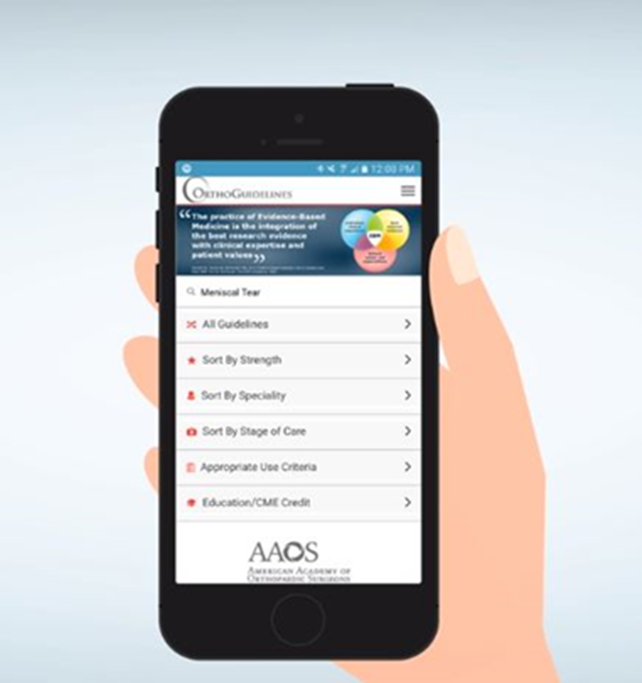
Easier access to AAOS Guidelines:
Sort Alphabetically by Topic
Sort Recommendations by Strength
(Strong, Moderate, Limited, Consensus)
Sort by Stage of Care
Search Across all CPGs via a Single Keyword Search
Easier Access to Individual Recommendations:
View recommendations via shortened titles
Access to full recommendation & rationale
Links to references (PubMed)
Notes:
OrthoGuidelines
OrthoGuidelines furnishes the user with easy access to all AAOS guidelines. Guidelines can be sorted either alphabetically, by strength of recommendation, or stage of care. All CPG’s are able to be located via a single keyword search. OrthoGuidelines additionally enables the user to view recommendations via abbreviated titles, and enables access to full recommendations and rationale. The user may likewise interface with PubMed references.

Slide 69
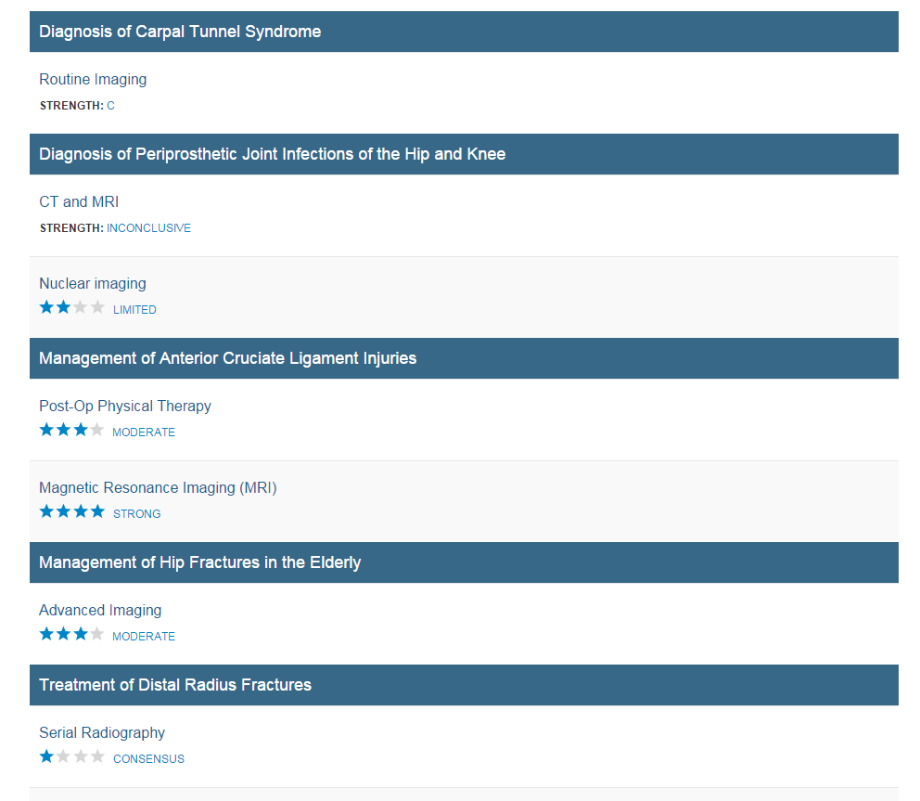
Imaging
Search across all CPG and AUC
Via a Single Keyword Search
Notes:
OrthoGuidelines allows the user to search across ALL Clinical Practice Guidelines and Appropriate Use Criteria via a single keyword search.

Slide 70
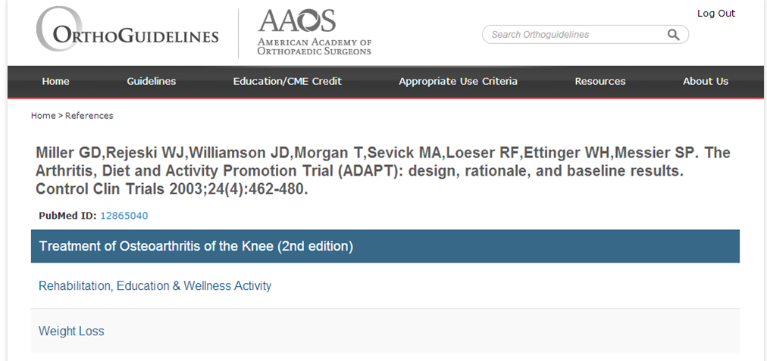
References provided for each recommendation
Links to PubMed
Notes:
The user is able to access all references for each recommendation via PubMed.

Slide 71
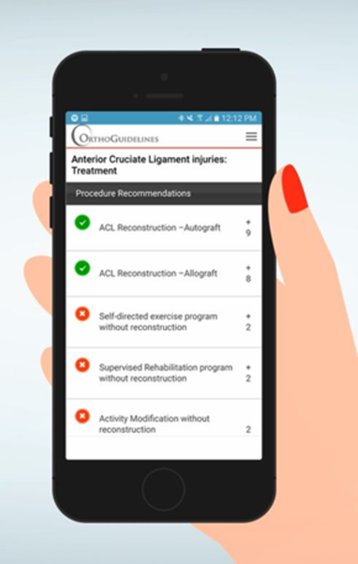
Appropriate Use Criteria Tool
Notes:
The American Academy of Orthopaedic Surgeons began developing Appropriate Use Criterias in 2011 as a tool to implement Evidence-based Clinical Practice Guidelines. Appropriate Use Criteria are created to inform clinicians for whom a procedure should be done. This involves using clinician expertise and experience, in conjunction with the relevant evidence, to rate the appropriateness of various treatments in a set of hypothetical, but clinically realistic, patient scenarios. Users can easily access this valuable tool via OrthoGuidlines.

Slide 72
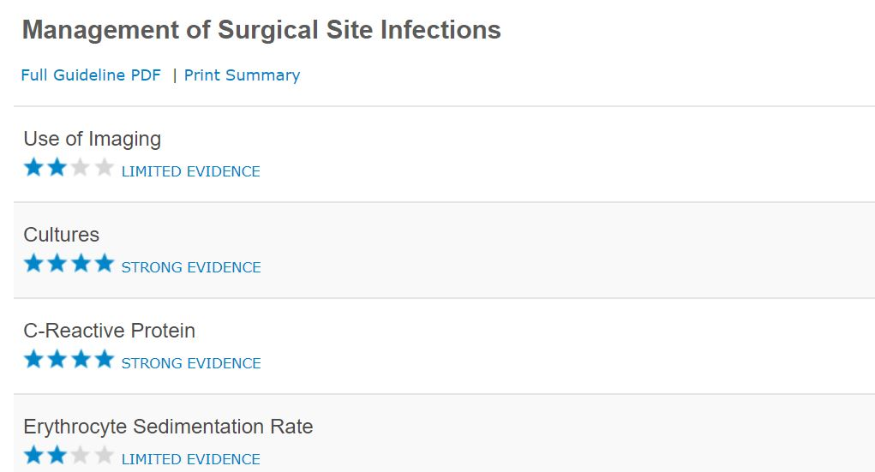
Published Clinical Practice Guidelines
Acute Achilles Tendon Rupture
Anterior Cruciate Ligament Injuries
Carpal Tunnel Syndrome
Distal Radius Fractures
Glenohumeral Joint Osteoarthritis
Hip Fractures in the Elderly
Osteoarthritis of the Hip
Osteoarthritis of the Knee (Arthroplasty)
Osteoarthritis of the Knee (Non-Arthroplasty)
Osteochondritis Dissecans
Pediatric Developmental Dysplasia of the Hip in infants up to Six Months
Pediatric Diaphyseal Femur Fractures
Pediatric Supracondylar Humerus Fractures
Periprosthetic Joint Infections of the Hip and Knee
Prevention of Orthopaedic Implant Infections in Patients Undergoing Dental Procedures
Rotator Cuff Problems
Surgical Site Infections
VTE Disease in Patients Undergoing Elective Hip & Knee Arthroplasty
Tranexamic Acid in Total Joint Arthroplasty (Endorsement)
Use of Imaging Prior to Referral to a Musculoskeletal Oncologist (Endorsement)
For additional information, please visit http://www.orthoguidelines.org/
Notes:
Published Clinical Practice Guidelines
· Acute Achilles Tendon Rupture
· Anterior Cruciate Ligament Injuries
· Carpal Tunnel Syndrome
· Distal Radius Fractures
· Glenohumeral Joint Osteoarthritis
· Hip Fractures in the Elderly
· Osteoarthritis of the Hip
· Osteoarthritis of the Knee (Arthroplasty)
· Osteoarthritis of the Knee (Non-Arthroplasty)
· Osteochondritis Dissecans
· Pediatric Developmental Dysplasia of the Hip in infants up to Six Months
· Pediatric Diaphyseal Femur Fractures
· Pediatric Supracondylar Humerus Fractures
· Periprosthetic Joint Infections of the Hip and Knee
· Prevention of Orthopaedic Implant Infections in Patients Undergoing Dental Procedures
· Rotator Cuff Problems
· Surgical Site Infections
· Tranexamic Acid in Total Joint Arthroplasty (Endorsement)
· Use of Imaging Prior to Referral to a Musculoskeletal Oncologist
· Venous Thromboembolic Disease in Patients Undergoing Elective Hip & Knee Arthroplasty

